Slide 1
















Learning
Teaching
Enhancing
Supporting
Sharing
Social Studies Leadership Network
April 18, 2014
Notes:
5 minutes for all announcements
Facilitator: Amy Treece
Materials: List of Facilitators
Welcome to SS Leadership Network.
Social Studies Education is central to the lives of all Americans, preparing them to be informed citizens in a democracy and knowledgeable consumers.
Wanted to take this opportunity to welcome you to our SS Leadership Network.
Introduce Facilitators (Dr. Klotter, Mikkaka Overstreet, Angela Hamblen, Sean Elkins, myself). Reference participants to the handout with brief description of strengths and contact information.
Recognition to Tina Tipton and Tracy Harris for creating this team

Slide 2

AGENDA
Welcome/Overview
Dr. Klotter-Leadership
TPGES-Enduring Skills
Develop A Plan for Leadership
Workshop—Inquiry Based Instruction
Evaluations

Slide 3

PADLET ADDRESS http://padlet.com/wall/APRILSSTLN
Notes:
Give participants time to find Padlet Address

Slide 4



Professional Learning Opportunities…
KCSS Fall 2014 Conference will be held on September 24-25 at the MET Center in Erlanger, KY.
Where Ideas Take F.L.I.G.H.T.
Saturday September 20th
Cost: FREE
Time: 8:00 am to 4:00 pm
Teaching American History Network Summit
EKU June 17/18
Cost: FREE
Notes:
Glenn Manns (if present) discuss KCSS
Angela talk about Bullitt County Tech Conference

Slide 5
University of Louisville AP Institute
Session I: June 16-20 - Advanced Placement Summer Institute (APSI)
U.S. History (new) Chris Averill
Session II: July 21-25 - Advanced Placement Summer Institute (APSI)
World History (combined) Donna Rogers-Beard
U.S. History (experienced) Gerri Hastings
Cost $500

Slide 6

Social Studies
Kathy Swan, a UK professor and director of the National Social Studies Standards Project, will present a strand focused on social studies. The sessions will give you the strategies you need to begin building the infrastructure for successful implementation when the Standards are released, while improving your Social Studies program now.
http://www.uky.edu/P12MathScience/
July 22-24
Cost: Conference Only $350

Slide 7

Literacy Link Newsletter
Notes:
MK discuss Literacy Link Resources

Slide 8

Where We’ve Been…
Describe roles, responsibilities, and expectations of a Teacher Leader
Identify and analyze effective formative assessment practices
Analyze the impact of the C3 Framework on SS instructional practices
Describe how KCAS (ELA & Literacy in History/Social Studies) supports
highly effective teaching and learning in Social Studies
Identify characteristics of inquiry based instruction / create an inquiry based learning experience
Notes:
5 minutes—Amy will discuss where we have been since starting our journey in February. We have spent time discussing your role as a teacher leader. Today, we will emphasize that particular pillar of the network in greater detail. We have spent some time discussing formative assessment practices and the value of keeping your fingers on the pulse of the lesson. Much of our meeting time has been spent focusing on the C3 framework and the impact of inquiry based instruction on practice. We spent time last meeting looking at connections between Literacy in History /SS Standards supports highly effective teaching and learning in SS. Many of you have continued or possibly began the process of inquiry based instruction.

Slide 9

Notes:
Dr. Klotter speaks on leadership 20 minutes

Slide 10
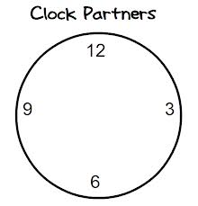
The most important quality of a leader is…
12:00
Same Grade Level Partner
3:00
Non-District Partner
6:00
“Push My Thinking” Partner
(From A Different Grade Band K-2, 3-5, 6-8, 9-12)
9:00
Same Grade Band Partner
(Ex. If I teach 3rd grade, I would find a 4th or 5th grade teacher.)
Page 4
Notes:
10 minutes
After two meetings, you have had the opportunity to work with different groups…we wanted to give you a routine that you could use when building community in your classroom for collaborative work.

Slide 11

Pillars again
Pillars of Network Meetings…
Network Foundations
Professional Learning
Highly Effective Teaching and learning
Kentucky’s Core Academic Standards
Assessment Literacy
Leadership
TPGES--Teacher Professional Growth and Effectiveness System

Slide 12

Notes:
Dr. Klotter…leadership

Slide 13
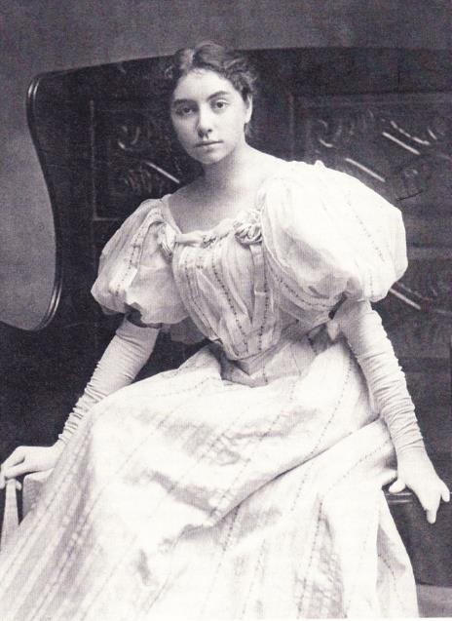
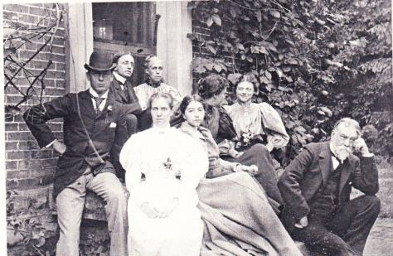
Madeline McDowell Breckinridge

Slide 14
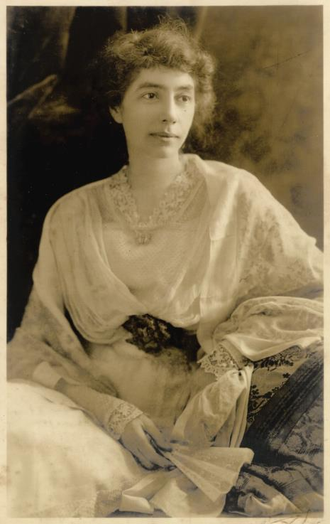

Slide 15
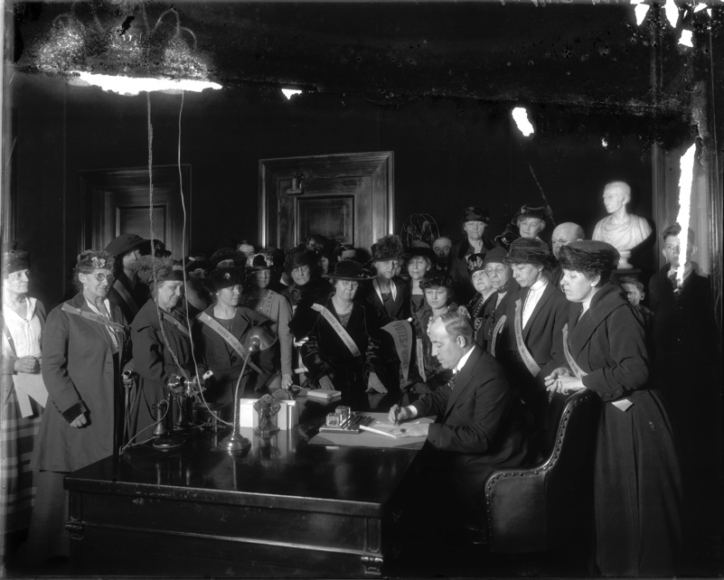
Ratification of 19th Amendment

Slide 16
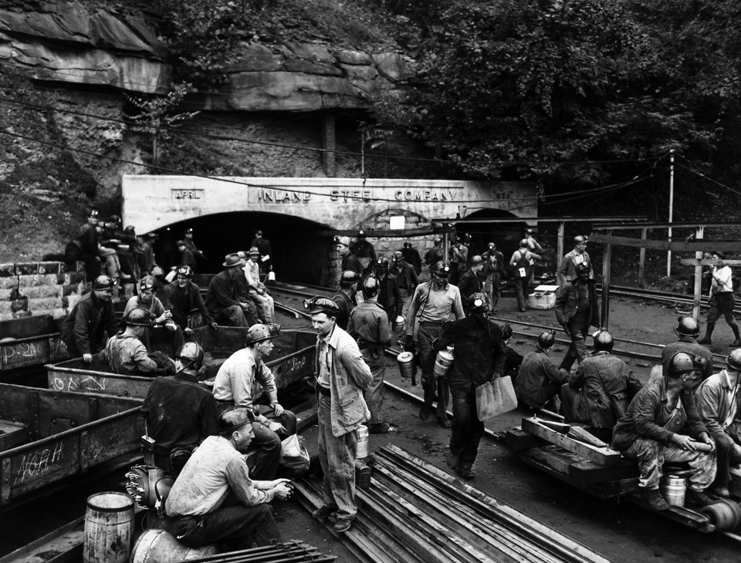

Slide 17
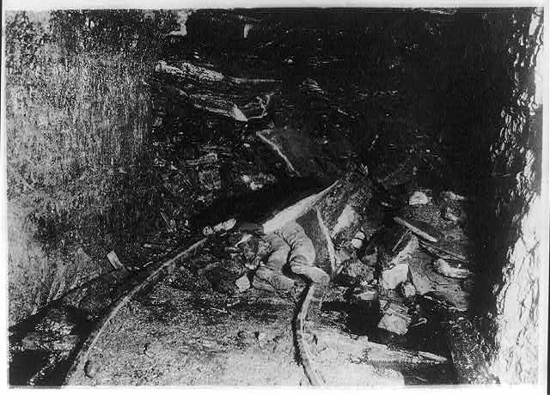

Slide 18
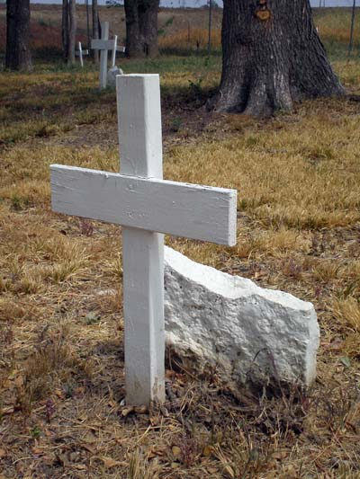

Slide 19
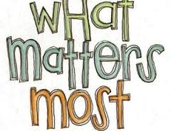
Clock Partner 12:00
Notes:
5 minutes
If you had no standards, what would you say matters most? What would you want your students to leave your class being able to do?

Slide 20

A Process to Identify the
Enduring Skills, Processes, & Concepts in Social Studies
Notes:
Slides 19-28
10 minutes
Facilitation needs: chart paper, markers, projector, standards documents copied, ES initial lists, copies of R/R Framework and Enduring definition on back.
Welcome and thank you for participating is this session. Teachers must help students gain more than content knowledge. They must ensure that students develop the skills to apply knowledge – sometimes to access the content, but in all cases so they can apply the content.
When students gain these skills and processes, they are more successful in many aspects of school and life beyond a single classroom.
As we think through the process of identifying enduring skills, processes and concepts, you will need your standards documents and scratch or chart paper.

Slide 21
Goals of this process
Page 5
Guide teachers to collaboratively identify the enduring skills in their content area
Support a meaningful student growth goal-setting process for development of quality student growth goals
Notes:
This process allows teachers to identify enduring skills that their students should master for their content.
It is part of the foundational work that supports a meaningful student growth goal-setting process and what is needed in order to develop a quality student growth goal.

Slide 22
This activity will
guide you through a process for identifying enduring skills in your content area.
help you differentiate between enduring skills and other skills needed for learning your content.
Notes:
This activity will model a process that you can use in your school or district.
We will work through the activity in entirety then provide more work time.

Slide 23

SKILL, noun
Competent excellence in performance. Dictionary.com
The ability to use one’s knowledge effectively and readily in execution and performance. Merriam & Webster Dictionary
Notes:
First, let’s define skill. These are samples of dictionary definitions. The key words in these two definitions are competence and use/performance. In both cases, if we think about application of skills, the expectation goes beyond knowing to doing.

Slide 24
SKILL
WHAT IT IS | WHAT IT ISN’T
Competency Ability to perform
Examples: Reading and comprehending complex text
Notes:
A skill is a competency. It is something students can demonstrate their ability to perform. There are levels of competency in their ability to perform a skill.
Here you see a literacy example that applies across content areas. Reading comprehension is a skill which involves various levels of competency in performing that skill. We can assess students’ ability to read and comprehend complex text.

Slide 25
SKILL
WHAT IT IS | WHAT IT ISN’T
Competency Ability to perform | A strategy
Examples: Reading and comprehending complex text | Non-examples: Annotating text Re-reading Questioning text
Notes:
A skill is different from a strategy. A definition from BusinessDictionary.com can help us understand how a strategy is different from a skill.
It defines strategy as “A method or plan chosen to bring about a desired future, such as achievement of a goal or solution to a problem.”
Reading comprehension is a skill which involves various levels of competency in performing that skill. However, marking text, re-reading, and questioning the text are all strategies readers use to support their comprehension.
While a strategy can be used to learn a skill or how to perform a skill better, it is not the skill itself. Again, the skills is the competency, the ability to perform.

Slide 26
SKILL
WHAT IT IS | WHAT IT ISN’T
Competency Ability to perform | A strategy Finite content
Examples: Reading and comprehending complex text | Non-examples: Annotating text Re-reading Questioning text Recognizing text features that contribute meaning in informational texts
Notes:
A skill is not finite content. In this example, teaching students how to notice and use text features (grade 3 reading standard 7) may be one way to help them gain a basic understanding about some broad details in an informational text, but it just one element of finite content knowledge students need in order for them to comprehend challenging informational texts.

Slide 27

Notes:
Now, we’d like for you to identify some skills based on your content.

Slide 28

Find the “big rocks”
Using the C3 Framework and Literacy Anchor Standards
Notes:
Standards documents include this larger guidance that supports the cohesiveness of all the grade level standards. Grade level standards are not where we would start this process. The “big rocks” of your standards, then will have clear connections to your grade-level standards. When you determine mastery, then you will be working in your explicit grade level standards.
Ask – for your content area, where might you start?
You can look for clues in cluster headings, section titles, big ideas, etc.

Slide 29

Table Teams
You are assigned a dimension of the C3 Framework and corresponding Literacy Anchor standards.
What’s your assignment?
Notes:
Idea: put assignments in an envelope with a picture of the detective on it.
Dimension 1 & Reading
Dimension 1 & Writing
Dimension 1 & speaking & listening
Dimension 2 & reading
Dimension 2 & writing
Dimension 2 & speaking & listening
Dimension 3 & reading
Dimension 3 & writing
Dimension 3 & speaking & listening

Slide 30

On your own -
Highlight or underline the skills or competencies you notice in your documents.
Notes:
Slide 29
Time: 10 minutes
Materials: Each person needs a copy of anchor standard and dimension for their group
Working individually, take time to read and underline or highlight any skills you can identify as you examine the document. Choose a section to begin if applicable.
Start with C3 Framework then look at Literacy Anchor Standards (KCAS) LOOK for those anchors that have obvious connections to your dimension.
Allow 10 minutes to get started. The goal is to begin working in the documents while developing an understanding (of skills presently, then enduring skills later in the activity).
Note that we are not yet trying to identify enduring skills; we’ll begin with identifying any skills included in your standards documents at the place in the document where you decided to start and help you discriminate which are enduring skills in the next steps of this process.

Slide 31
SKILL, noun
Competent excellence in performance. Dictionary.com
The ability to use one’s knowledge effectively and readily in execution and performance. Merriam & Webster Dictionary
Notes:
First, let’s define skill. These are samples of dictionary definitions. The key words in these two definitions are competence and use/performance. In both cases, if we think about application of skills, the expectation goes beyond knowing to doing.

Slide 32
Together -
Chart the skills you’ve underlined or highlighted.
Notes:
Slide 31
Time: 15 minutes
Materials: Chart Paper
Next, we’d like to take a few minutes for you to work together to chart the skills you’ve underlined or highlighted.

Slide 33
What About ENDURING?
In order to get to a quality student growth goal, you need to move beyond skills to identifying the ENDURING SKILLS, CONCEPTS, or PROCESSES for your content area.
Notes:
Slides 32-37
10 minutes
Now we are ready to differentiate and identify those skills which we would consider “enduring.”
It is important to note that this is a necessary step in order to develop a quality student growth goal that impacts student learning in a meaningful way.
We need to move beyond “skills” to identifying the enduring learning in your content because the student growth goal you set will involve instruction that reaches across the course or the year.

Slide 34
Defining ENDURING
Learning that
ENDURES beyond a single test date,
is of value in other disciplines,
is relevant beyond the classroom,
is worthy of embedded, course-long focus,
may be necessary for the next level of instruction.
Page 6
Notes:
First, lets’ look at how we can define enduring.
Enduring learning . . . (see slide)
An example of enduring learning that is necessary for the next level of instruction is: Social Studies 6-8th grade band literacy skills need to be developed in order for the student to be prepared to perform at the 11/12 grade band for using primary and secondary sources.

Slide 35
ENDURING LEARNING Writing Example
EXAMPLES | NON-EXAMPLES
Write arguments to support claims with clear reasons and relevant evidence. | -Establish the significance of claims - Create logical organization of claims, reasons and evidence -Use words, phrases and clauses to create cohesion
Sub Skills
Notes:
Let’s look at a few examples and non-examples. For writing, an enduring skill would be to write arguments to support claims with clear reasons and relevant evidence. This is an enduring skill since it is relevant across disciplines and beyond school. It applies to real life in real situations as students make claims and support them with clear reasons and evidence. In every classroom, we would want students to be able to make arguments and support claims with relevant information. Our literacy standards for Science, Social studies and technical subjects apply these skills.
The non-examples (using language from grade 8 writing) are skills, but they are foundational skills necessary to achieve the enduring skill of developing arguments; they are sub-skills and not in themselves and alone worthy of year-long focus.

Slide 36
ENDURING LEARNING Reading Example
EXAMPLES | NON-EXAMPLES
Summarize key supporting details and ideas | -Identifying main ideas of a text -Differentiate between bias and evidence. -Differentiate between essential and irrelevant information. -Skimming or scanning a text.
Sub Skills
Strategy
Notes:
A similar example for reading is summarizing key supporting details and ideas. This is certainly a skill we embed in instruction and assess all year. It ‘s valuable across disciplines and in real world situations. The non-examples again include sub-skills that support summarization, but in themselves, alone, not worthy of year long focus. The last non-example is a strategy. Skimming and scanning might be used to access information to summarize, these are not the skill itself.

Slide 37
ENDURING LEARNING Science Example
EXAMPLES | NON-EXAMPLES
Develop models using an analogy, example, or abstract representation to describe a scientific principle or design solution. | Create a model of an erupting volcano using vinegar and baking soda.
Activity
Notes:
In this science example, students must think critically and synthesize information in order to demonstrate this enduring skill - develop models using an analogy, example, or abstract representation to describe a scientific principal or design solution. Although the ES mentions “scientific principles,” the practice of developing models applies across content areas and certainly to real life situations. The non-example is not a skills at all, but rather an activity. Remember, activities may support a standard or building a strategy, but are not standards or even learning targets.

Slide 38
ENDURING LEARNING Social Studies Example
EXAMPLES | NON-EXAMPLES
Produce an argument to support claims with appropriate use of relevant historical evidence. | Describe point of view for primary and secondary sources. Use Chicago Style correctly when citing evidence. Improve student perception of history.
Sub Skill
Strategy
Disposition
Notes:
Here is a example of from Dimension 3 of the C3 Framework for social studies, Developing Claims and Using Evidence. The non-examples include a sub-skill, a strategy (being able to use Chicago Style), and a perception. An enduring skill for the purpose of instruction and for goal setting for student growth must be standards-based. Although we want a students to have a positive perception of history, this is not standards-based. You may notice that the C3 Framework has close alignment with the literacy standards.

Slide 39
Return to your Chart
Highlight what on your list meets this definition of enduring.
Notes:
Slide 38
5 minutes
Referring to the definition, highlight the skills that you consider “enduring” on your chart. (Go to next slide to display definition. You can also provide the definition on a handout)

Slide 40
Defining ENDURING
Learning that
ENDURES beyond a single test date,
is of value in other disciplines,
is relevant beyond the classroom,
is worthy of embedded, course-long focus,
may be necessary for the next level of instruction.
Notes:
Direction Slide
First, lets’ look at how we can define enduring.
Enduring learning (see slide)
An example of enduring learning that is necessary for the next level of instruction is: Social Studies 6-8th grade band literacy skills need to be developed in order for the student to be prepared to perform at the 11/12 grade band for using primary and secondary sources.

Slide 41

Notes:
5 minutes

Slide 42
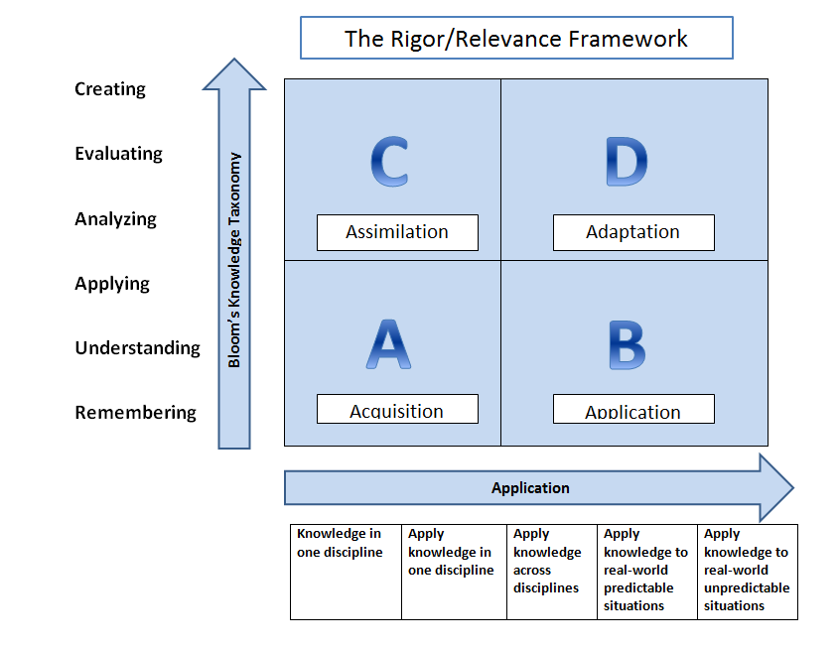
Notes:
Slides 41-44
5 minutes
Let’s use another framework to further support what you have identified as enduring skills.
We can use the R/R Framework to more explicitly define what is more critical for enduring skills. Some of you may be familiar with this work by Willard (Bill) Daggett.
Take a moment to look at this chart. Notice there is a thinking continuum up the left side and an action continuum across the bottom.

Slide 43
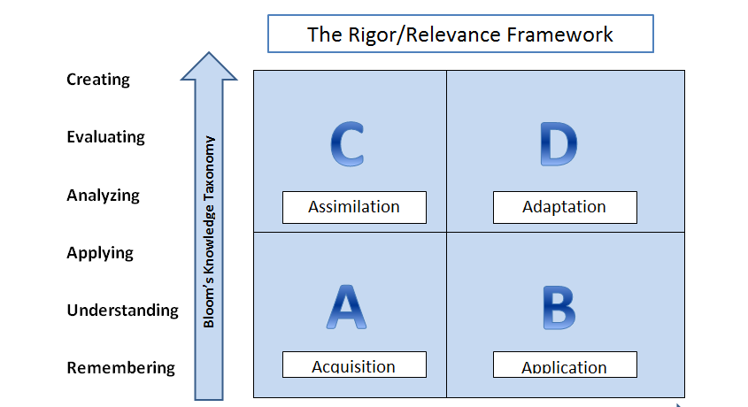
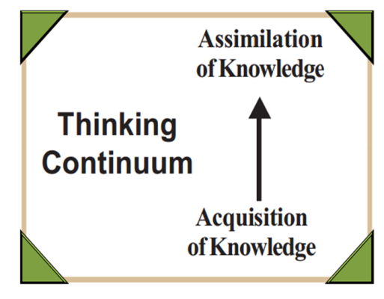
Notes:
Let’s first look at the left side of the Rigor/Relevance Framework and which is a thinking continuum.
The Rigor/Relevance Framework is based on two dimensions of higher standards and student achievement. First, there is a continuum of knowledge that describes levels of knowledge increasing in complexity from acquisition to assimilation. The Knowledge Taxonomy is based on the six levels of Bloom’s Taxonomy and describes various levels of thinking from awareness to evaluation.
The high end of the Knowledge Taxonomy labels more complex ways in which individuals use knowledge. At this level, knowledge is fully integrated into students’ minds, and individuals can do much more than simply locate information. They can take several pieces of knowledge and combine them in both logical and creative ways. Assimilation of knowledge describes this high level of the thinking continuum.
Assimilation is often referred to as a higher-order thinking skill: at this level, the student can solve multistep problems and create unique work and solutions.

Slide 44
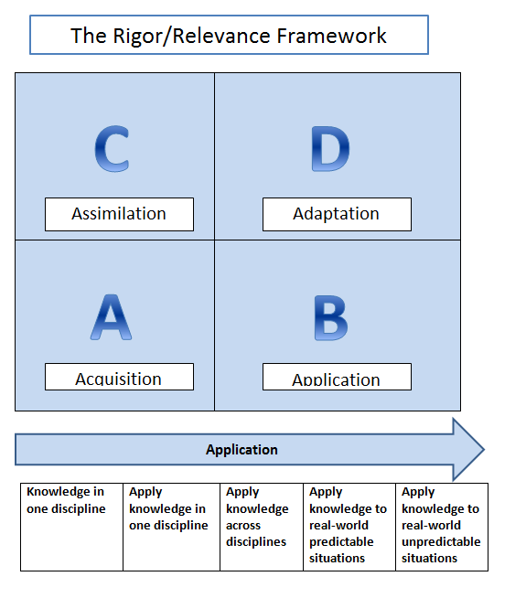
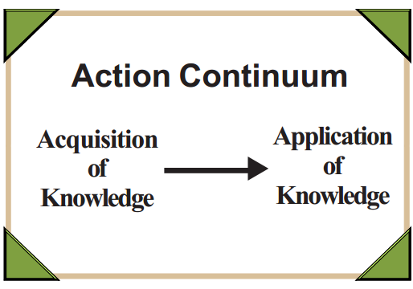
Notes:
Now, let’s look across the bottom of the R/R Framework. The second continuum, created by Dr. Willard R. Daggett, is known as the Application Model. The five levels of this action continuum are:
(1) knowledge in one discipline
(2) apply in discipline
(3) apply across disciplines
(4) apply to real-world predictable situations
(5) apply to real-world unpredictable situations
The Application Model describes using knowledge. While the low end is knowledge acquired for its own sake, the high end signifies action — use of that knowledge to solve complex real-world problems and to create projects, designs, and other works for use in real-world situations.

Slide 45

Page 7
Notes:
So, how can the R/R Framework be useful to us in identifying and differentiating enduring skills in our content areas?
We could ask ourselves these questions to test what we’ve identified as enduring:
Does using the skill require a student to apply it in quadrant D of the R/R Framework?
In other words, what level of thinking is required to apply the skill?
Can the skill be applied at levels 3, 4 or 5 of the action continuum?
An enduring skill should lead you to quadrant D. Let’s talk about grammar for example. At it’s best, it may fit into quadrant B. I do not need to think at analysis, synthesis or evaluation levels to use grammar. Although I would apply grammar across disciplines, applying grammar to real-world predicable or unpredictable situations doesn’t fit in this case.
The R/R Framework provides you a check point for making sure the skills you’ve identified as enduring match the criteria.

Slide 46
Return to your Chart
Do you still consider what you highlighted enduring?
Notes:
Slide 44
7 minutes
Look back at what you’ve highlighted on your chart. Have a conversation with your team referring back to the definition and this framework: Do you still consider what you’ve identified enduring?

Slide 47
Enduring Learning
Page 8
What it is
What it isn’t
Clock Partner
3:00
Clock Partner
6:00
Notes:
Slide 45
10 minutes
Tell participants that they will talk through this what it is and what it isn’t chart with their clock partners – find your 3:00 partner and talk about what it is, then when you hear the signal, find your 6:00 partner and talk about what it isn’t.

Slide 48
ENDURING LEARNING
WHAT IT IS | WHAT IT ISN’T
Worthy of extended focus Fundamental to learning in other disciplines Aptitude that has value and utility beyond one narrow context Foundational for the application of content Applicable beyond school Can be measured over time
Notes:
Here you see what we collected from various sessions. We’ll just look at the “what it is” side first.

Slide 49
ENDURING LEARNING
WHAT IT IS | WHAT IT ISN’T
 | A sub skill Explicit content knowledge An activity A skill with limited application A strategy for learning
Notes:
Let’s look at “what it isn’t.”
This charting is a key step as teachers begin this process. It is important to keep at the forefront the difference between skills that are necessary for students to develop in the classroom for learning content, and those that endure beyond the content and single classrooms.

Slide 50
Share one example on Padlet
Review the examples you charted.
Share one example you feel confident about on Padlet.
Notes:
Slide 48
5 minutes
Go back to your table,
Ask each group to share one example they feel confident about and describe how it both meets the definition of enduring and aligns with quadrant D of the R/R framework.

Slide 51
PADLET ADDRESS http://padlet.com/wall/APRILSSTLN
Notes:
Give participants time to find Padlet Address

Slide 52
Defend it
At your table,
Pick one of the examples on Padlet.
EXPLAIN how the example fits the definition of Enduring AND the R/R Framework Quadrant D.
Notes:
Slide 50
5 minutes
Ask each group (at their table) to share one example they feel confident about and describe how it both meets the definition of enduring and aligns with quadrant D of the R/R framework.

Slide 53

Continue to work collaboratively through your C3 Framework and Anchor standards for your assigned section.
Record on chart.
Use the tools:
*Enduring definition
*Rigor/Relevance Framework
*What It Is/What It Isn’t chart
Notes:
Slide 52-53
Time 30 minutes
What do you need to do next? Next steps would include: continue to dig into other sections of your standards if necessary; work collaboratively, return to these definitions & charts to recalibrate as you work.
Next steps may also include guiding others in your district to work through this process.

Slide 54

Chart your work. Post.
Enduring Skill
Connection to Framework / Literacy Anchor Standards
Notes:
Should we provide the 4 column chart here for teachers to record also on paper? (since we’ll use it later)

Slide 55
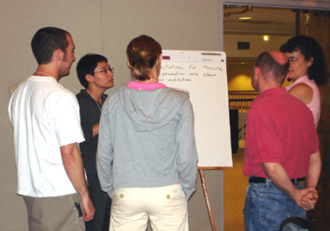
Gallery Walk
Take a gallery walk to see what other teams have produced.
Find good examples of your assigned characteristic in the enduring skills charted.
Choose a leader in your group to share out.
Notes:
15 minutes

Slide 56
Enduring Skills…
Applies Knowledge to Real World Predictable, or Unpredictable Situations | Applies Higher Level Blooms; Analyzing, Evaluating, Creating
Is of Value in Other Disciplines | Is Worthy of Embedded, Course-long Focus
Notes:
Sticker on District templates
Assign Table Groups a specific color

Slide 57
This activity will
Guide you through a process for identifying enduring skills in your content area.
Help you differentiate between enduring skills and other skills needed for learning purposes.
Notes:
5 minutes
Slides 55-59
Let’s look back at the intention of this activity.

Slide 58
Goals of this process
Guide teachers to collaboratively identify the enduring skills in their content area.
Support a meaningful student growth goal-setting process and development of quality student growth goals.
Notes:
Overall the goals of the process (see slide). When goal-setting, you want to ask yourself, is the outcome worth the focus of year-long/course-long study? Focusing on enduring skills helps you answer this question.

Slide 59

Assessing Mastery of Enduring Skills
Notes:
Once you’ve identified enduring skills for your content, the next step is develop assessments that will help you know where students are in mastering those skills. This is intended as a collaborative process.
You need the Enduring Skills Initial List and your grade level standards.

Slide 60

The goals of the next process…
Guide teachers to articulate what proficiency in an enduring skill looks like at a given grade level.
Identify appropriate assessments available or that need to be developed.
Support a meaningful student growth goal-setting process and development of quality student growth goals.
Notes:
With this next step, we continue the foundational work that supports a meaningful student growth goal-setting process and what is needed in order to develop a quality student growth goal.
Once teachers know the enduring skills for their content area, they must then identify what proficiency looks like for their students – at their grade level.

Slide 61
What’s Next?
What is your role?
Who is your audience?
How will you share this in your district?
Notes:
Amy—close and lead to lunch
How can we get this out to districts in a way that supports understanding of ESs and supports a meaningful student growth process?
Who are our high-capacity individuals that we need to leverage to build understanding?
Facilitators chart to record

Slide 62

Lunch 11:30-12:00

Slide 63



LEADERSHIP
You as
a Learner
In Your
Classroom
Leading in Your School, District, or Region
Notes:
12:00-12:30

Slide 64
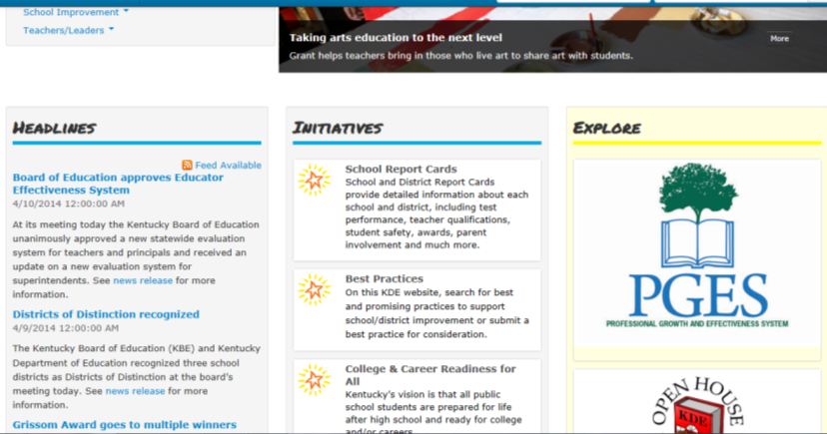
http://education.ky.gov/Pages/default.aspx
Notes:
Show participants how to navigate the website…click on PGES icon for resources / most recent updates

Slide 65

Plan, Do, …
Page 9
Use your knowledge and resources regarding Enduring Skills from the morning session…
Plan:
What will I do with what I have learned in this network meeting?
Do:
When, where, how, with whom will I do what I have planned?
Notes:
Take some time to discuss as a district … Plan/Do

Slide 66




Inquiry Based Instruction
Move to…
Same Grade Level Same Content Groups
Notes:
12:30-2:45
5 minutes to make change to same grade level groups

Slide 67
I
16
32.06
C3
nstructional Shifts
Iodine
Craft questions that matter.
Establish a collaborative context to support student inquiry.
Integrate content and skills meaningfully.
Articulate disciplinary literacy practices and outcomes.
Provide tangible opportunities for taking informed action.
Notes:
2 minutes

Slide 68

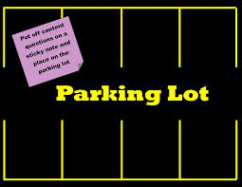

What is a compelling question?
How do I craft “age appropriate” questions that matter?
What strategies can I use to facilitate inquiry based learning?

Slide 69
What is a Compelling Question?
Intellectually meaty
Reflects an enduring issue, concern, or debate in Social Studies
Student-friendly (Causes genuine and relevant inquiry into the big ideas)
Provokes deep thought, lively discussion, authentic debate, sustained inquiry, and new understanding as well as more questions
Requires students to consider alternatives, weigh evidence, support their ideas, and justify their answers
Stimulates vital, on-going rethinking of big ideas, assumptions, and prior lessons
Sparks meaningful connections with prior learning and personal experiences
Notes:
8 minutes
Begin with Table Talk
As a group, generate a list of characteristics of a compelling question…you have two minutes
Copy on Bright colored paper to add to packet later

Slide 70

Does It Stand The Test…Are You Compelled?
Locate Your 9:00 Clock Partner
Using “Thumbs Up” / “Thumbs Down” …tell us what you think.
Are you compelled?
Notes:
10 minutes slides 48-49

Slide 71
When and why should people change their minds?
How do new points of view pave the way for progress?
What are the five largest sources of oil for US markets?
What is justice?
Who are community helpers?
Why do we need rules?

Slide 72

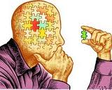
Your Turn…
It is crucial to recognize that inquiry-based teaching should not be viewed as technique or instructional practice or method used to teach a subject. Rather, inquiry starts with teachers as engaged learners and researchers with the foundational belief that the topics they teach are rich, living and generous places for wonder and exploration.

Slide 73
See-Think-Wonder
Page 10
Step 1: See | Step 2: Think | Step 3: Wonder
(List only the things that you observe—what you can actually put your fingers on.) *Write down your list. *Share your findings with a partner. | (Based on what you are seeing and noticing, what does this make you think?) *Record your interpretations based on your observations. *Back up your interpretations with evidence. | (What are you wondering? What questions do you have?) *Record any questions that you may have.
Notes:
This “thinking routine” emphasizes the importance of observation as the basis for thinking and wondering. The “seeing” provides the opportunity to look carefully, to fully observe and to notice before interpreting. The placement of Wonder as the final step of the routine ensures that learners have had time to think about and synthesize the information. This is a great place to begin exploring with inquiry.

Slide 74

SOURCE 1
Notes:
10 minutes
Use See-Think-Wonder “Thinking Routine”

Slide 75
Image Sources
http://islamicrenaissance.co.uk/if-god-exists-why-does-poverty-2/
http://www.aonestudy.com/articles/poverty.aspx
http://youth.afairerworld.org/files/child_rights/
http://forcechange.com
http://leofish.com/poverty-and-pluto/

Slide 76

"Brother Can You Spare A Dime"
Once I Built A Railroad, Made It Run
Made it race against time
Once I built a railroad, now it's done
Brother can you spare a dime?
Once I built a tower to the sun
Brick , mortar, and lime
Once I built a tower, now it's done
Brother can you spare a dime?
Once in khaki suits
Gee, we looked swell
Full of that yankee doodle de dum
Half a million boots went marching through hell
And I was the kid with a drum
Say don't you remember, they called me Al
It was Al, Al all the time
Say don't you remember, I'm your pal!
Brother can you spare a dime?
Once I built a railroad, I made it run
And I made it race against time
Once I built a railroad, now it's done
Hey Brother ain’t got a dime about you, have you?
And once I built a tower, yes a tower to the sun, of brick, mortar, and lime
Yes, I’m the fellow built a tower, now it's done
Hey Buddy ain’t got a dime about you, have you? ?
Once in khaki suits
Gee, we looked swell
Full of that yankee doodle de dum
Half a million boots went marching through hell
And I was the kid with a drum
Say don't you remember, don’t you remember, They called me Al , it was Al, Al all the time
Don't you remember, I'm your pal!
Brother can you spare a dime?
SOURCE 2
Al Jolson
Notes:
Revisit your See-Think-Wonder Organizer…this time instead of See, What do you hear? Specific phrases…
What does this make you think? Wonder?

Slide 77

Michael Harrington Describes the “Other America”, 1962
SOURCE 3
After analyzing the sources…
Grow your thinking…
What are you wondering…
Notes:
15 minutes to explore additional sources

Slide 78

Crafting Compelling Questions
What are your ideas, thoughts, questions, wonderings on caring for the poor? Who is responsible? What rights do they have?
TASK: As a table group,
craft a compelling
question that you will
continue to explore.
Notes:
10 minutes
Amy--Work with your table group to take the information from the image, text, song and video to craft a compelling question. Remember to use the guidelines of a compelling question.

Slide 79
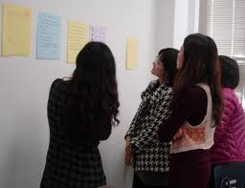


Gallery Walk
Post Compelling Questions around the room.
Individually—place a check mark by the questions that you feel are most compelling.
Notes:
10 minutes
Amy--Strategy—CHALK TALK: Post compelling questions on chart paper around the room. Conduct a gallery walk.

Slide 80

Revisit and Refine
As a “Table Group”, return to your compelling question(s).
Based on your findings
from the Gallery Walk…
Are revisions needed?
Could it be modified to become more compelling? If so…refine your question.
Notes:
5 minutes
Amy--Remind participants to reference the checklist for what makes a compelling question…

Slide 81
Notes:
5 minutes

Slide 82





EXPLORE
What sources would I use to encourage students to explore the compelling question more deeply?
On post-it notes write specific resources (source sets) that would fuel student inquiry on this topic…place notes on the chart with the compelling question.
Notes:
20 minutes
Angela
Hand out another potential source for visual

Slide 83

ASSESS FOR UNDERSTANDING
How would you assess student understanding of the compelling question?
CHALLENGE: Generate a list of ways to assess student learning
other than writing.
Teaching History with Technology
http://thwt.org/index.php
Notes:
15 minutes
Angela--After teachers have working time…allow them to shout out…each table shares one way to assess.

Slide 84

Reflect on My Practice
Page 11
With an elbow partner at your table…
Review the student work samples that you brought. Explain the purpose of the assessment (What was the intended learning? What enduring skills were addressed?)
Based on today’s process, is this assessment one that you would give again? What modifications could you apply to make it stronger?
With your table group….
Discuss the implications for teaching and learning (including implications for each person’s practice, student learning, or ways to support individual student growth of enduring skills.)
Notes:
25 minutes
MK--If teachers did not bring student work samples, ask them to reflect on an assessment they have given in recent weeks or one they have witnessed in a classroom.

Slide 85
Session Review and List of To-Do
Page 12
Topic | Follow Up
Enduring Skills | Use Resources provided on KDE Website to support TPGES implementation in school/district—Identifying Enduring Skills
Inquiry Based Instruction | Implement In My Classroom/Model For Others In My School and/or District: Crafting Questions that Matter. Developing Source Sets that Promote Inquiry. Creating effective assessments to measure student learning. Reflect on my practice; continue to modify current practice to meet the needs of learners.
Notes:
Amy—2:45-3:00

Slide 86
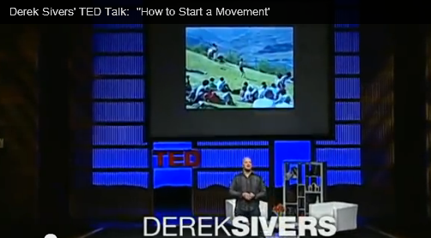
Be A Leader…
One Lone NUT
How to Start a Movement - The One Lone NUT
Notes:
http://youtu.be/RXMnDG3QzxE
I wanted to leave you today with a final thought on leadership. It takes courage to be in your position, to take a stand and lead others in this work.

Slide 87

EVALUATIONS
Please complete your evaluations.
We use your feedback to plan future sessions.

