Slide 1
Re-designing the History Framework with the New Standards
Betsy and Kevin Webster
Betsy.hall@owen.kyschools.us
Kevin.webster@owen.kyschools.us

Slide 2
Draft Standards—Timeline
Where to find them—KDE website http://education.ky.gov/curriculum/conpro/socstud/Pages/Proposed-Social-Studies-for-the-Next-Generation.aspx
When will they be adopted?
Stakeholders will review and provide feedback through December 2015.
The Social Studies content team will make revisions after the Feedback is reviewed.
The Kentucky Board of Education will consider the KASSS for the second reading in April 2016.
The legislative committee review process will take place in late spring and summer 2016.
During the 2016-2017 school year, Social Studies for elementary and middle school will not be assessed.
The End-of-Course U.S. History exam will continue to be administered in 2015-2016 and 2016-2017 during this transition.
Supposedly the new social studies assessments for appropriate grade levels will be administered during the 2017-2018 school year.

Slide 3
C3—College, Career, and Civic Life
The Inquiry Cycle
-This is the national framework within which our standards were created.

Slide 4
KAS for Social Studies
KAS are the new draft standards for Kentucky
Kentucky Academic Standards

Slide 5
KDE website KAS curriculum options

Slide 6
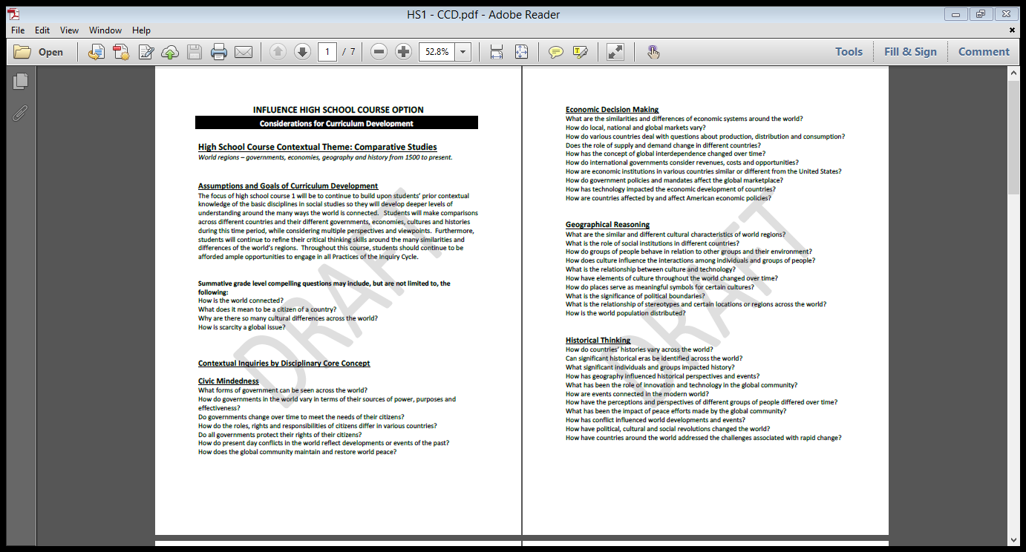

Slide 7
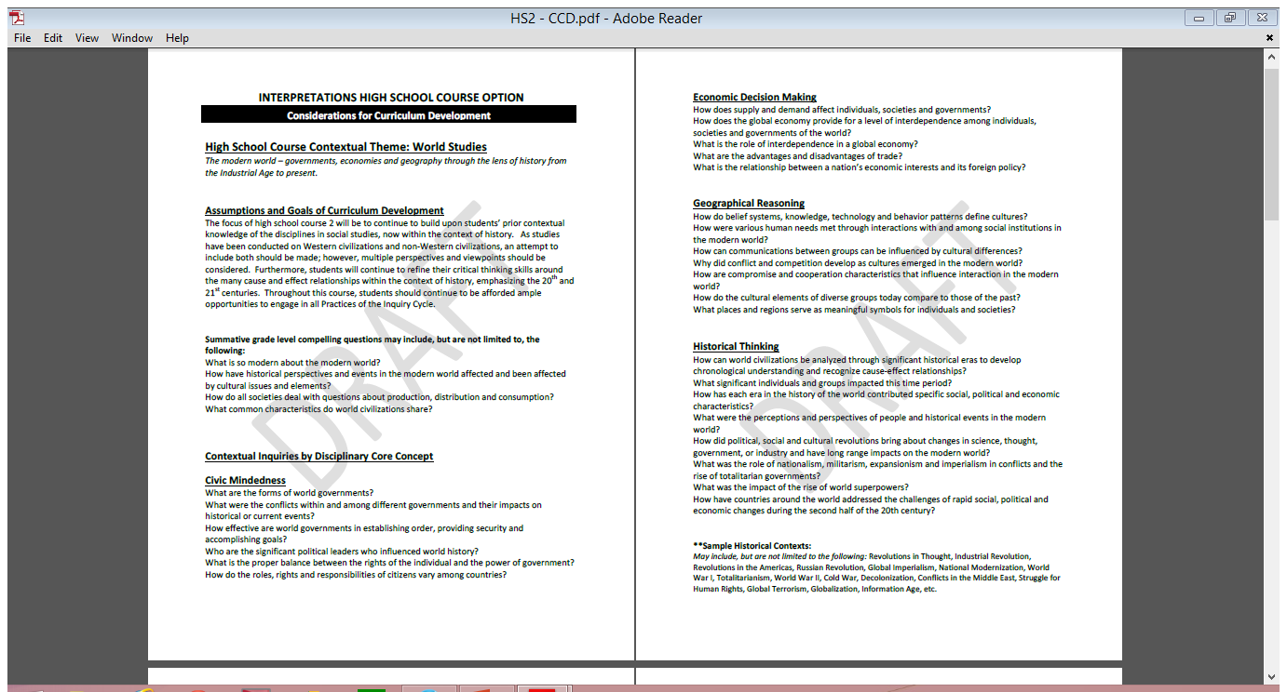

Slide 8
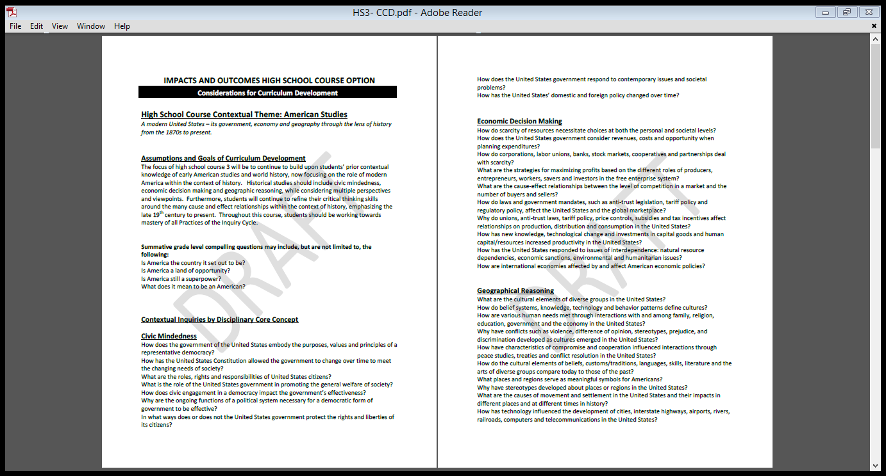

Slide 9
What content do we teach with the new standards?
Example of what we are trying to do with the new standards.
Re-design of our high school curriculum
Moving toward new Classes SS1 and SS2, and eventually SS3, although we are still teaching U.S. History with juniors because of the current EOC
What are we doing within the classes?
Thematic based units based on content/context we thought was important, based on 4.1 standards
Themes incorporating all 4 disciplinary core concepts and the inquiry cycle.

Slide 10
Owen County Sample Course Outlines
SS1
Criminal Justice
Settlement Patterns
World Religions
Depressions, Recessions, and Economic Downturns
We the People
SS2
World Revolutions
Migration
Changes in Economic Global Power
How War has Shaped the World
Advancements in Technology that changed the Word?
Energy and Environment
Project Citizen

Slide 11
SS2—Unit 1: World Revolutions
Question: How have world revolutions shaped the modern world?
Unit Topics:
Agricultural and Industrial Revolutions
Scientific Revolution
Renaissance Reformation and Enlightenment
National Revolutions
Revolutions in America
Communist Revolutions
Focus Standard (4.1):
SS-HS-5.3.3-Students will analyze how an Age of Revolution brought about changes in science, thought, government and industry (e.g., Newtonian physics, free trade principles, rise of democratic principles, development of the modern state) that shaped the modern world, and evaluate the long range impact of these changes on the modern world.

Slide 12
KAS
KAS
HS2.CM.3 Processes, Rules and Laws Analyze how people use and challenge laws concerning
societal issues across various levels of government.
HS4.CM.3 Processes, Rules and Laws Analyze historical, contemporary and emerging methods for
changing societies, while promoting the general welfare.
HS2.EDM.4 Economic Decision Making Use economic analysis to evaluate how economic choices
and government policies impact individuals and groups.
HS3.GR.11 Global Interconnections Evaluate how the development of economic globalization and
the desire for access to scarce resources and markets contribute to global conflict and cooperation.
HS2.HT.12 Chronological Reasoning: Causation and Continuity Analyze multiple and complex
causes and effects of developments, events and historical periods to identify change and continuity
in historical contexts and explain why it is significant.
HS2.HT.14 Historical Arguments Analyze the central arguments from several historical sources to
collect evidence to construct a coherent argument, acknowledging all counterclaims, while taking
into consideration change over time, historical perspectives and relevance of sources.
HS4.HT.15 Interpretation and Synthesis Evaluate and question multiple historical sources to pursue
further inquiry, for the purpose of synthesizing insights about the past with insights from the
present.

Slide 13
Other 4.1 Standards
SS-HS-1.1.1-Students will compare and contrast (purposes, sources of power) various forms of government in the world (e.g., monarchy, democracy, republic, dictatorship) and evaluate how effective they have been in establishing order, providing security and accomplishing common goals.
SS-HS-2.3.1-Students will explain the reasons why conflict and competition (e.g., violence, difference of opinion, stereotypes, prejudice, discrimination, genocide) may develop as cultures emerge in the modern world (1500 A.D. to present) and the United States (Reconstruction to present).
SS-HS-5.1.1-Students will use a variety of tools (e.g., primary and secondary sources, data, artifacts) to analyze perceptions and perspectives (e.g., gender, race, region, ethnic group, nationality, age, economic status, religion, politics, geographic factors) of people and historical events in the modern world (1500 A.D. to present) and United States History (Reconstruction to present).
SS-HS-5.1.2-Students will analyze how history is a series of connected events shaped by multiple cause and effect relationships, tying past to present.

Slide 14
PBL
Project Based Learning
Experiences
As Dr. Swan mentioned yesterday, must be bridled.
Students don’t get it
Scaffolding
What is PBL, what is not PBL?

Slide 15
How can we use standards based learning and grading in history?
What we have experienced
Discussion at school and district level
What does proficiency look like?
What is mastery of a standard?

Slide 16
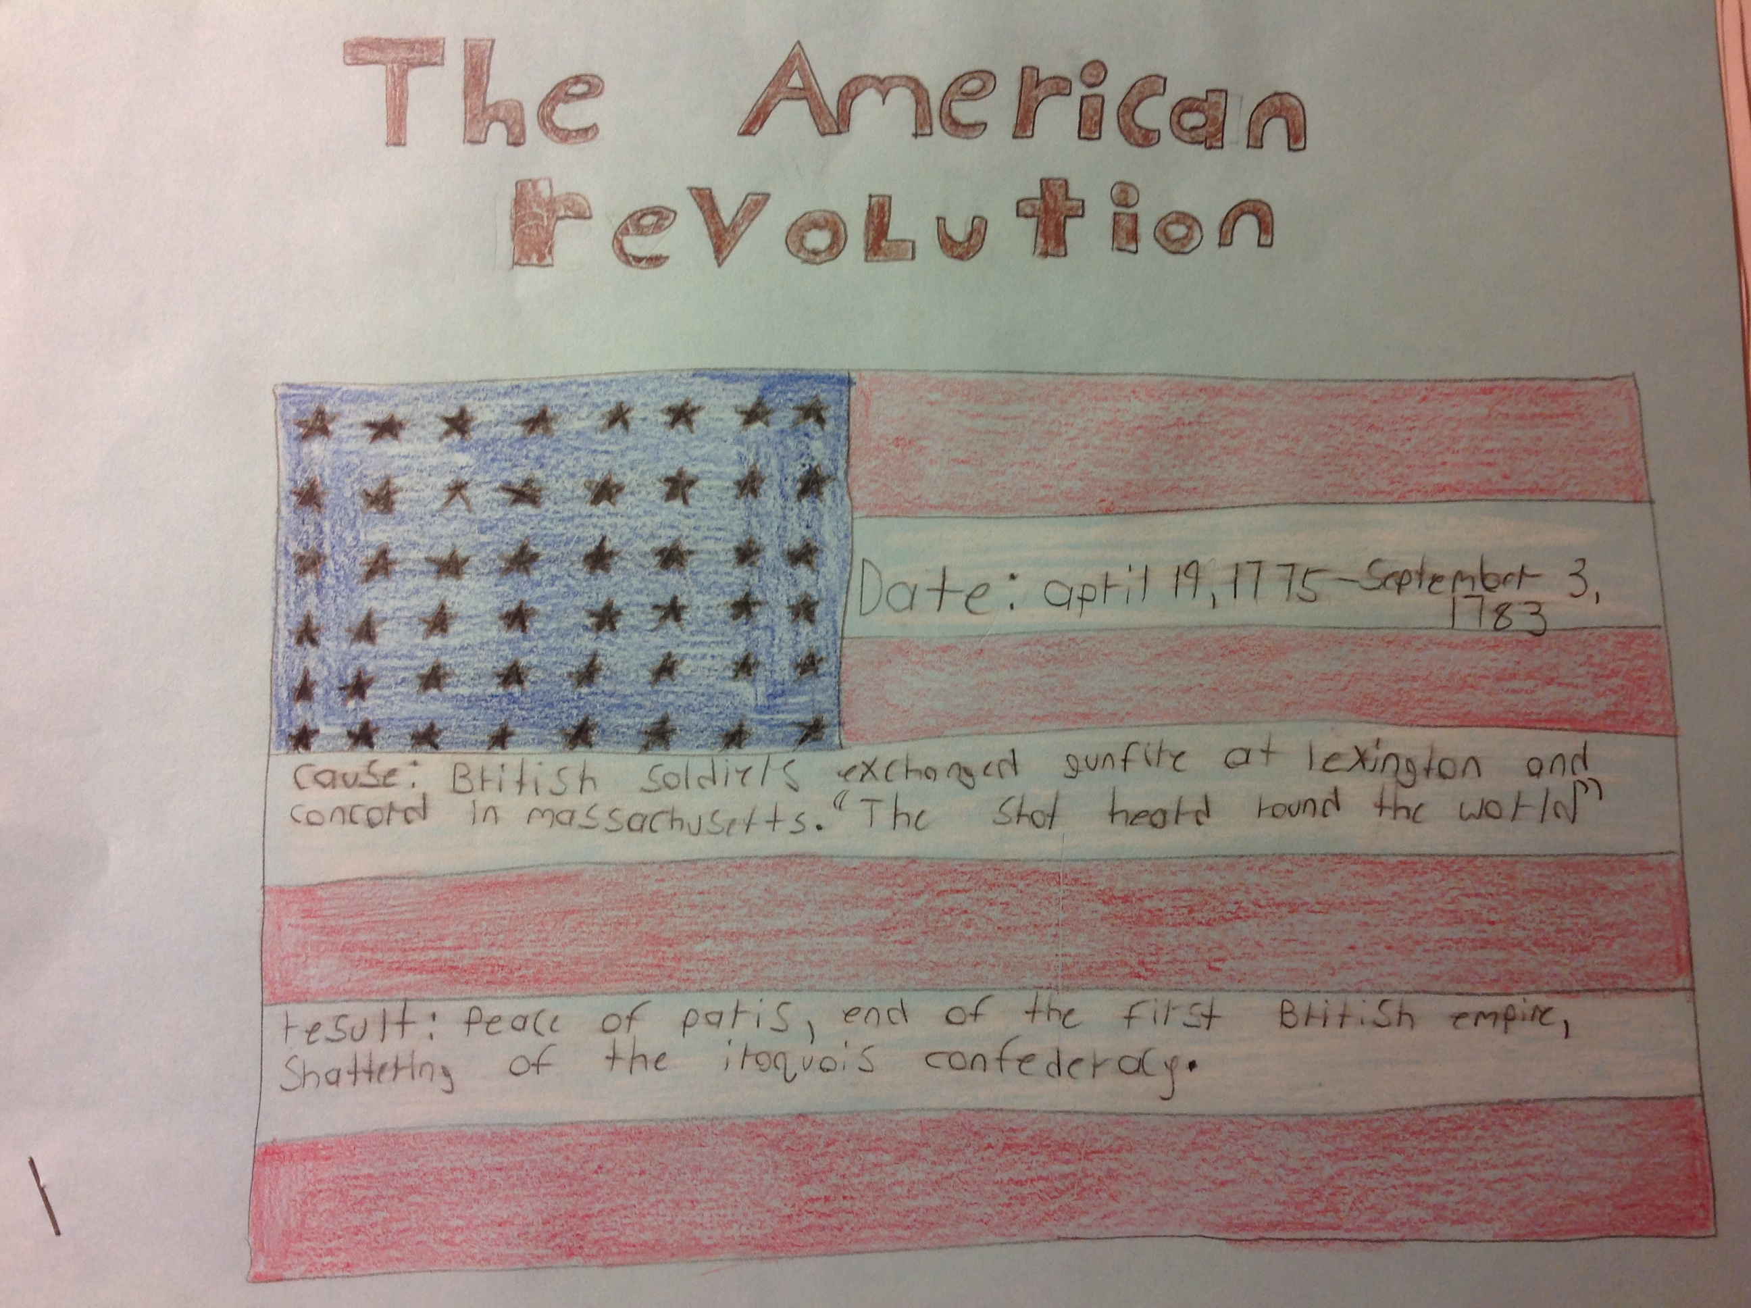
Student Samples—good and bad

Slide 17
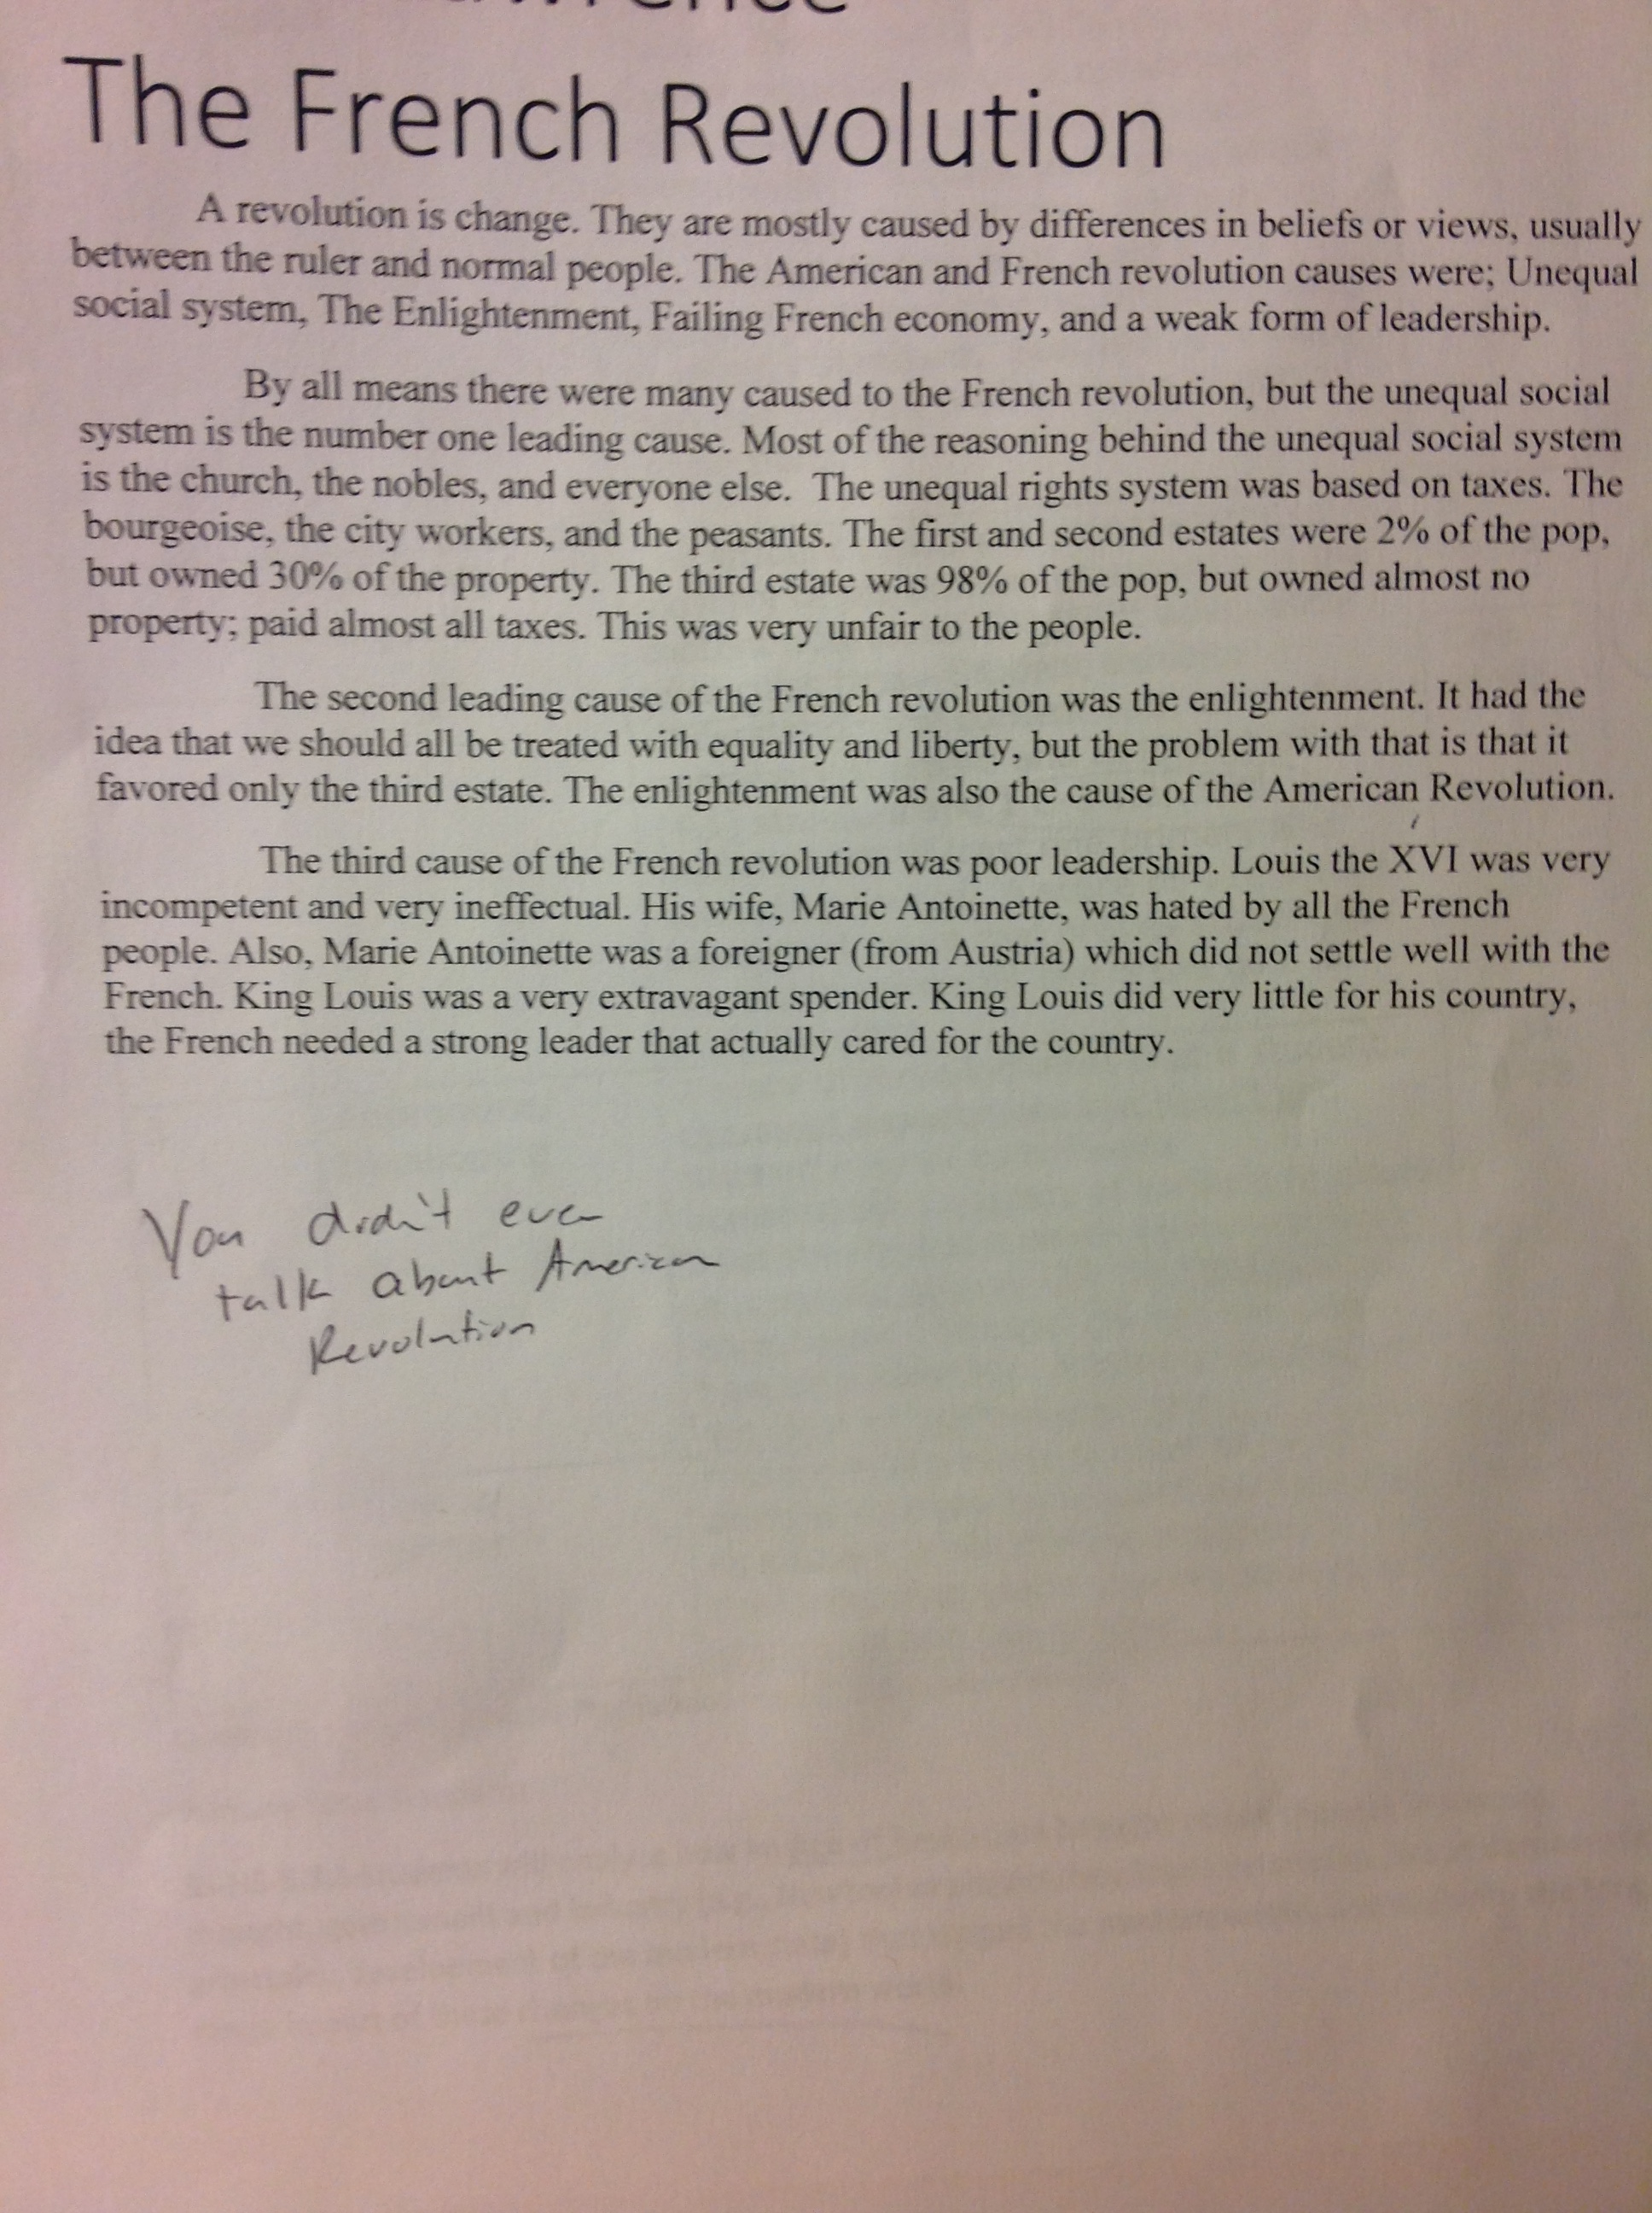

Slide 18
A much better sample
Question: How have revolutions shaped the modern World?
Topics: Scientific Revolution and Reformation
Science and the Church-A hypothetical conversation between Copernicus, Galileo and Pope Paul III
Nicolas Copernicus was sitting around with other scientist and said, “I have placed the sun at the center of the universe instead of the Earth, we have created the heliocentric theory.” As the room goes silent he calls upon another colleague named Galileo to further discuss the theory.
Galileo said, “Yes Copernicus, I concur with your analysis and reasoning, the sun is at the center of our solar system.”
Pope Paul III upon hearing of this challenge to the church’s traditional view of the Geocentric Theory, which had supported the church’s teachings of a God-Centered universe, decided to pay Galileo and Copernicus a visit. Pope Paul visited the local church that Galileo and Copernicus attended and after church met the two boastful scientists outside the church. As the Pope approached the two gentleman, he overheard them discussing their new theory, “Gentleman,” he interrupted, “this is so very wrong of you. You shall not speak of this theory that challenges church teachings and authority. You must be punished and you will be brought before the inquisition.”
At the inquisition, the gentleman were found guilty and would not recant their findings and the Pope had them placed under arrest for heresy. They would be executed after a period of time if they would not recant their views.
Galileo and Copernicus requested the presence of the Pope and he obliged, “yes gentleman, I heard you wished to speak to me.”
“Yes” the two responded, “we would like an opportunity to explain ourselves. We did not intent to question you or your authority sir, we were simply responding to our findings. You see, Nicolas and I are scientists,” Galileo explained to the Pope. “We have made some incredible discoveries as of late and we think you would be intrigued by them.”
The Pope was speechless and Galileo removed the cloth that had hidden the telescope. “Take a look,” said Galileo, and the Pope looked through the glass in amazement. Galileo continued, “As you can see, with the telescope we can now see things that have been hidden from man’s eye for years. And through our observations, we have concluded that unknowingly to them, Ptolemy and Aristotle were not correct when they created the geocentric theory.”
Galileo continued, “In 1543 Nicholas Copernicus published his theory of the universe, and while he still had planets moving in patterns of circles rather than ellipses, he proposed that these circles had no true center.”
“I also stated the center of the Earth is no the center of the universe but is the center of gravity and the lunar sphere. The Earth is one of seven planets I the solar system which evolve around the stationary sun,” stated Copernicus.
Pope Paul was stunned by nodded his head in assurance, “I understand gentleman, but no one must know that I agree, you must only teach this as an alternate theory, as the church needs time to respond.”
As the church moved forward and the reformation continued, the church (Catholic Church) was forced to reform itself in what became known as the Catholic or Counter-Reformation. During this counter-reformation, the church was force to re-define many of its beliefs, traditions and teachings, but many thought it was not enough. Furthermore, much of the Scientific Revolution took place in protestant nations where scientists could work free from the fear of persecution of the church. Because of this, protestant nations such as Britain, France, the Netherlands, Germany and even the United States led the way in scientific advancement and later industrialization, which eventually led to the global domination of the wealthy westernized nations that dominated world power for nearly two centuries.

Slide 19
Sample Rubric and Assignment

Slide 20
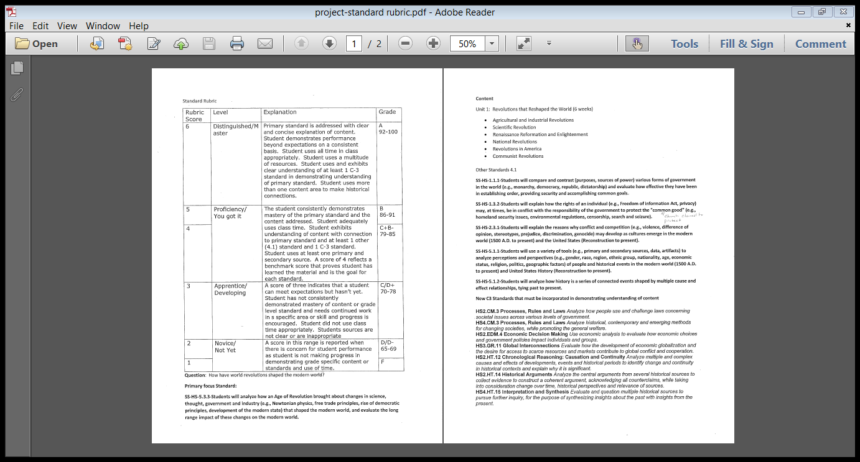
Sample Rubric

Slide 21
Inquiry at OCHS
Students are struggling with where to begin, where to find the facts, what sources to use, what facts to use, what to do with the facts.
Even if students can get facts, they are having problems doing something with them.
Inquiry is the discovery process, anyone can repeat facts, but you have to know how to get there, how to find the answer, and the students lack the skill set in the beginning.
Baby steps, teach them how to do it. Learn the process, then we can get the product.

Slide 22
How can we incorporate the TAKING ACTION component in the history classroom?
Write a newspaper editorial/letter
Create a Facebook page on an issue
Speak at a school or town meeting
Organize a flyer campaign to raise awareness
Volunteer
Circulate a petition
Invite a guest speaker
Present to another class
Have a debate with invited guests
Promote a cause on Instagram or Twitter
Organize a rally
Initiate an informed conversation
Interview and expert or Activist
Conduct and publish a survey that gauges community opinion
Work collaboratively to write a solution
Create a class position statement
Form a club
Create a community education pamphlet
Organize a fundraising event for a cause
Implement programs—KYA, KUNA, Project Citizen, We the People

Slide 23
Questions?

