Slide 1
OVEC SSTLN
Please sit in grade bands
November, 23 2015
http://ovecssnetwork.weebly.com/

Slide 2
Agenda
Dr. Stephen Pruitt
Revisit Argumentation and Rubrics
Summative Assessment
“Student” Work
Self-Assessment
Written Feedback
Oral Feedback
Professional Learning
Vs. PD
Perspective taking
Professional Plan
PLC

Slide 3
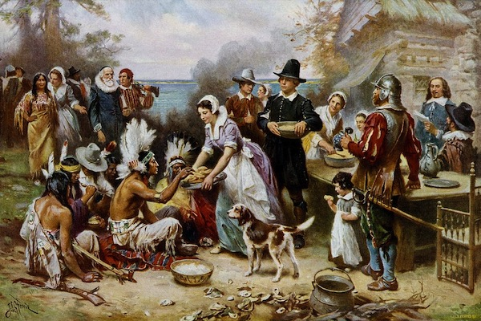
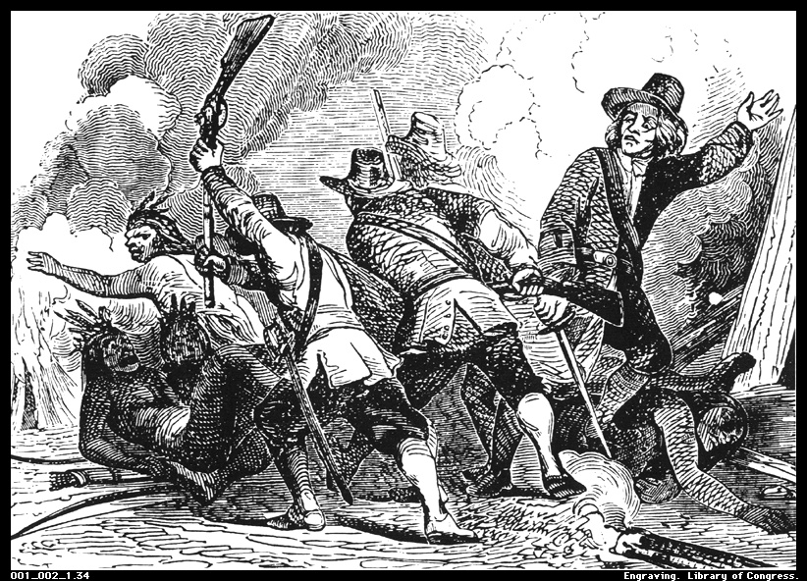
Norms
Pausing
Paraphrasing
Providing Data
Posing Questions
Presume Positive Intentions
Putting Ideas on the Table
Paying Attention

Slide 4
Year at a Glance

Slide 5
What is argumentation?
The process of reasoning systematically to advance an idea.
An argument is a collection of claims supported by relevant evidence, which can be considered an answer to the question investigated by the research.
As arguments become more sophisticated, students might include counterclaims.

Slide 6
Student Mastery?
“A student has achieved mastery when he or she can consistently demonstrate proficiency in a particular task, skill, or set of content and is capable of teaching it to a peer. . .”
“[If you can] present students with a new challenge that they have never seen and they know how to apply their skills and knowledge to meet the challenge every time.”
Teaching Students to Self-Assess

Slide 7
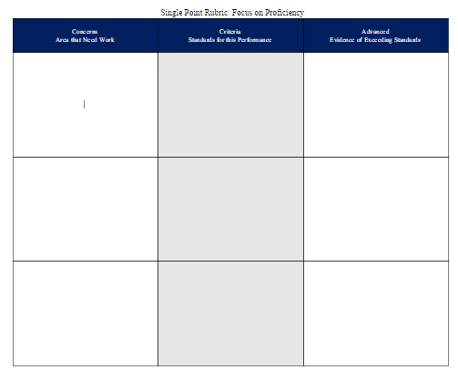
Bridging Arguments to Rubrics
What are the “asks of Argumentation”?
Contextual Knowledge
Reasoning Skills
Structure of Argumentation
Creating Single Point Rubric Aimed at Proficiency
Draft/Select Proficiency criteria
for your grade level based
compare criteria with others at table
draft a common rubric on chart paper
Gallery Walk
Return and Revise

Slide 8
Looking at “Student” Samples
Self-Assessment (as a student)
Teaching Students to Self-Assess
“To help students grow, we must teach them to develop the skill of metacognition”
“Teaching reflection can help students decipher their own learning
Complete Google Forms (OVEC SS website)
Progression in the Classroom
From description to analysis
Accounts-Based Reflection (as a student)
Assessing Historical Thinking and Understanding
Focus on “Structure of Argumentation
Write about the choices you made and provide reasons for your decision

Slide 9
Looking at “Student” Samples
Single-Point Rubric Feedback (as a student)
Read partner’s reflection before reading their summative piece
Read their summative piece
How to Give Effective Feedback to Your Students
Focus on the success criteria of the single-point
Describe don’t judge/evaluate
Don’t norm-reference
Pair improvement suggestions with positive suggestions

Slide 10
Looking at “Student” Samples
Peer Review—Oral Feedback (as a student)
Use self-regulated feedback
Use single-point rubric
Use IDM and own experience
How to Give Effective Feedback to Your Students
What would you like to talk about first?
Which part of your piece are you most proud?
What part of your piece will require more attention?
Do you see any patterns?
Do you feel that the suggestions on the rubric are merited?

Slide 11
Looking at “Student” Samples
As a teacher who will be designing inquiry experiences…
behat
What student Needs should you consider? (e.g.--scaffolding, support)
What “Wonderings” do you have about this process?
What Excites you about giving students these opportunities?
What Support do you need to successfully design/implement student inquires?

Slide 12
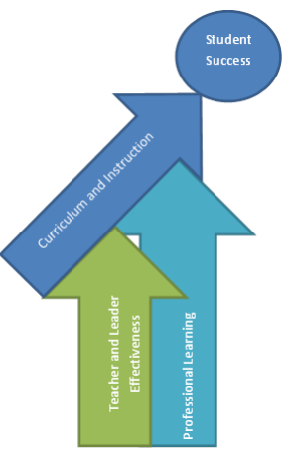
What is Professional Learning?
PL vs. PD
PL Perspectives
PL Individual Plan
PLC Priority Plan
Books!

Slide 13
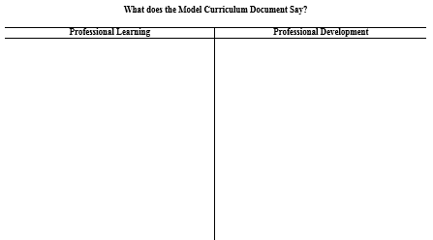
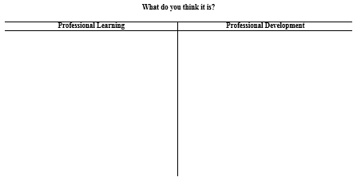
PL vs. PD

Slide 14
What is Professional Learning?
Professional learning is defined in 704 KAR 3:035* Section 1 as “an individual and collective responsibility that fosters shared accountability among the entire education workforce for student achievement, and
aligns with Kentucky’s Academic Standards in 704 KAR 3:303, educator effectiveness standards, individual growth goals, and school, school district, and state goals for student achievement;
focuses on content, pedagogy, pedagogical content-knowledge, as specified in certification requirements and other related job-specific performance standards and expectations; and
occurs among educators at school who share accountability for student results;
is facilitated by well-prepared school and district leaders including curriculum specialists, principals, coaches, mentors or other teacher leaders;
serves simultaneously three purposes: individual improvement, school improvement and program implementation; and
occurs several times per week.”

Slide 15
Perspectives on Professional Learning Communities
As you read your assigned article consider the following questions…
What is the perspective on professional learning communities described in this article?
What is similar to your own perspective? What is different?
Why might these similarities and differences exist?
What is your “take away” from this article?

Slide 16
Perspectives on Professional Learning Communities
As a district, how can we make OUR learning community more effective?
As a teacher leader, what is my role?

Slide 17
Professional Learning Plan
I would like to become more effective at ________
What tells me this is an area of growth is_____(data/evidence). [Where am I?]
I will know I’ve attained this goal/target by/when I ____ (outcome/measure). [Where do I want to go?]
Here is my plan for “closing the gap”: (the ACTIVITIES that will enable the learning)
Attend
Conference___
Read
____
Talk to
_____
Attend
______
Read _______
= Professional DEVELOPMENT;
Inside=supporting learning goal;
Outside=not pushing on goal
PLC
Attend conference ____
Observe and analyze___
Work with___ as a thinking/feedback partner
Participate in
_____
Participate in
_____

Slide 18
Why do I want/need to engage in this experience?
Professional Learning Plan
I would like to become more effective at ________ because _____________.
What tells me this is an area of growth is_____(data/evidence). [Where am I?]
I will know I’ve attained this goal/target by/when I ____ (outcome/measure). [Where do I want to go?]
3. What specific learning goals will this specific learning experience help me accomplish?
1. How can I put myself in the best frame of mind for intentional learning through this experience?
5.What supports can I put in place now to ensure time and support for practice, reflection, and follow-up to this specific learning?
=To help individuals or teams prepare for a professional learning or learning event-use or adapt for a particular learning experience, whether virtual, face-to-face, short-term or ongoing.
4. What knowledge, practice, skills, or habits do I hope this will make possible?
2. What data or information will help me be optimally prepared for this learning experience?

Slide 19
Professional Learning Plan
I would like to become more effective at ________ because ____________.
Here is my plan for “closing the gap”: (the ACTIVITIES that will enable the learning)
Attend
Conference___
Read
____
Talk to
_____
Attend
______
Read _______
= Professional DEVELOPMENT;
Inside=supporting learning goal;
Outside=not pushing on goal
PLC
Attend conference ____
Observe and analyze___
Work with___ as a thinking/feedback partner
Participate in
_____
Participate in
_____

Slide 20
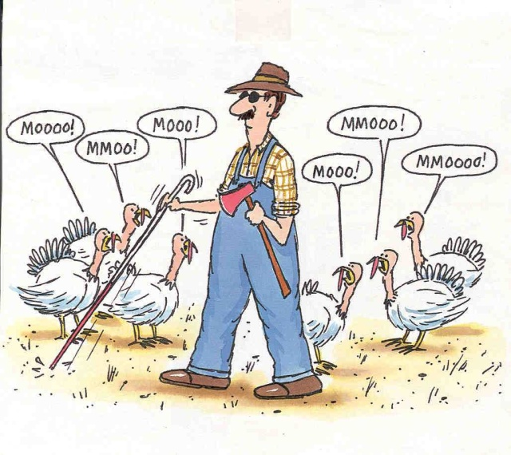
Evaluations & Certificates
What will you take back to your district?
What will help your professional learning?
Evaluations
Certificates
Enjoy your Thanksgiving!
Questions or Concerns?
ryan.new@education.ky.gov
http://ovecssnetwork.weebly.com/

