Slide 1
















Learning
Teaching
Enhancing
Supporting
Sharing
Social Studies Leadership Network
October 24, 2014

Slide 2

Notes:
Think of an experience in your classroom practice where you were willing to take a risk and you experienced great success. Think of something that you would like to try with your students, but you are a little hesitant for fear of how it will work out. Share your insight with at least two thinking partners who are not in your district.

Slide 3
OCTOBER SSTLN—Why are we here?
Build Capacity of SSTL Assessment Literacy (Defensible Evidence)
Build Capacity of SSTL CHETL (Questioning)
Build Capacity of SSTL KCAS (Critical Components Proposed Standards/Professional Development Needs)
Build Capacity of SSTL Leadership (Purpose of Curriculum for Next Generation Learners, Complete Needs Assessment)

Slide 4
Social Studies Standards Timeline
Through 2013
1. Formed a 40+ member stakeholder group to set vision, establish specifications for new standards
2. Established key threads for Kentucky Social Studies Standards
Through August 2014
3. Selected 40 teacher writers to draft standards using vision, priorities set from 2013 stakeholder group
4. Drafted set of standards with anchors/progressions informed by Global Competence Matrix, P21 Skills, C3 Framework and How Students Learn History in the Classroom
5. Established protocol for focus groups
September-December 2014
6. Introducing standards via focus groups, Leadership Networks, KBE Meeting and conferences
7. Soliciting and reviewing feedback , revising draft standards when necessary
Notes:
Give updates from KBE meeting October 7th
Discuss where we currently are according to this timeline shared by Karen Kidwell at KBE

Slide 5
Social Studies Standards for the Next Generation
Anchor Standards
K-12 Progressions
Grade Level Standards
Grade Level Themes
Unpack Standards
Feedback from Stakeholders to Inform the Work
Accountability Assessments
Build Classroom Assessments
Shift Instructional Practice
Curriculum
Notes:
November Writing Team Reconvenes to Address Feedback

Slide 6
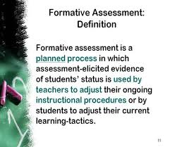


Defensible Evidence of Learning
Notes:
District Teams…discuss the idea of using defensible evidence of learning to address multiple stakeholders in the process

Slide 7



How would you define “Defensible Evidence” of student learning?
Notes:
Beginnings of conversations around defensible evidence of the practices. What is defensible evidence of learning? Watch video clip of a teachers classroom what would you script as defensible evidence?
Ask district teams to converse and generate a definition…call on districts to share their thinking.

Slide 8
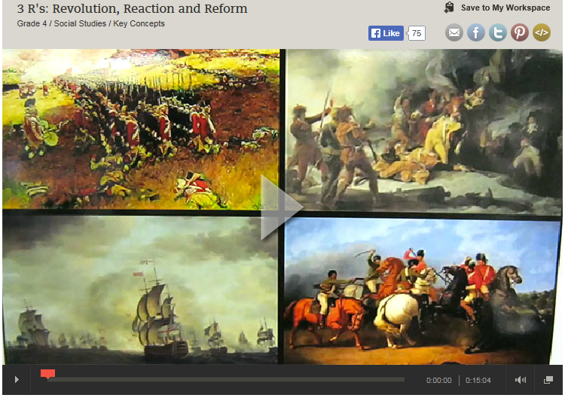
As you watch this clip…
https://www.teachingchannel.org/videos/teaching-complex-concepts
Script what you
consider to be
defensible evidence
of student learning.
Notes:
Video is a way to do formative assessment of the group. Defensible evidence looks like ability of the teacher to translate minute by minute data into evidence. May contradict with what districts see (data is quantitative not qualitative). Resources: CASL 2 … read minute by minute article.
Table Talk

Slide 9
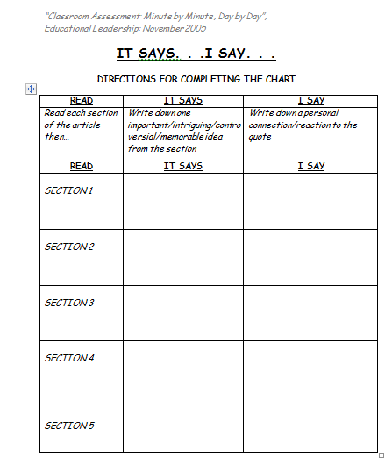
Classroom Assessment: Minute by Minute, Day by Day

Slide 10

“Standing Meeting”
How do the assessment strategies in the article provide teachers with the opportunity to collect defensible evidence of student learning?
“CHALK TALK” Record your thinking on the poster provided.
Notes:
Locate Thinking Partners not in your district team. Groups of 3 to 4…gather around a poster for “Chalk Talk”

Slide 11


Slide 12

Consider this…
The teacher is usually the person who asks the questions during a discussion. In a longitudinal study of elementary and secondary school classes, Dillon (1990) found that each student asks only one question(s) per month on average. Teachers must take deliberate steps to get their students to ask questions.
Notes:
Ask participants to guess how often students ask questions.

Slide 13
Consider this…
The teacher is usually the person who asks the questions during a discussion. In a longitudinal study of elementary and secondary school classes, Dillon (1990) found that each student asks only ONE question(s) per month on average. Teachers must take deliberate steps to get their students to ask questions.
Notes:
Ask participants to guess how often students ask questions.

Slide 14
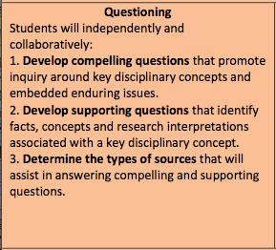
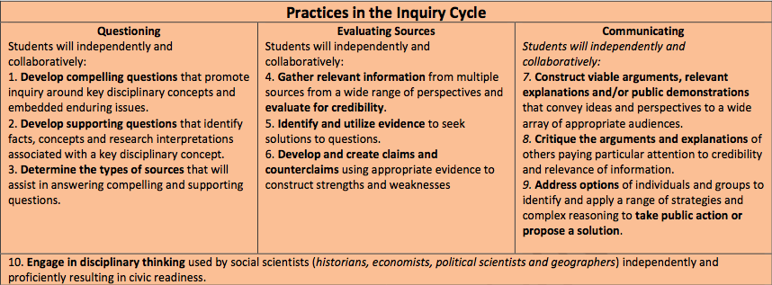
Highly Effective Teaching and Learning
Creating Compelling and Supporting Questions
Notes:
Considering Questioning on the Inquiry Cycle, what might be some defensible evidence that a teacher could elicit from their students to demonstrate proficiency?

Slide 15
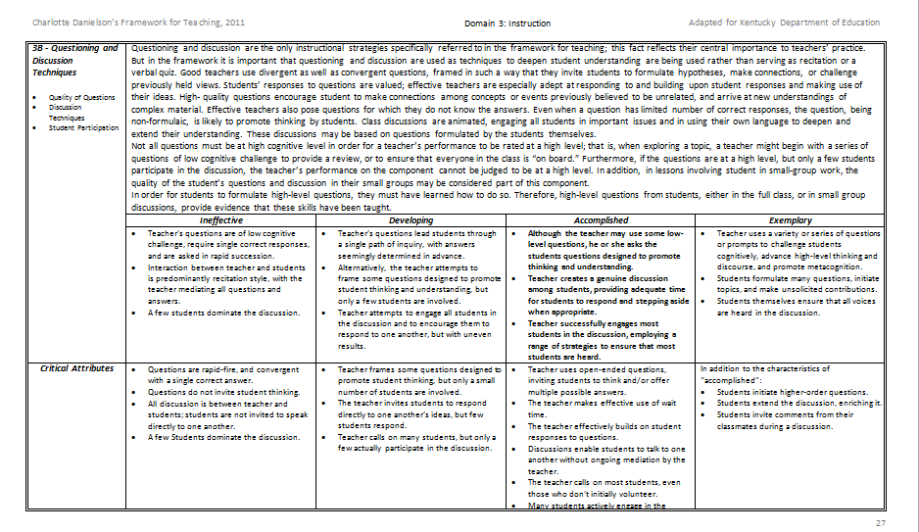
Domain 3: Instruction
3b – Questioning & Discussion Techniques
What might be
Defensible Evidence
of learning?
Notes:
Work together with your district teams to discuss…What might be some defensible evidence that teachers could elicit from students to demonstrate proficiency?

Slide 16



Question Formulation Technique
QFT is ONE TECHNIQUE teachers may use to fulfill
the STRATEGY “Engineering effective classroom
discussions, questions and Learning tasks.”
Notes:
District Teams One Strategy…not the only strategy to help us with our professional learning today…also can be something that you apply in your own classroom

Slide 17
Question Focus
Critical Components of the DCCs prepare students for College, Career, and Civic-Life Readiness.
Notes:
District Teams
You will have 5 minutes to generate as many questions as possible around this Question Focus.

Slide 18
Rules
1. Ask as many questions as you can.
Do not stop to answer, judge or discuss.
Write down every question exactly as it was stated. (Please number your questions.)
Change any statements into questions.
Critical Components of the DCCs prepare students for College, Career, and Civic-Life Readiness.

Slide 19
Categorizing Questions:
Closed/Open
Definitions:
  Closed-ended questions can be answered with a “yes” or “no” or with a one-word answer.
  Open-ended questions require
  more explanation.
Directions: Identify your questions as closed-ended or open-ended by marking them with a “C” or an “O”.
Notes:
Let’s shift to look at questions in a different way, specifically looking at closed and open-ended questions.
So with your partner, let’s relook at your questions and follow the directions on this slide…

Slide 20
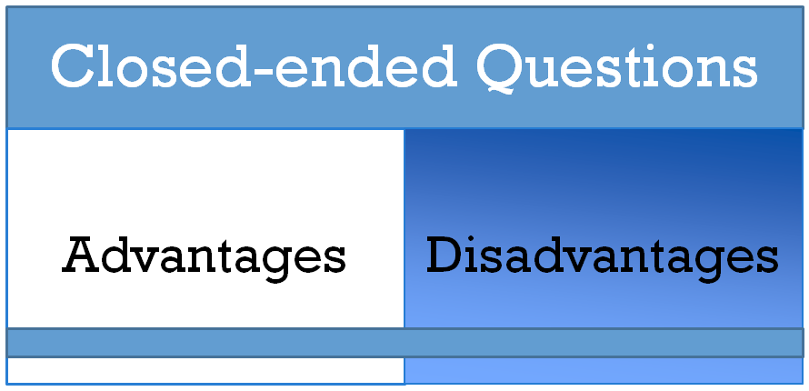
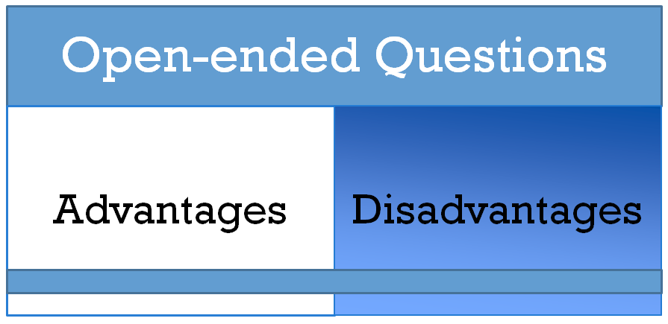
Discussion
Notes:
Discuss as a group, what could be potential advantages / disadvantages of closed and open ended questions.

Slide 21


Change Closed to Open
Directions: Take one closed-ended question and change it into an open-ended question

Slide 22
Thinking in many different directions
(Closed to Open Questioning)
DIVERGENT
THINKING

Slide 23
Narrowing Down, Focusing
(Open to Closed Questioning)
CONVERGENT
THINKING

Slide 24
Prioritizing Questions
Review your list of questions
Choose the three questions you consider most important.
While prioritizing, think about your Q-Focus:
Critical Components of the DCCs prepare students for College, Career, and Civic-Life Readiness.
Notes:
Think about the questions you shared and think about if there are ones that leap out at you as a particularly important question that you want to think about. So, take a minute with your partner and do some thinking around prioritization now. What was a question that you saw or you thought was important…
Let’s quickly share out some of those questions. *note, draw attention to those questions that begin to name the problem, or if any transition to what can be done to address the problem, or if anyone changed a closed to open question which may have allowed them to focus on specific steps they can take.

Slide 25
Prioritizing Questions
Why did you choose those three questions as the most important?
Where are your priority questions in the sequence of your entire list of questions?
Notes:
Note that the sequence of priority questions illustrates that as our understanding grows/ learning occurs, we refine our thinking, and we continue to ask questions.

Slide 26

http://padlet.com/amy_treece/ss1i8nnatyqn
As a District Team…Pose a question to “PADLET” regarding the Question Focus.
Critical Components of the DCCs prepare students for College, Career, and Civic-Life Readiness.
Notes:
District Teams define critical components. End goal is create a definition of critical component. Agree on definition (ex. Spatial reasoning)

Slide 27

Reflection
What did you learn?
How did you learn it? What defensible evidence could you offer?
What do you understand differently now about asking questions?
Notes:
Okay… you just produced questions. You saw the process for changing questions and prioritizing questions. So, what did you learn? *Share*
So, then how did you learn what you learned? *Share*
What you see here is that when people did the learning, they figured things out; or when they began to problem solve, they did it by asking questions, by being engaged, by figuring things out themselves, but by using a structured and rigorous process for doing that which eliminates wasted time in finding the wrong question.
Subsequently, what do you understand differently now about asking questions? *Share*
Research from QFT suggests that when teachers use this process in the classroom, they feel that they are doing far more effective teaching and there is much deeper learning among the students.

Slide 28
Connections
Connecting Question Formulation Technique to the Inquiry Practices

Slide 29


In My Classroom
Preparing to Use the QFT
Take a few minutes to begin thinking about how you can incorporate QFT into an upcoming unit of study...share your thinking with colleagues.
After Lunch We Will Be in Grade Level Groups of “3”

Slide 30

LUNCH
NOTE: After Lunch please transition into Grade Level Groups .

Slide 31

Welcome Back…Grade Level Teams
Share ideas…Preparing to Use the QFT
Take a few minutes to share out ways you can incorporate QFT into an upcoming unit of study.

Slide 32
In Grade Level Groups of “3”
Use the definition of “Critical Components”…
Examine Grade Level Standards
Propose Potential “Critical Components” for Grade Level Standards
Rank each “Critical Component” in terms of NEED for Extended Professional Learning (1 least need to 5 most need)
Standing Meeting (Elementary, Middle, High)
Notes:
Grade Level teams chart critical components * Outcome is Content deficits identified from teachers as classroom practitioners. Critical components are big strands. and identify professional learning needs to implement standards. Determine professional learning with partners around inquiry practices while focusing on specific content. Critical components stream the courses together.

Slide 33
YouTube - 21st Century Education in New Brunswick, Canada

Slide 34

District Teams

Slide 35
Social Studies Standards for the Next Generation
Anchor Standards
K-12 Progressions
Grade Level Standards
Grade Level Themes
Unpack Standards
Feedback from Stakeholders to Inform the Work
Accountability Assessments
Build Classroom Assessments
Shift Instructional Practice
Curriculum

Slide 36
Stages of the Work
Resource…Model Curriculum Framework
Curriculum framing
Curriculum writing
Curriculum implementation
Curriculum review
Curriculum evaluation
Notes:
The Kentucky Model Curriculum Framework is intended to generate discussion of a P-12 curriculum, offer direction for curriculum design with links to resources, and guide the curriculum writing process. The KMCF is offered as the curriculum framing stage of the work.
The curriculum writing stage and all other stages noted in blue are completed at the district and school level. Updates in curriculum content are at the heart of educators work for learners and for educators own professional development. You may want to begin thinking about a “phase in” process for the writing stage. Perhaps your district curriculum could be developed following a timeline based on the timed release of the content standards. For example, you may want to use the Curriculum Framework initially to address English/Language Arts and Mathematics. Because the English/Language Arts Standards include a section on ELA and Literacy in History/Social Studies, Science, and Technical Subjects it will be wise to start with a Curriculum Writing Team that is cross-curricular. Don’t forget to include out-of-school partners from the community on your team.
The implementation stage involves delivery of the curriculum in time for implementation. Considering the professional learning opportunities and support materials needed for teachers, principals and others in schools will be essential for moving toward the implementation of the curriculum. Supports like sample deconstructed standards, the gap analysis tool, and sample pacing guides found in the KMCF will be helpful resources in the writing and implementation stages.
Setting up a curriculum review and evaluation process by teachers and key groups will make it clear that curriculum development is an ongoing process. Identifying and recording issues that need to be taken into account in subsequent areas of curriculum development or revisions to current curriculum documents is a part of the process.
The KMCF will be reviewed and updated annually based on feedback from educators and other stakeholders from across the Commonwealth. The annual update will reflect any changes to the content standards and will stay current with the latest research, technological advances, and professional literature to ensure a relevant and rigorous response to the expectation of students and the professionals who serve them.

Slide 37
As a District Team Consider…
What should comprise a curriculum for a next generation learner?
Review pgs. 18-20 of Model Curriculum Framework
Highlight significant phrases that answer Focus Question.
Discuss Focus Question
James just started Kindergarten. He will enter the workforce around 2030.
How will we prepare him?
Notes:
What curriculum really is…come to an understanding of what curriculum really is and a needs assessment of components of curriculum? Identify what they need… (ex. If we don’t really have learning targets they need to begin working in CASL). This is all about the PROCESS…building capacity to get there in the end. Districts have to see the need themselves first.

Slide 38

What should comprise a curriculum for a next generation learner?
Create a “Purpose Statement” for curriculum that meets the needs of Next Generation Learners.
https://docs.google.com/document/d/1QBA9Lw2dAxAcr4UDXFTMoyYTr_7GMcmrAqnDvSuBPV8/edit?usp=sharing
Our curriculum at (District Name) must…
Notes:
This “Purpose Statement” will be shared with participants at SSTLN (district teams) in October…
Purpose Statement clearly defines

Slide 39
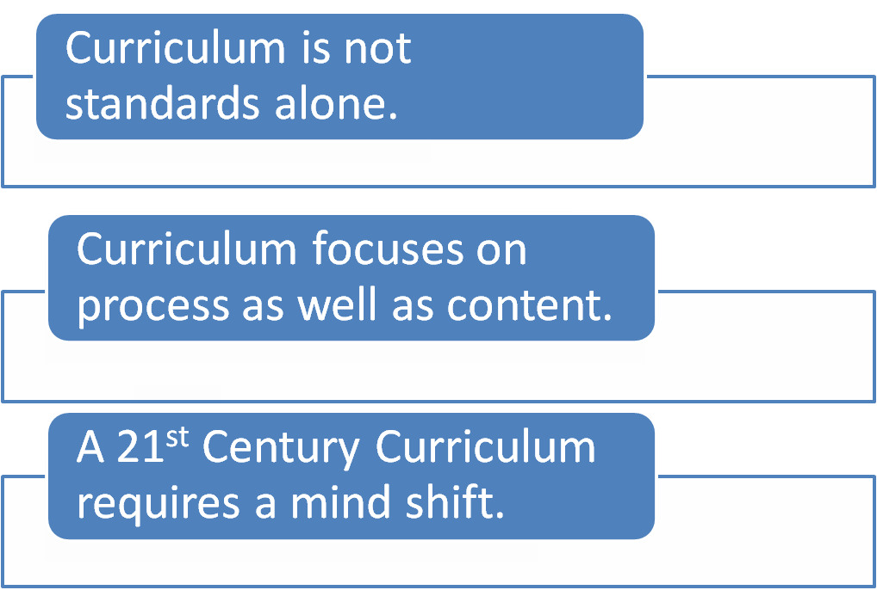
REMEMBER:
Notes:
Remember:
Curriculum is not standards alone. So, consider the other stakeholders that need to be a part of the process of curriculum writing. For example, out-of-school time partners from community, business, and higher education.
A curriculum framework is an evolving resource that will have continuous development and refinement for it must reflect an understanding and
acknowledgment of the changing nature of the challenges and demands that continue to shape the learner of the future. As we move from what we are presently doing toward a more 21st century form of education a mind shift is required. Think and Apply exercises located throughout the KMCF will help lead conversations toward this mind shift.
If we accept that we need to prepare students for a vastly different future than we have known, then our understanding of the focus of education also needs to shift. An example: Developing cross-curricular competencies such as managing and monitoring one’s own learning, capacity and predisposition to work together with others in teams, information and communication technologies, and creativity and flexibility of thinking will need to be addressed in addition to cross-curricular perspectives such as cultural sensitivity and respect and engaged citizenship.
There are pockets in KY where this mind shift has begun. The staff in districts and schools are letting go of habits, beliefs and traditions. This is necessary when we shift mental models of what “school” looks like. The KY Model Curriculum Framework must include a directory of model sites. So, we encourage schools/districts and others involved in the process to provide feedback and inform the committee in the coming year about the use of this resource and movement by districts and/or schools in a 21st century direction. The KMCF will be updated annually and sharing districts/schools innovative practices and direction with others is one of the goals of these annual updates to the KMCF resource.

Slide 40

Self-Assessment
Based upon “PURPOSE STATEMENTS” created by District Teams, use the self-assessment provided to determine current capacity.
Please return ONE form per
District in order to direct the
work of the Planning Team.

Slide 41
OCTOBER SSTLN—Why are we here?
Build Capacity of SSTL Assessment Literacy (Defensible Evidence)
Build Capacity of SSTL CHETL (Questioning)
Build Capacity of SSTL KCAS (Critical Components Proposed Standards/Professional Development Needs)
Build Capacity of SSTL Leadership (Purpose of Curriculum for Next Generation Learners, Complete Needs Assessment)

Slide 42

Defining Defensible Evidence: Mastery of Questioning
Defensible Evidence: examples from instructional practice that can be defended as mastery of a skill.
What evidence can you provide from your classroom that students are mastering the art of questioning?
Bring DEFENSIBLE EVIDENCE of EFFECTIVE STUDENT QUESTIONING to the NOVEMBER meeting

Slide 43

Students' Questions as a Catalyst for:
Deeper Learning, Joy in Teaching and a Healthier
Please register at The Right Question Institute
rightquestion.org
Free Resources
Notes:
Put a picture of Make Just One Change on here

Slide 44
Session Review | List of To Do In Our District, School, Classroom we will…
KCAS Updates on Standards Development Process *November Feedback Used to Refine Draft
ASSESSMENT LITERACY Defensible Evidence *How do you plan to share your understanding of the impact of collecting defensible evidence on student achievement?
CHETL Questioning *How can you intentionally incorporate opportunities for students to formulate their own questions? Remember to return in November with some “defensible evidence” of effective student questioning.
KCAS Critical Components for Professional Development *What are content related PD needs? *What dates would be best to avoid for summer sessions?
LEADERSHIP Building Capacity of Teacher/District Leaders to Design Curriculum for Next Generation Learners *What are District Needs for completing this work?
Notes:
Support Districts in the work we are asking them to start doing…using networks to help facilitate those conversations. The ask is…districts are going to eventually be writing curriculum to meet the needs of a next generation learner. SSTLN is a place to support the work.

