Slide 1
OVEC SSTLN
October 21, 2015
http://ovecssnetwork.weebly.com/

Slide 2
Agenda
Making Meaning Protocol
“Shoring up” Inquiries
Peer Review
Assessments
Rubrics
*Reflections

Slide 3
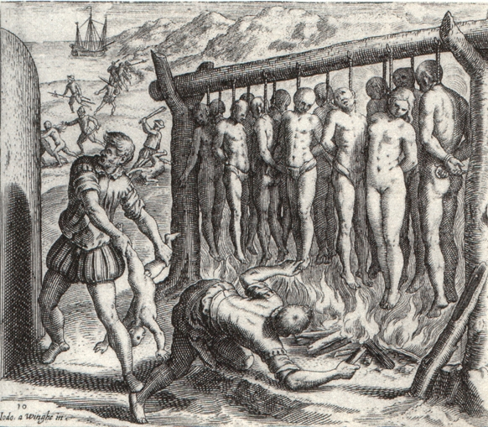
Norms. . .
Pausing
Paraphrasing
Providing Data
Posing Questions
Presume Positive Intentions
Putting Ideas on the Table
Paying Attention

Slide 4
Year at a Glance

Slide 5
Making Meaning Protocol
Anchor Standard
Grade level standard and DCC (i.e. CM, ED, GR, HT)
Questions
That you will need to answer as teacher
That your students will need to be able to answer
Big Ideas
What are some of the big ideas that come to mind?
What are connections between DCCs that might be helpful?
Context
What context is most appropriate for disseminating content standards?

Slide 6
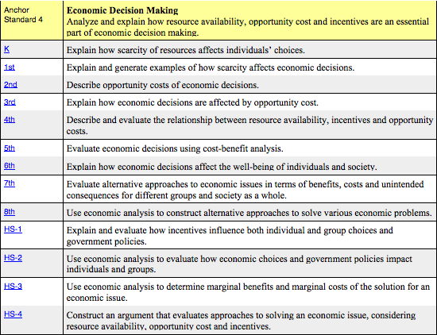

Slide 7
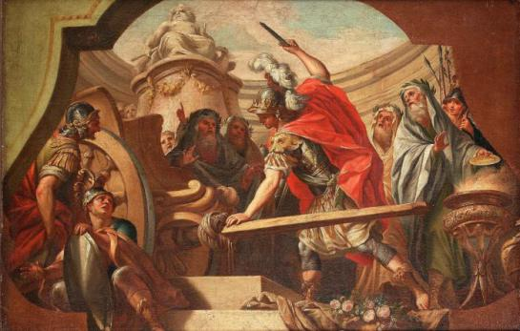
Making Meaning Protocol
Look at your Inquiries
Use the “Making Meaning” protocol
KASSS
Questions
Big Ideas
Context (multiple)
Self-Assess/Reflection #1

Slide 8
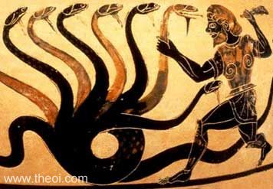
“Shoring up” Inquiries
QUESTIONS
Compelling Questions
Supporting Questions
TASKS
Formative Tasks
Summative Task
SOURCES

Slide 9
Part I: What is good practice?
EQUIP Rubric
Your Inquiry
New York Toolkit
Feedback Protocol (group of 3)
Exchange Inquires with partners
Person A facilitates as B and C discuss
Person B facilitates as A and C discuss
Person C facilitates as A and B discuss
Tools
Equip Rubric
Facilitation Rubric
Facilitation Questions
Self-Assess/Reflection #2 and #3
A
B
C

Slide 10
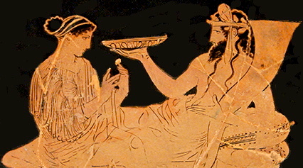
Enjoy your Lunch

Slide 11
Part II Assessment: How do you know it?
Where does assessment occur?
What will this tell you about what kids know?
What evidence does this assessment type provide that informs instruction tomorrow?
Self-Assess/Reflection #4 and #5

Slide 12
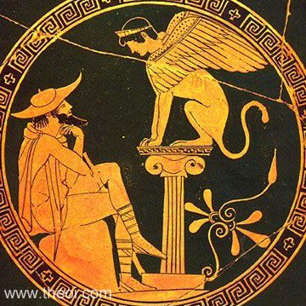
What is argumentation?

Slide 13
What is argumentation?
The process of reasoning systematically to advance an idea.
An argument is a collection of claims supported by relevant evidence, which can be considered an answer to the question investigated by the research.
As arguments become more sophisticated, students might include counterclaims.

Slide 14
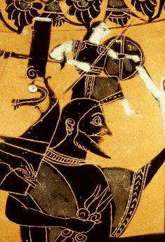
Argumentation
Brainstorm what argumentation asks of students (list, group, label)
As a teacher, what is the most efficient and accurate way to assess each component of argumentation?
What are the challenges/ advantages of each assessment?
What is the cognitive demand of students tasked with arguments?

Slide 15
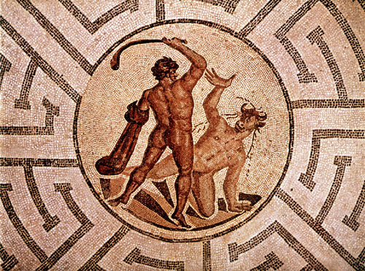
Part II Rubrics: How do you know it?
Jigsaw: How to Create and Use Rubrics
Partner
A reads (What is a rubric) pgs. 4-5
B reads (Why rubrics are important) pgs. 11-12
Benefits for Learners
Benefits for Teachers

Slide 16
Bridging Arguments and Rubric
Return to list of participants of “argumentation ask of students”
Contextual Knowledge
Reasoning Skills
Structure of Argumentation
Surveying Existing Rubrics
APUSH, TN Core, LDC (3-5, 6-12)
Creating Single Point Rubric Aimed at Proficiency
Draft/Select Proficiency criteria for your grade level based on the above/own categories of criteria

Slide 17
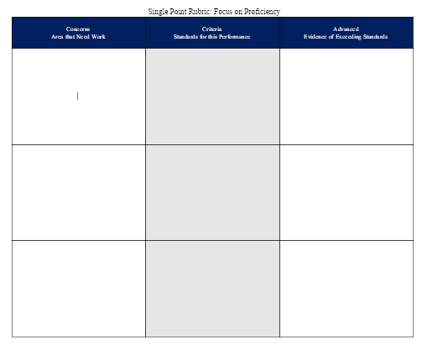
Part II Rubrics: How do you know it?

Slide 18
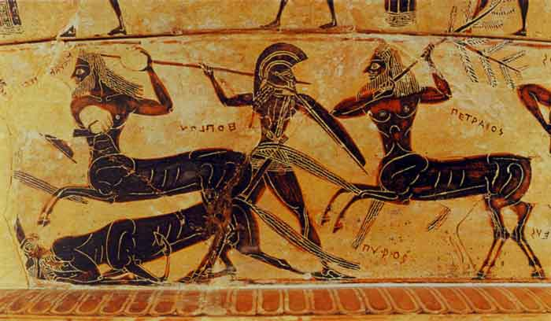
Recap: What is Good Practice and how do we know?
Review CHELT and FfT
Today’s Meet (www.todaysmeet.com)
What aspects of inquiry lessons are good practice?
Self-Assess/Reflection #6 and #7

Slide 19
Unpacking the Day
DLT from an Administrator’s perspective.
What can I take back to my PLCs?
Making Meaning Protocol
Inquiry Based Units Checklist
Feedback Protocol
Facilitator Rubric and Facilitator Questions
Equip Rubric
Requirements for Argumentation
Rubric Creation
Homework for November = Student Work

Slide 20
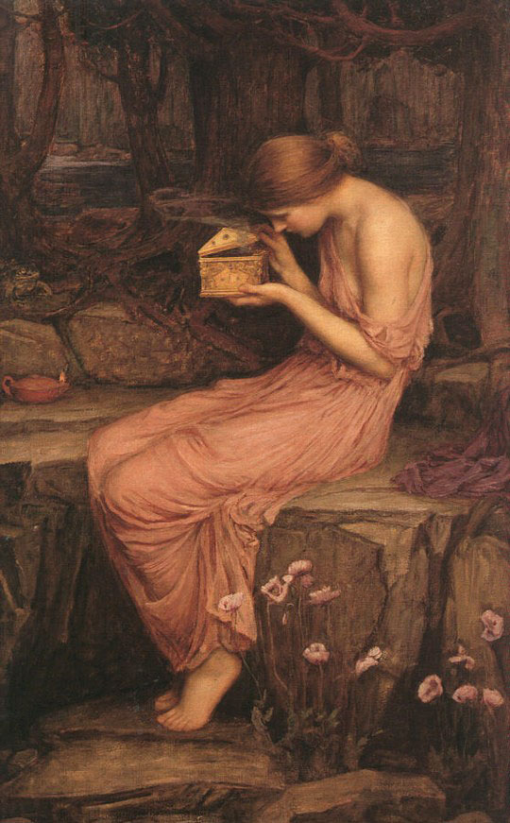
Evaluations &
Certificates
Ryan.new@education.ky.gov
http://ovecssnetwork.weebly.com/

