Slide 1
















Learning
Teaching
Enhancing
Supporting
Sharing
Social Studies Leadership Network
February 28, 2014
Notes:
5 minutes
Facilitator: Amy Treece
Materials: List of Facilitators
Welcome to SS Leadership Network.
Social Studies Education is central to the lives of all Americans, preparing them to be informed citizens in a democracy and knowledgeable consumers.
Wanted to take this opportunity to welcome you to our SS Leadership Network.
Introduce Facilitators (Dr. Klotter, Mikkaka Overstreet, Angela Hamblen, Sean Elkins, myself). Reference participants to the handout with brief description of strengths and contact information.
Recognition to Tina Tipton and Tracy Harris for creating this team

Slide 2

http://ovecssnetwork.weebly.com
*Networks
*Content Networks
*Social Studies
*Presentations and Handouts

Slide 3

“Agents of Change”
The only way to make sense out of change is to plunge into it, move with it, and join the dance.
--Alan Watts
Notes:
2 minutes
Facilitator: Amy Treece
Take a moment to ponder this quote. You as Social Studies Teacher Leaders and Your commitment to this Leadership Network and your District Leadership Team places you in a very unique role. As Agents of Change, we must be ready to embrace the challenges that are before us because we believe in the promise of tomorrow. As a member of this network, we will work together, form close relationships with teacher leaders from other districts and develop a network of support as we move forward with this work. Our ultimate goal is to have a positive impact teaching and learning in classrooms across our school, our district and our state.

Slide 4
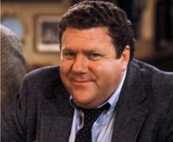
Social Studies Leadership Network NORMS
Be an ambassador of “lifelong learning.”
Show your enthusiasm for the work, support the learning of
others, be willing to take risks, participate fully.
Come to meetings prepared.
Be on time, any preparations/ readings completed, with
necessary materials.
Be focused during meetings. Stick to network goals/ targets, use technology to enhance work at hand, limit sidebar conversations.
Work collaboratively. All members’ contributions are valued and honored, seek first to understand, then be understood
Notes:
3 minutes
Materials: Norms Sheet in Binder
Please take a moment to review our Norms for this work.
Members of a professional learning community must be prepared to slosh around together in the mess, to endure temporary discomfort, to accept uncertainty, to celebrate their discoveries, and to move quickly beyond their mistakes. They must recognize that even with the most careful planning, misunderstandings will occur occasionally, uncertainty will prevail, people will resort to old habits, and things will go wrong. At those moments, they must give one another the benefit of the doubt, maintain a sense of humor and, above all, demonstrate what Patrick Dolan refers to as grace.
DuFour and Eaker

Slide 5

Kentucky Leadership Networks…
What Participants Need to Know
Task:
Take five minutes to review Kentucky Leadership Networks—What Participants Need to Know
Reflect Individually:
Why am I here (what is my role)?
How do my individual strengths support this vision?
What is my goal for participation in the Leadership Network for Social Studies?
Notes:
20 minutes
Facilitator: Sean Elkins
Participants Read: Kentucky Leadership Networks What Participants Need to Know
After reflecting individually, share with the members of your district team your goals for this work.
Draw attention to the remaining resources found
Released Statement from Karen Kidwell Social Studies Networks
Characteristics of the Right Network Participant
Graphic Organizer to Record Members of the District Leadership Team (homework to locate names of members)

Slide 6

Notes:
9:00 am to 9:10 am
Take a brief break (10 minutes)
Relocate into Grade Level Teams Locate 1 to 2 teachers who teach the same subject and grade level

Slide 7

Pillars again
Pillars of Network Meetings…Network Foundations
Professional Learning
Highly Effective Teaching and learning
Kentucky’s Core Academic Standards
Assessment Literacy
Leadership
TPGES--Teacher Professional Growth and Effectiveness System
Notes:
40 Minutes
Facilitator: Mikkaka Overstreet
Move Teacher Leaders into Grade Level Teams
Encourage them to locate 1 or 2 teachers who teach the same subject / grade level
(5 minutes)
Introduce the 4 Pillars of Kentucky Leadership Networks…also discuss the importance of Professional Learning and TPGES
This Focus of this session is Assessment Literacy
CHETL Classroom Assessment and Reflection
FfT Domain 3 Assessment Using Assessment in Instruction

Slide 8
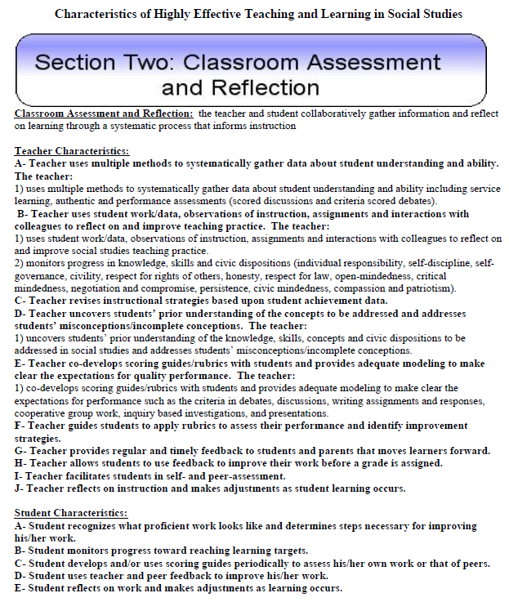
Assessment Literacy – CHETL/Social Studies
Notes:
For this session you will be using CHETL Classroom Assessment and Reflection and…

Slide 9
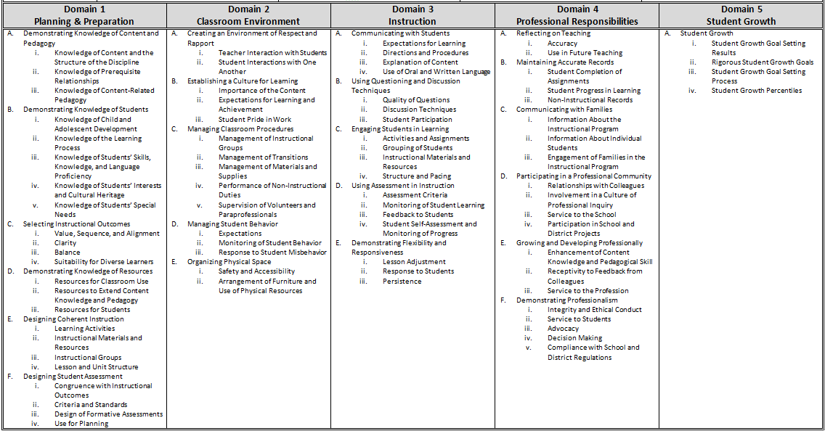
Overview of the Framework for Teaching
Notes:
The Danielson Framework for Teaching Domain 3 Using Assessment In Instruction to evaluate effective formative assessment practices in a Social Studies Classroom.

Slide 10
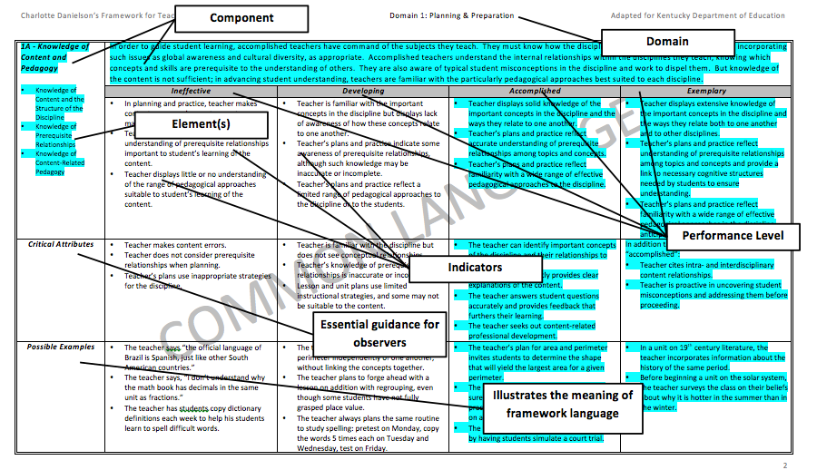
Notes:
Take a moment to familiarize yourself with the structure of the Framework for Teaching. (May want to do a quick formative assessment to check participants familiarity with the framework ex. Thumbs Up/Thumbs Down)

Slide 11
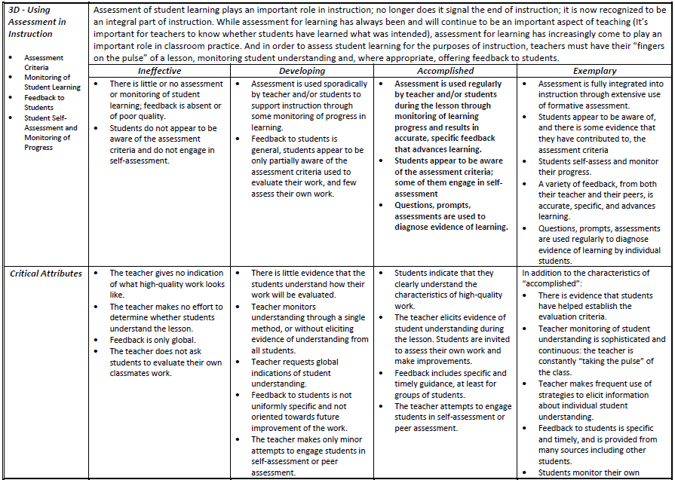
3D – Using Assessment in Instruction
Notes:
Encourage Participants to focus on the Accomplished Column of the Framework.
Discuss “What indicators demonstrate a teacher who is Accomplished or Exemplary in terms of using assessment?”
May encourage teachers to do some self-reflection…where would you situate yourself on this chart—this is not to share out/just to think individually.

Slide 12

Formative Assessment Strategies
Discuss at your table:
Find one of the strategies you have used in your classroom. Briefly describe how it went and what you liked about using it with students.
Find one strategy you will try in your classroom before our next meeting in March.
Notes:
(5 minutes)
Direct Teachers to Locate the Formative Assessment Strategies Quick Reference Guide in their packet. Have teachers review the assessments and discuss a way they have use it (or a modified version of it) in their classroom. Discuss success/concerns/ways to modify to meet the needs of your learners.
Introduce the Reflective Journal to record results of techniques implemented

Slide 13
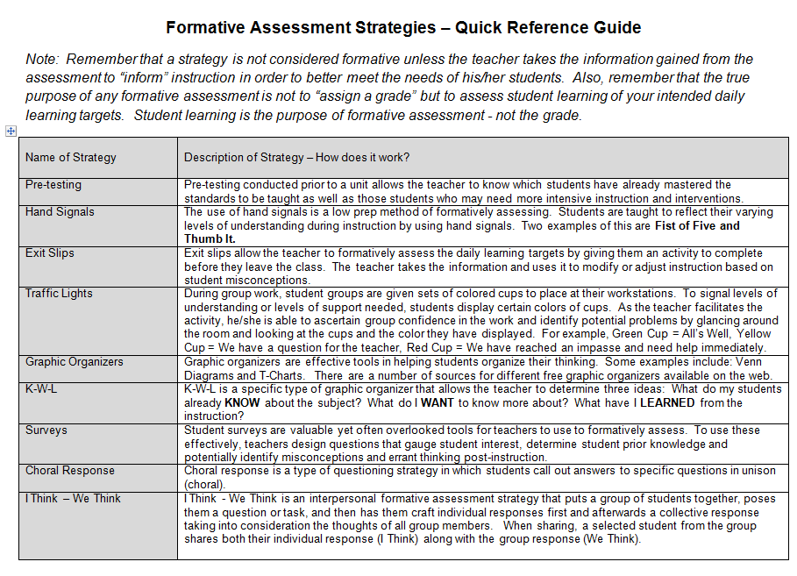

Slide 14
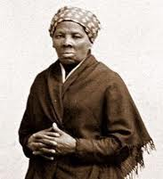
Slavery in America:
Building Background Knowledge
https://www.teachingchannel.org/videos/teaching-slavery
Record evidence you see related to
assessment throughout the video
Questions to Consider
What makes the word sort an effective warm-up?
How does Ms. Wicketts plan her lesson around the needs of her students?
How does Ms. Wicketts prepare her students for reading and writing about Harriet Tubman?
Notes:
25 minutes
I Think We Think Graphic Organizer (record individual reflections and then group reflections)
Watch video (14 minutes), record individual responses to the questions. Remind teachers that as they engage in peer observations, they may be looking for some of the same evidence (effective use of assessment in classroom instruction).
Discuss (10 minutes) questions as a group and record collective responses.
Share out … a few volunteers share their “I Think” and “We Think” responses

Slide 15

How does this connect to prior learning?
How can I use this to impact my classroom practice?
How can I use this to impact my district?
Notes:
3 minutes
Be sure to give time for reflection

Slide 16


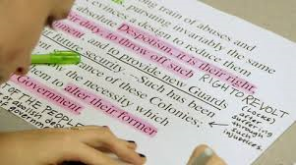




Thinking Like a Historian

Slide 17

Thinking Like A Historian
Locate a partner within grade level groups.
Read “Thinking Like A Historian” by Sam Wineburg silently until both partners reach the end of a segment.
“Say Something” (using one of the prompts)
Complete the reading.
Discuss with whole group.
Notes:
Dr. Klotter gives introduction “Why Study History”
Amy Treece explains Say Something Protocol and Article Stopping Points
Give Partners 20 minutes to read article/discuss
Share out as a whole group 5 minutes

Slide 18
Thinking Like A Historian Segments
SEGMENT 1 (Historical Thinking: Memorizing Facts and Stuff? AND Historians as Detectives: Searching for Evidence Among Primary Sources pg. 1)
SEGMENT 2 (What is Historical Thinking? AND Teaching Students to Thing Historically pgs. 2-3)
SEGMENT 3 (Why Teach Students to Think Like Historians? pg. 4)

Slide 19
Notes:
Take a brief break (10 minutes)
Stay in Grade Level Teams

Slide 20
What makes risks worth taking?
Security is mostly a superstition. It does not exist in nature, nor do the children of men as a whole experience it. Avoiding danger is not safer in the long run than outright exposure. Life is either a daring adventure, or nothing. To keep our faces toward change and behave like free spirits in the presence of fate is strength undefeatable.
--Helen Keller
Notes:
5 minutes…
What makes risks worth taking? Is a compelling question.
View the video Clip Agents of Change
Have students complete a “Brain Dump” take everything that is in their mind regarding the power of an individual to impact society.
Encourage participants to annotate the quote. Record thinkings and wonderings.
Hand out cards for card sort while groups are thinking independently.

Slide 21

List-Group-Label Directions
Who is our spotlight “Agent of Change”?
Group the words listed by some shared characteristics or commonalties.
Decide on a label for each group.
Try to add words to the categories on the organized lists.
Share your thinking.
Who is our spotlight “Agent of Change”?
Notes:
20 minutes
Provide groups with individual cards for card sort.
Participants work to sort cards into categories.
You have a stack of cards available at your work stations. Work together to categorize these words using your background knowledge. Place the words into categories and then attempt to discover the main topic to be addressed today.
Each group shares with the class its method of categorization and the thinking behind its choices, while adding words from other class members. Teachers can extend this activity by having students convert their organized concepts into a Semantic Map which a visual expression of their thinking.

Slide 22
List-Group-Label
Boycott Women’s Political Council Patron Civil Rights Desegregation Resolutions Grievances Segregation Advocate | NAACP Reverend M.L. King Motivate Arrest Jim Crow Era Legal Codes Social Movement Reform Plessy vs. Ferguson Discrimination
Notes:
20 minutes
You have a stack of cards available at your work stations. Work together to categorize these words using your background knowledge. Place the words into categories and then attempt to discover the main topic to be addressed today.

Slide 23
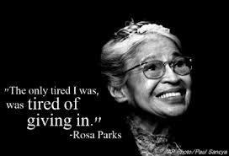
Rosa Parks … An Agent of Change
With your shoulder partner, retell the story of Rosa Parks. Discuss how the actions of this individual left a lasting impact on society as a whole. http://historicalthinkingmatters.org/rosaparks/
Notes:
5 minutes
Retell the story using as many of the words as possible
History is a series of stories. Today, we are going to take a look into the story of one individual…one Agent of Change.
Discuss Rosa Parks
Hand out document sets (one per table group)
Hand out analysis sheets (one per person)

Slide 24

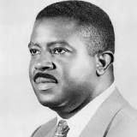


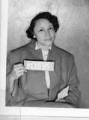
Learning Target: I can describe the actions of Rosa Parks, and I can analyze the impact that these actions had on society as a whole.
“Inquiring” Minds Want to Know…
Mrs. Parks was ideal for the role assigned to her by history…her character was impeccable and her dedication deep-rooted –M.L. King
What made Rosa Parks’ risks worth taking?
Was she successful as an “Agent of Change”?
Notes:
As Historical Detectives, we will attempt to describe that actions of Rosa Parks and analyze the impacts that these actions had on society as a whole.
What made Rosa Parks’ risks worth taking?
Was she successful as an agent of change?

Slide 25

Thinking Like A Historian…
What made Rosa Parks’ risks worth taking?
Was she successful as an “Agent of Change”?
Sourcing
Contextualizing
Close Reading
Critical Vocabulary
Corroborating Sources
Notes:
35 minutes to investigate sources
--5 minutes introducing graphic organizer
--5 minutes modeling
--25 minutes Gradual Release
Graphic Organizer
Can I use this document to answer the bigger question?
What made Rosa Parks’ risks worth taking?
Was she a successful “Agent of Change”?
Model How to analyze One source with the whole group.
Document A: Excerpt From Letter to the Mayor
Document B: NAACP Minutes
Document C: Announcement
Document D: Letter to Ann
Document E: Photograph of Bond
Document F: Handbill
Document G: MLK Speaks
Document H: Interview
Allow Participants to select sources and collect information.
Bottom Has a Reflection: How would I use primary sources with my students? What about this do I like? What would I change?
What document did you choose and why?

Slide 26
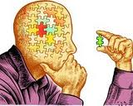
As a History Detective,
You decide…
What made Rosa Parks’ risks worth taking?
Was she successful as an “Agent of Change”?
USE DOCUMENTS and SCHEMA
SPECIFIC EXAMPLES and QUOTES
Notes:
Is there a place where you could use a similar question in your classroom?
What kind of documents could you use to tell this story?
How could you translate this into a learning experience.
Learning Target: I can evaluate secondary sources for an accurate retelling of historical events using evidence from primary sources.
Social Science is Thinking…it is driven by inquiry. Students are inquisitive by nature—they like to ask questions and to look for answers and imagine possibilities. Think critically as you gather, evaluate, analyze and synthesize data. Think flexibly about multiple sources of information, sifting through puzzling, conflicting and sometimes biased texts to corroborate information and perspectives.
Social Science is Metacognitive…think about your thinking as you research and develop claims and insights grounded in evidence from multiple, credible sources. Deepen background knowledge, examine and expand upon beliefs, make sense of the world and your role in it, develop an understanding of the impact choices make.
Social Science is Complex…represents a dynamic set of content area disciplines (history, civics, geography and economics). Social Scientists must critically examine multiple, authentic sources to recognize patterns.

Slide 27
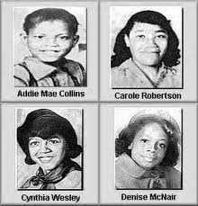
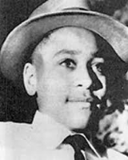
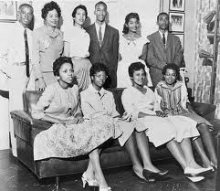
What makes risks worth taking?
Never doubt that a small group of thoughtful, committed citizens can change the world; indeed, it's the only thing that ever has. – Margaret Mead

Slide 28

For March…
Locate 1 or 2 partners who teach the same content/same grade level as you teach.
Decide on one topic that you will be teaching after our March meeting. This will be the focus of one of your learning experiences next month.
Be sure your lesson idea centers around a primary / secondary source.
Notes:
Select one current Content Standard you will be teaching in March.
Submit names and content standard/idea on card provided. Color coded according to grade level.
High School Copy of Quality Core Standards and Program of Studies
Core Content 4.1 Middle School
Core Content 4.1 Elementary

Slide 29
How does this connect to prior learning?
How can I use this to impact my classroom practice?
How can I use this to impact my district?
Notes:
Encourage Reflection

Slide 30

OVEC Leadership Network Meeting
PowerPoint adapted from the following sources:
*LA County Office of Education C3 Webcast
*Dr. Kathy Swan's "Achieving the C3: An exploration into 21st century social studies"
Notes:
11:45-12:15

Slide 31
Digging into the C3 Document
C3 Framework
Learning Target: Analyze the structure and intent of the C3 Framework for Social Studies to transform teaching and learning.
What is the C3 Framework?

Slide 32
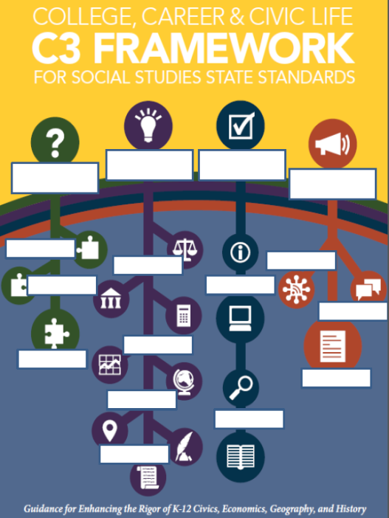
Notes:
5 minutes
Ask participants to get out Framework Books
Picture Prediction
Based on the symbols included in the graphic, predict what you think might be the critical components of the C3 Framework.
Discuss

Slide 33


Kentucky Leadership Networks for Social Studies
Assessments
KCAS SS and Literacy in History/SS
Curriculum
+
Instruction
Teacher Development
Notes:
5 minutes
Senate Bill 1 (2009) requires that Kentucky revise all content standards to reflect the necessary knowledge and skills needed to ensure that all students are college and career ready. In February 2013, a team of elementary, middle, high school, higher education and key SS advocacy group representatives began to set the vision for and drafting new SS standards for the commonwealth. These new standards will be guided by C3 Framework.
Participants in Kentucky’s Leadership Networks for SS will focus on developing their capacity to implement and support hightly effective teaching, learning, and assessment practices in SS. It is important to note that we do have a Framework that is based upon the Inquiry Arc and presented into four dimensions: 1. Developing Questions and Planning Inquiries 2. Applying Disciplinary Concepts and Tools 3. Evaluating sources and using evidence and 4. Communicating conclusions and taking informed action. It is our goal as a network that participants will engage in networking opportunities that will result in the development of rigorous and congruent curricula, assessments, and instructional practices.
OVER TIME, Our goal is to have a solid, defensible, world-class draft of college/career ready standards to present to the Kentucky Board of Education –POSSIBLY SOMETIME in 2014.

Slide 34


Please Note…
FRAMEWORK ≠ STANDARDS
Notes:
The Final C3 Framework was released on Constitution Day, September 17th. Small writing teams are continuing in their work to capture the thinking of the team and the intent of the Framework. Teacher, School, and District Leaders participating in Kentucky’s Leadership Networks for Social Studies will have multiple opportunities to dig into the framework, analyze its strengths and provide feedback on the usefulness of it to inform Social Studies standards and practice. Particpants will also have multiple opportunities to provide input/feedback on the standards revision work. Collectively, the participats will be authors of the vision for 21st century social and civic education in the Commonwealth.

Slide 35

D1

Slide 36

DIMENSION ONE: Developing Questions and Planning Inquires pg23
Constructing Compelling Questions pg24
Constructing Supporting Questions pg25
Determining Helpful Resources pg25

Slide 37
D2

Slide 38

DIMENSION TWO: Applying Disciplinary Concepts and Tools pg29
CIVICS pg31
ECONOMICS pg35
GEOGRAPHY pg40
HISTORY pg45

Slide 39
D3

Slide 40

DIMENSION THREE: Evaluating Sources and Using Evidence pg53
Gathering and Evaluating Sources pg54
Developing Claims Using Evidence pg55

Slide 41
D4

Slide 42

DIMENSION FOUR: Communicating
Conclusions and Taking Informed Action pg59
Communicating Conclusions pg60
Critiquing Conclusions pg61
Taking Informed Action pg62

Slide 43

C3 Framework Investigation
Your Task: With your table group, discuss the following:
1. What do you notice about the structure and/or content of the C3 document?
2. What is new or different about the content or skills in C3?
3. What impacts will the C3 Framework have on teaching and learning?
Notes:
Feel free to tab key components of the Framework

Slide 44

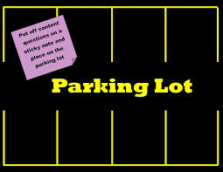
Parking Lot
As a team OR individually, take a few moments to reflect on your experiences…
What specific questions do you have regarding the C3 Framework, and its impact on teaching and learning?
Place your question on the
C3 Parking Lot.
Notes:
Chart Paper for Parking Lot
Introduce Graphic Organizer for Recording C3 Framework Information from Kathy Swan’s Presentation

Slide 45
How does this connect to prior learning?
How can I use this to impact my classroom practice?
How can I use this to impact my district?
Notes:
Be sure to give time for reflection

Slide 46


Slide 47

Dr. Kathy Swan
Achieving the C3: An exploration into 21st Century social studies
OVEC, January 24, 2014

Slide 48

Elephant in the Room

Slide 49
What is Social Studies?
We explore the following questions:
  What does it mean to be human?
  What does is mean to be humane?
We apply disciplinary perspectives/lenses to human issues, events and ideas:
  Political
  Economic
  Geographic
  Historical
We apply what we have learned in a meaningful way.

Slide 50






Should government assist corporations in developing hybrid technologies?
How do we create a tax environment to spur this innovation?
Where does this technology find the most “wiggle room”? Rural, urban and/or suburban communities?
Gendered?
What innovations in the past created social, political, economic change?
Chaine operatoire?
Do hybrid technologies enhance the common good? Can and should we do something about them?

Slide 51

?
?
?
?
?
?

Slide 52
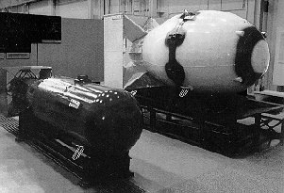
?
?
?
?
?
?

Slide 53
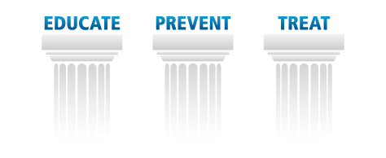
Inquiry
Arc
Disciplinary
Literacy
Civic
Life
C3 Foundations

Slide 54

C3 Inquiry Arc
College, Career and Civic Life (C3)
Framework for Social Studies State Standards:
Guidance for enhancing the rigor of K-12
civics, economics, geography and history

Slide 55
C3 Inquiry Arc
Dimension 1: Developing Questions and Planning Inquiries
Dimension 2: Applying Disciplinary Tools and Concepts (Civics, Economics, Geography, and History)
Dimension 3: Evaluating Sources and Using Evidence
Dimension 4: Communicating Conclusions and Taking Informed Action
What is the C3 Framework?

Slide 56
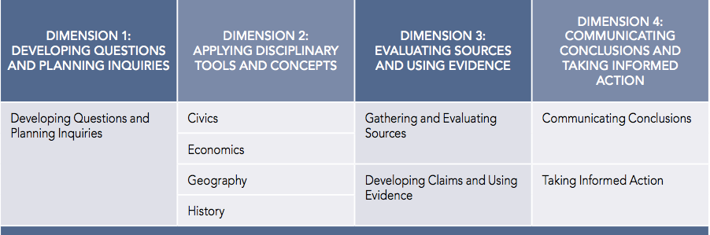
C3 Framework Organization

Slide 57
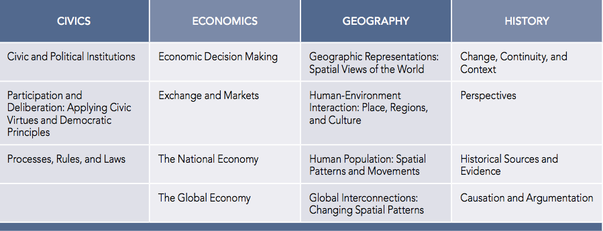
Dimension 2:
Applying Disciplinary Tools and Concepts

Slide 58
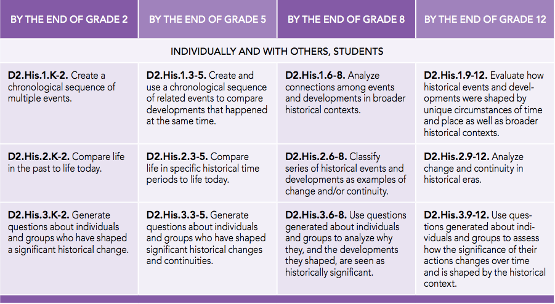
History K-12 Pathway

Slide 59
Common Core ELA
The C3 Framework fully incorporates and extends the expectations for literacy learning put forward in the ELA Common Core. We view the literacy skills detailed in the ELA Common Core as establishing a foundation for inquiry in social studies. These literacy skills are an indispensable part of social studies.
What is the C3 Framework?

Slide 60
Common Core ELA
Foundational, Supportive, and Vital Connections to CC Anchor Standards
Shared Language
  e.g., argumentation, evidence, sources, discourse
Graphical and Narrative Explanations threaded throughout C3
What is the C3 Framework?

Slide 61
C3 Literacies
Questioning
Selecting sources
Gathering information from sources
Evaluating sources
Making claims
Using evidence
Constructing arguments and explanations
Adapting arguments and explanations
Presenting arguments and explanations
Critiquing arguments and explanations
Analyzing social problems
Assessing options for action
Taking informed action
Inquiry
What is the C3 Framework?
Using deliberative processes
Participating in school settings
Following rules
Making economic decisions
Using economic data
Identifying prices in a market
Disciplinary
Reasoning spatially
Constructing maps
Using geographic data
Classifying historical sources
Determining the purpose of an historical source
Analyzing cause and effect in history

Slide 62
Civic Engagement
Now more than ever, students need the intellectual power to recognize societal problems, ask good questions and develop robust investigations into them, consider possible solutions and consequences, separate evidence-based claims from parochial opinions, and communicate and act upon what they learn.
What is the C3 Framework?
What is the C3 Framework?

Slide 63
Civic Engagement
The Civic Arc of the C3.
Civil and democratic discourse within a diverse and collaborative context.
  e.g., Individually and with others, students will…
  e.g., D2.Civ.9.9-12. Use appropriate deliberative processes in multiple settings.
Taking Informed Action
What is the C3 Framework?
What is the C3 Framework?

Slide 64
Next Steps
What can the C3 do
in Kentucky?
Foundation for new standards ☑
Recalibrate Relationship w/ Literacy ☑
Professional Learning (In-service and pre-service) framed by an Instructional Arc ☑
Curriculum and Instruction ☑
Assessment reform ☑
To explain to policy makers: “What is social studies and how does it contribute to the 3 C’s?” ☑
How will the C3 Framework
be used?

Slide 65

Teaching the C3 Framework:
A Guide to Inquiry-based Instruction in Social Studies
Newseum
Smithsonian American History Museum
Smithsonian American Indian Museum
Bill of Rights Institute
Gilder Lehrman
National Archives
Library of Congress
Center for Action Civics
National History Day
Facing History & Ourselves
Federal Reserve
National Constitution Center
Colonial Williamsburg
Ford’s Theater
Center for Economic Education and Entrepreneurship
National Geographic
Big History

Slide 66
What have we learned so far?
Curricular partners have strengths and weaknesses when it comes to the “Instructional Arc” of the C3;
Not starting from scratch, but re-mixing or shifting existing resources to align with C3;
Educational reform language is problematic
  No teacher wants an extreme makeover;
Identifying key instructional shifts could be helpful for the professional learning of teachers and create awareness of the C3 as an instructional tool.

Slide 67
Instructional Shifts of the C3*
Social Studies teachers will need to:
Craft questions that matter.
Create and maintain a learning environment to support inquiry.
Integrate content and skills meaningfully (reconcile the breadth/depth debate).
Become explicit (clear) about disciplinary literacy outcomes and practices.
Get serious about civic life/informed action.
*Under Construction: Hot off the Presses!

Slide 68

Are these the right shifts?
Tell me what you think.
Time to get our C3 on!

Slide 69

Now for the Big Finish!

Slide 70






Thinking Like A
Citizen
Kathy Swan
University of Kentucky
S. G. Grant
Binghamton University
Emma Thacker
University of Kentucky
Notes:
Kathy

Slide 71

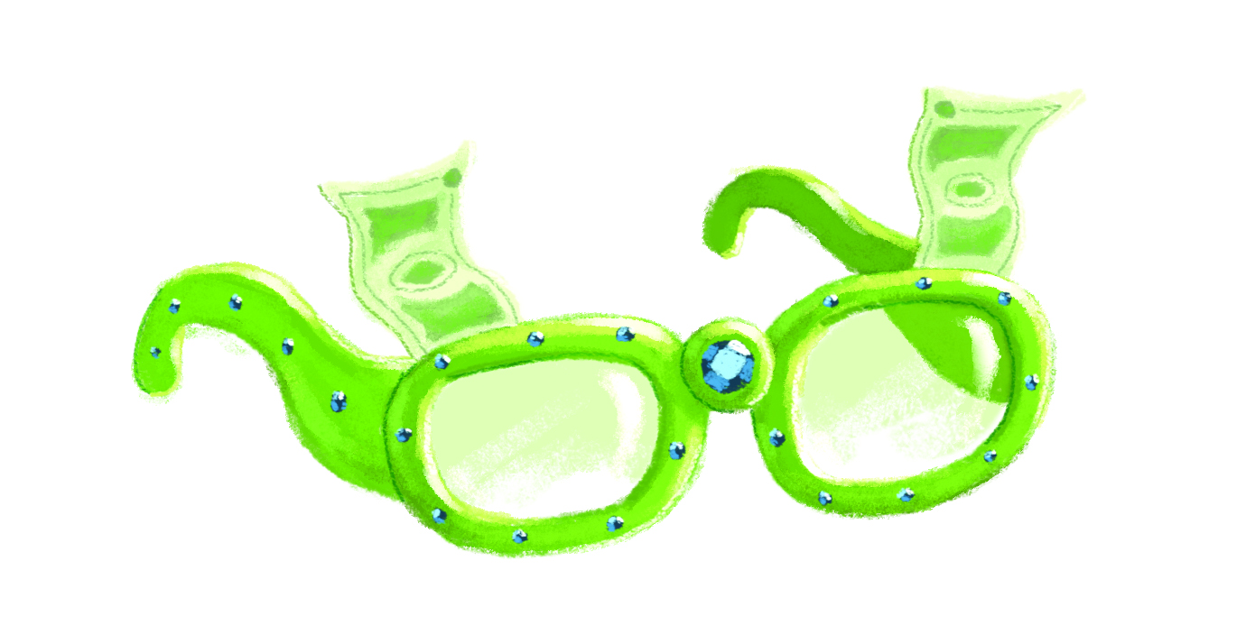

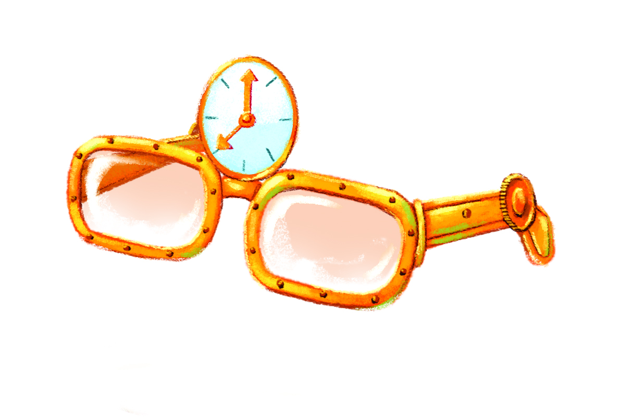


The Spectacular Social Studies Spectacles
Whose Swings Are They, Anyway?
Why Can’t I Say That?
It’s None Of Your Business!
What Color Am I?
Why Is This SO Boring?
Notes:
Emma

Slide 72

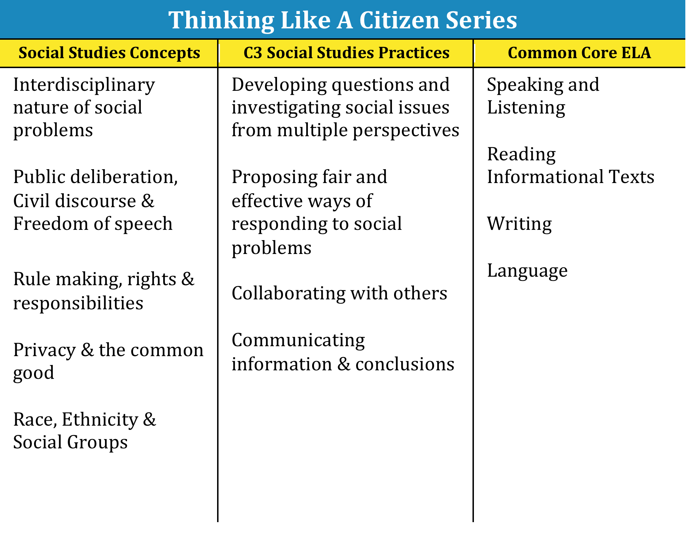
Notes:
Kathy

Slide 73

Table Texting
C3 Framework Impacts on Teaching and Learning
Record a question regarding the C3 Framework on the Table Texting Form provided.
Record your response.
At signal, pass to the right. Read your colleague’s response and reply.
3. Repeat step 3 until complete.
Notes:
At the end of Dr. Swan’s presentation, participants will be asked to generate a question regarding the impact of the C3 Framework on teaching and learning.

Slide 74
Notes:
Take a brief break (10 minutes)
District Teams

Slide 75

Becoming Agents of Change
Building Capacity Around the 4 Pillars
Notes:
District Teams

Slide 76
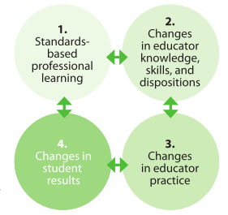

Building Capacity
Develop Skills
Increase Knowledge
Use Resources to Develop a Plan to Meet Specific District Needs
Long Term Sustainable Model
Notes:
Reference Capacity Building vs. Train the Trainer

Slide 77


1. Kentucky’s Core Academic Standards
  How are you understanding & implementing
the standards in your classroom, school & district?
2. Highly Effective Teaching and Learning
  How are you emphasizing highly effective teaching and learning characteristics in your classroom, school & district?
3. Assessment Literacy
  How are you using formative/summative assessment to improve instruction & learning in your classroom, school & district?
4. Leadership
  How are you using the leadership capacity you are building to share information in your school & district?

Slide 78

Plan, Do, Review
Plan:
What will I do with what I have learned in this network meeting?
Do:
When, where, how, with whom will I do what I have planned?
Notes:
5 minutes
Begin with individual reflection: What will I do with what I have learned in this network meeting? When, where, how, with whom will I do what I have planned?
10 minutes
Discuss as a District: What will we do with what we have learned in this network meeting? When, where, how, with whom will I do what I have planned?
Share One Aspect of Your Plan.
Any Inspirations? Any Take Aways?

Slide 79
Session Review and List of “To Do”
Topic & Activities | Before Our Next Meeting…
Assessment -Formative Assessment Strategies | *Implement Formative Assessment Strategy *Reflect and Record Impacts
Historical Thinking Model Lesson -Thinking Like A Historian | *Look for ways to Incorporate Primary Sources…History Detectives *Be Ready to plan with grade level partners (integrate instruction around a primary and/or secondary source). This lesson will be implemented between March 25th and April 17th.
C3 Framework -Investigate Structure and Impacts on Teaching and Learning | *Investigate * Think About Impacts on Teaching and Learning * Pose questions
Plan, Do, Review | *Identify Members of District Leadership Team *How Do I Become An Agent of Change? *Discuss Plans with District Leadership Team

Slide 80

Please complete your evaluations….
Thank You!
See You At Oldham County Administrative Annex
Monday, March 24th
Notes:
Technology Tools that Support Highly Effective Teaching And Learning
Using Text Sets to Support Instruction – Text Complexity
Creating History Mysteries – Learn from a Professional in the Field
Assessment Literacy – Effective Formative Assessments
Questioning – Developing Compelling and Supporting Questions

