Slide 1
Learning
Teaching
Enhancing
Supporting
Sharing
Social Studies Leadership Network
Notes:
5 minutes
Facilitator: Amy Treece
Materials: List of Facilitators
Welcome to SS Leadership Network.
Acknowledge new team members

Slide 2
Live Binder
http://www.livebinders.com/play/play/1283144
1283144

Slide 3
From Last Meeting…
You have requested…
More modeling of inquiry based instruction
More discussion on C3 Framework and Standards
More grade level work time
More Strategies that align with TPGES
More information about SS Standards
Notes:
Just to address the final bullet, Jennifer Frakes (Oldham County) is our SS Consultant KDE…leading work of writing teams to continue finalizing drafts of standards to be finished in the Fall of 2014

Slide 4
Today’s Agenda
Page 2
C3 Framework Connections to KCAS ELA & Literacy in History / SS
Deep Dive into C3 Framework—Instructional Shifts of Inquiry Based Instruction
Why Study History? (Engaging in Inquiry Based Learning Experience)
Crafting An Inquiry Based Learning Experience
Know, Plan, Do—My Role As A Teacher Leader
Notes:
Today is a day that we will immerse fully into C3/the process of Inquiry Based Instruction

Slide 5
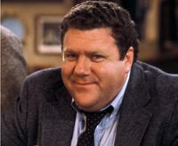
Social Studies Leadership Network NORMS
Be an ambassador of “lifelong learning.”
Show your enthusiasm for the work, support the learning of
others, be willing to take risks, participate fully.
Come to meetings prepared.
Be on time, any preparations/ readings completed, with
necessary materials.
Be focused during meetings. Stick to network goals/ targets, use technology to enhance work at hand, limit sidebar conversations.
Work collaboratively. All members’ contributions are valued and honored, seek first to understand, then be understood
Notes:
3 minutes
Materials: Norms Sheet in Binder
Please take a moment to review our Norms for this work.
Members of a professional learning community must be prepared to slosh around together in the mess, to endure temporary discomfort, to accept uncertainty, to celebrate their discoveries, and to move quickly beyond their mistakes. They must recognize that even with the most careful planning, misunderstandings will occur occasionally, uncertainty will prevail, people will resort to old habits, and things will go wrong. At those moments, they must give one another the benefit of the doubt, maintain a sense of humor and, above all, demonstrate what Patrick Dolan refers to as grace.
DuFour and Eaker

Slide 6
Pillars again
Pillars of Network Meetings…Network Foundations
Professional Learning
Highly Effective Teaching and learning
Kentucky’s Core Academic Standards
Assessment Literacy
Leadership
TPGES--Teacher Professional Growth and Effectiveness System
Notes:
8:35-8:45
Review Formative Assessment Strategies

Slide 7
I can analyze formative assessment practices to determine impact on learning.
Formative Assessment Strategies Discuss at your table:
One of the strategies from your Reflection Journal.
Briefly describe how it went and what you liked about using it with students.
PAGE 5
Notes:
(5 minutes)
Direct Teachers to Discuss the Formative Assessment Strategies Reflection Journal. Have teachers review the assessments and discuss a way they have use it (or a modified version of it) in their classroom. Discuss success/concerns/ways to modify to meet the needs of your learners.

Slide 8
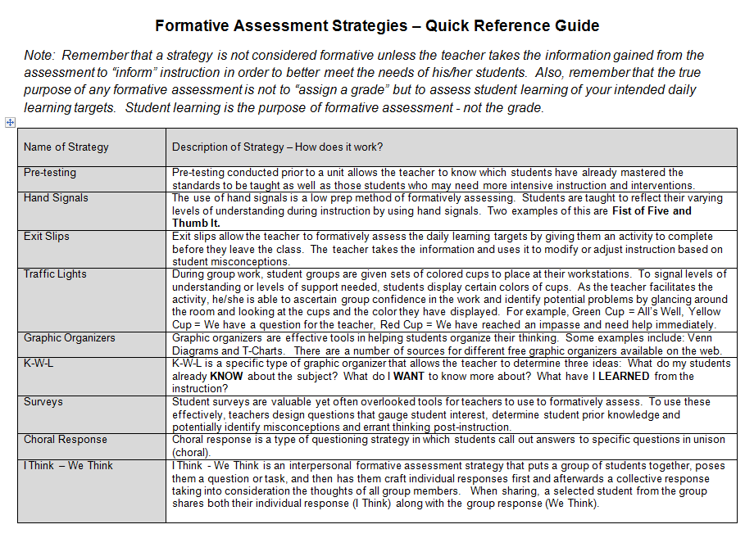

Slide 9
Pillars again
Pillars of Network Meetings…Network Foundations
Professional Learning
Highly Effective Teaching and learning
Kentucky’s Core Academic Standards
Assessment Literacy
Leadership
TPGES--Teacher Professional Growth and Effectiveness System
Notes:
8:45-9:30
Grade Level Teams

Slide 10
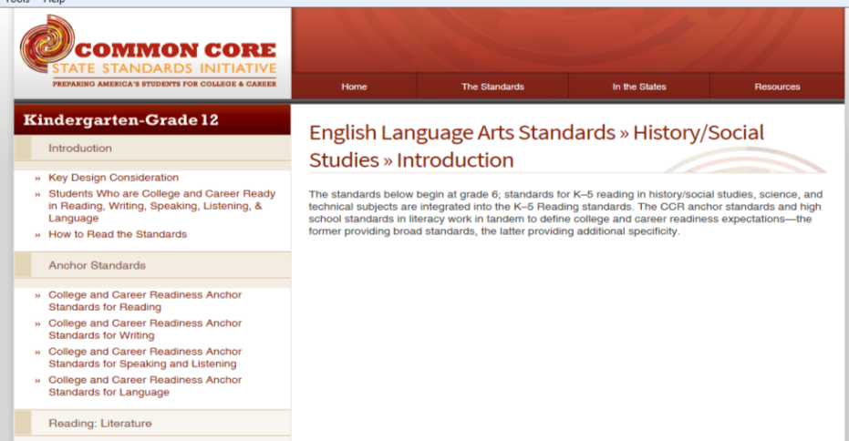
PAGE 6
I can describe how KCAS (ELA & Literacy in History/SS) supports highly effective teaching and learning in Social Studies.
Notes:
KCAS
Analyze C3 Framework Indicators for current grade band in each of the Four Dimensions—Complete a Self –Assessment (which ones do you feel most comfortable with/where are your growth areas going to be)
How do the documents that guide our instruction (C3 Framework and KCAS) fit together?
What are the “Look Fors” when I walk into a C3 Classroom?

Slide 11
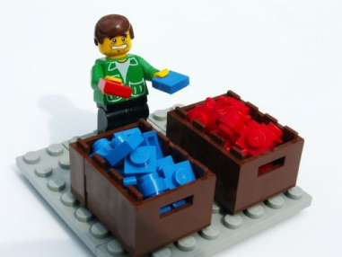
Card Sort
Let’s look at the language of the KCAS and the C3. Can you tell which statements come from which document?

Slide 12
KCAS
C3
Draw on information from multiple print or digital sources, demonstrating the ability to locate an answer to a question quickly or to solve a problem efficiently.
Cite specific textual evidence to support analysis of primary and secondary sources, connecting insights gained from specific details to an understanding of the text as a whole.
Evaluate various explanations for actions or events and determine which explanation best accords with textual evidence, acknowledging where the text leaves matters uncertain.
Questions are just the starting point for an inquiry. To develop an inquiry, students will also determine the data sources needed to help answer compelling and supporting questions.
Determine the kinds of sources that will be helpful in answering compelling and supporting questions, taking into consideration multiple points of view represented in the sources, the types of sources available, and the potential uses of the sources.

Slide 13
KCAS
C3
Propel conversations by posing and responding to questions that probe reasoning and evidence; ensure a hearing for a full range of positions on a topic or issue; clarify, verify, or challenge ideas and conclusions; and promote divergent and creative perspectives.
Evaluate authors’ differing points of view on the same historical event or issue by assessing the authors’ claims, reasoning, and evidence.
Integrate information from diverse sources, both primary and secondary, into a coherent understanding of an idea or event, noting discrepancies among sources.
Integrate evidence from multiple relevant historical sources and interpretations into a reasoned argument about the past.
Detect possible limitations in various kinds of historical evidence and differing secondary interpretations.

Slide 14
Brainstorm
What words or phrases come to mind when you think of KCAS? What are the big ideas?

Slide 15
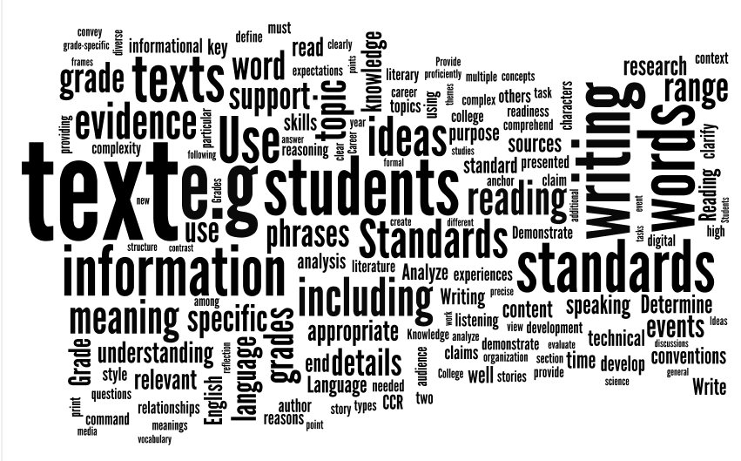

Slide 17
Notes:
Set up for Dr. Swan

Slide 18
Pillars again
Pillars of Network Meetings…Network Foundations
Professional Learning
Highly Effective Teaching and learning
Kentucky’s Core Academic Standards
Assessment Literacy
Leadership
TPGES--Teacher Professional Growth and Effectiveness System
Notes:
Deep Dive Into the C3 Framework

Slide 19
Deep Dive Into the C3 Framework
PAGE 7
Dr. Kathy Swan
I can describe the impact of the C3 Framework on Social Studies Education.
Notes:
Remind participants that there will be a document in color in their binder from the previous month.

Slide 20
Notes:
12:00-12:45

Slide 21
Pillars again
Pillars of Network Meetings…Network Foundations
Professional Learning
Highly Effective Teaching and learning
Kentucky’s Core Academic Standards
Assessment Literacy
Leadership
TPGES--Teacher Professional Growth and Effectiveness System

Slide 22
Why Study History?
I can identify characteristics of inquiry based instruction and explain the importance of historical thinking.
PAGES 8-16

Slide 23
The Historian as Detective:
The Goebel Murder Mystery

Slide 24
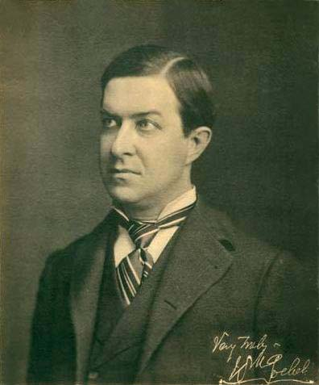

Slide 25
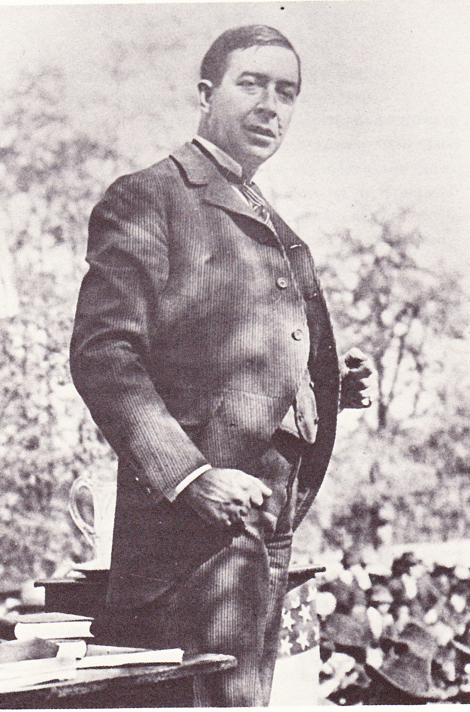

Slide 27
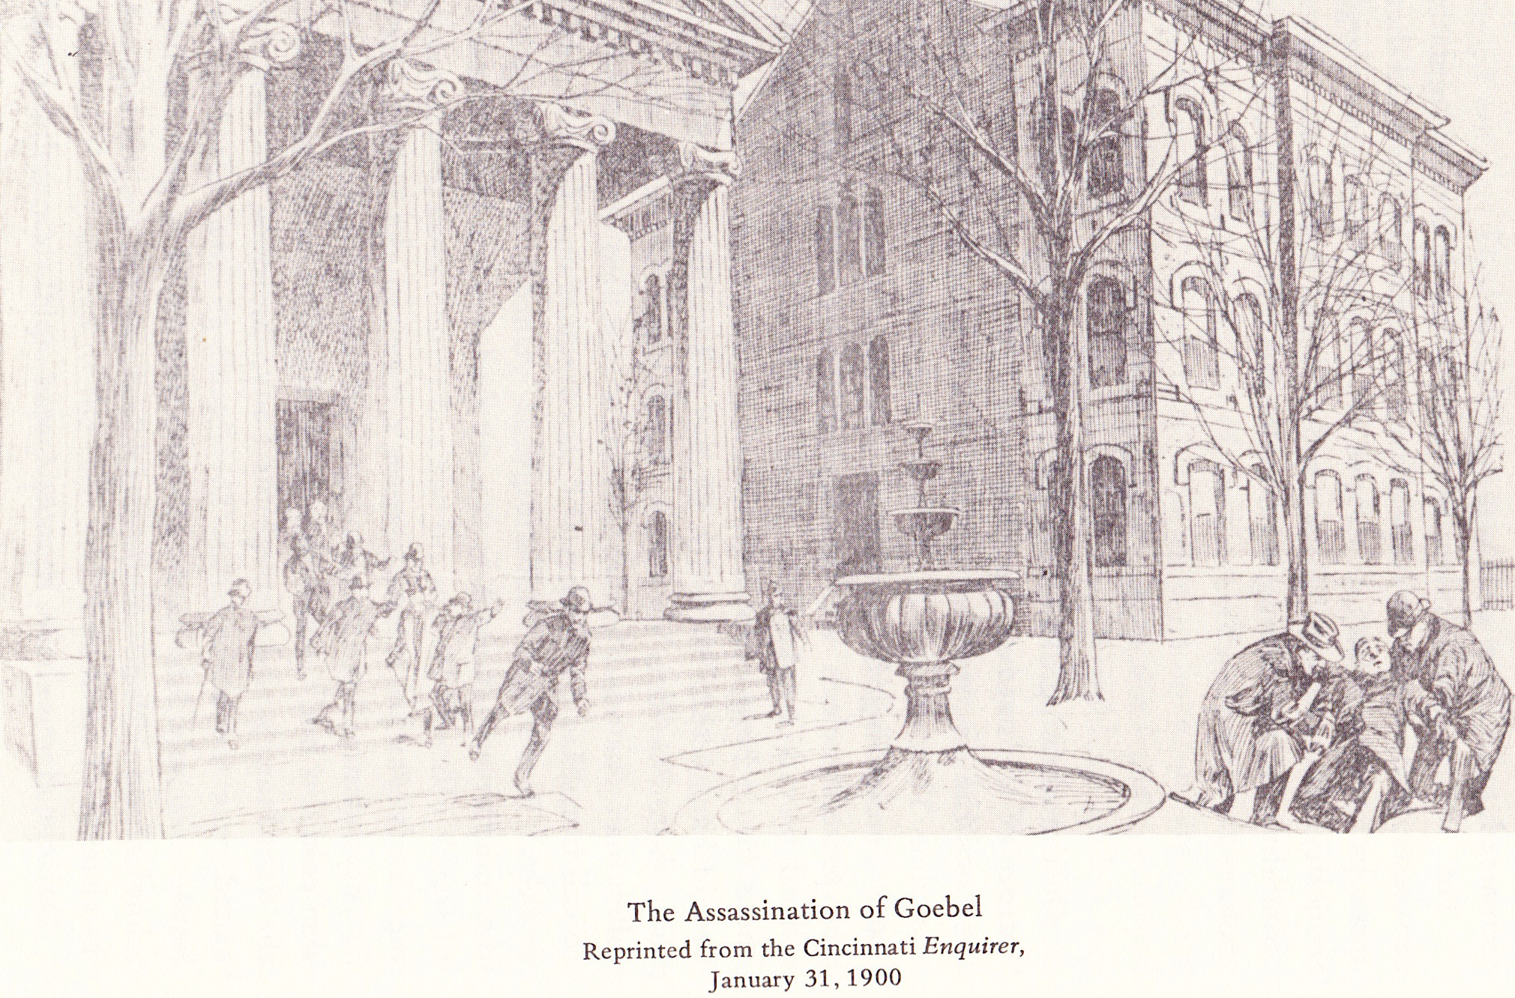
Goebel Assassination

Slide 28
THE HISTORIAN AS DETECTIVE
Who, What, When, Where, Why, and How
Who was involved?
2. What happened?
When and where did it happen?
How did it happen?
How many shots were there?
Where did they come from?
Where was Chinn?
What did Goebel say after he was shot?
9. Who shot Goebel?

Slide 30
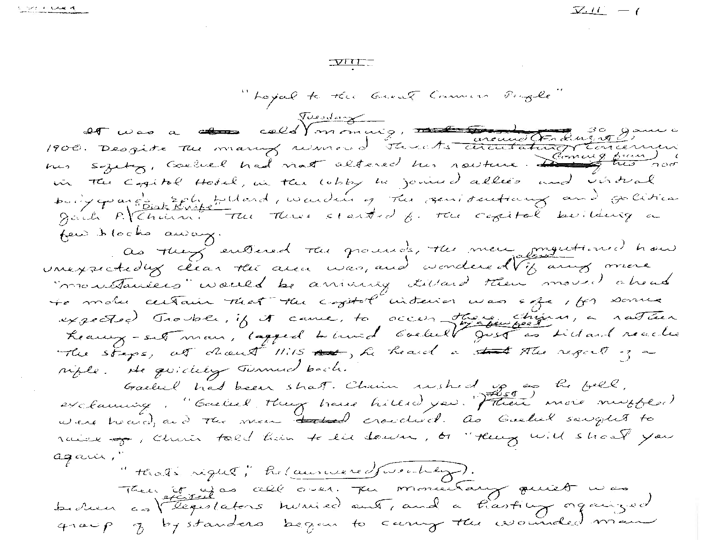

Slide 31
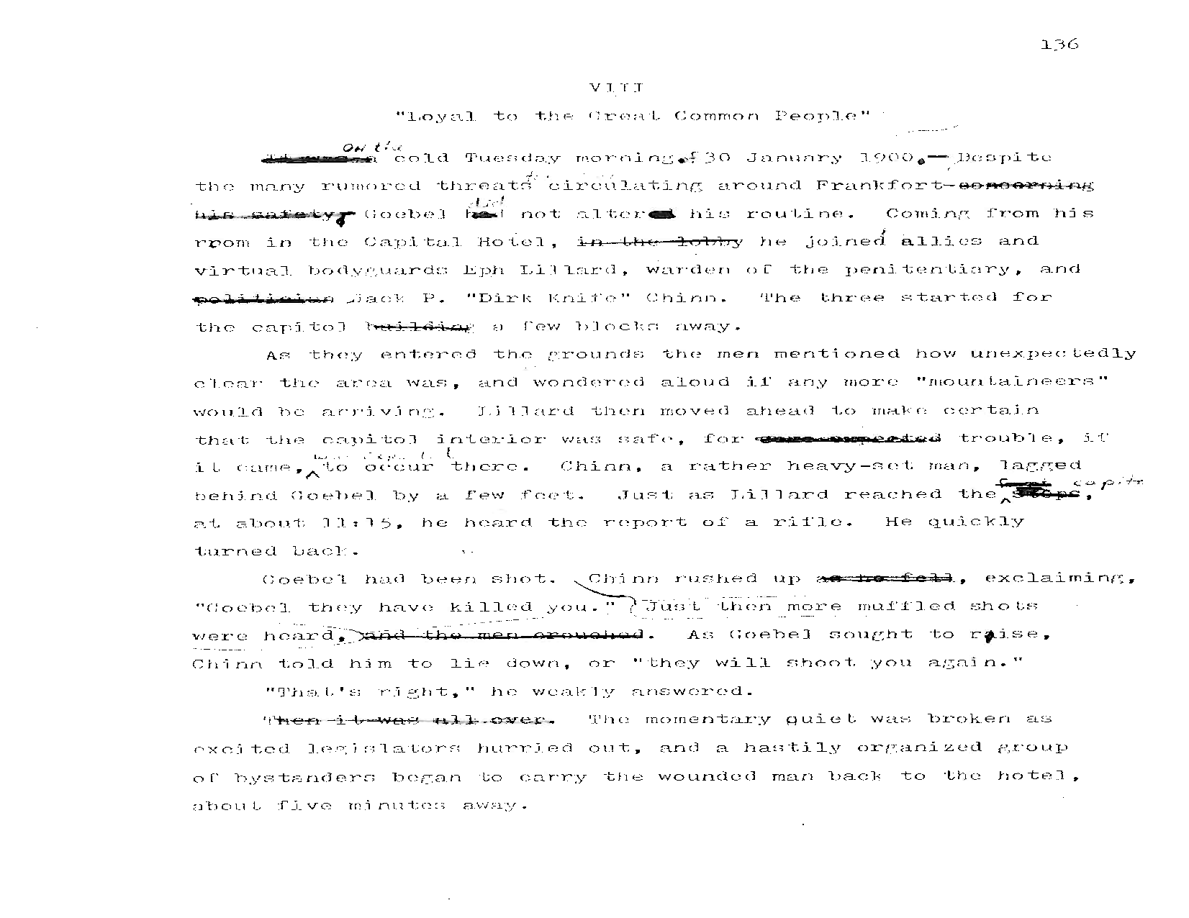

Slide 33
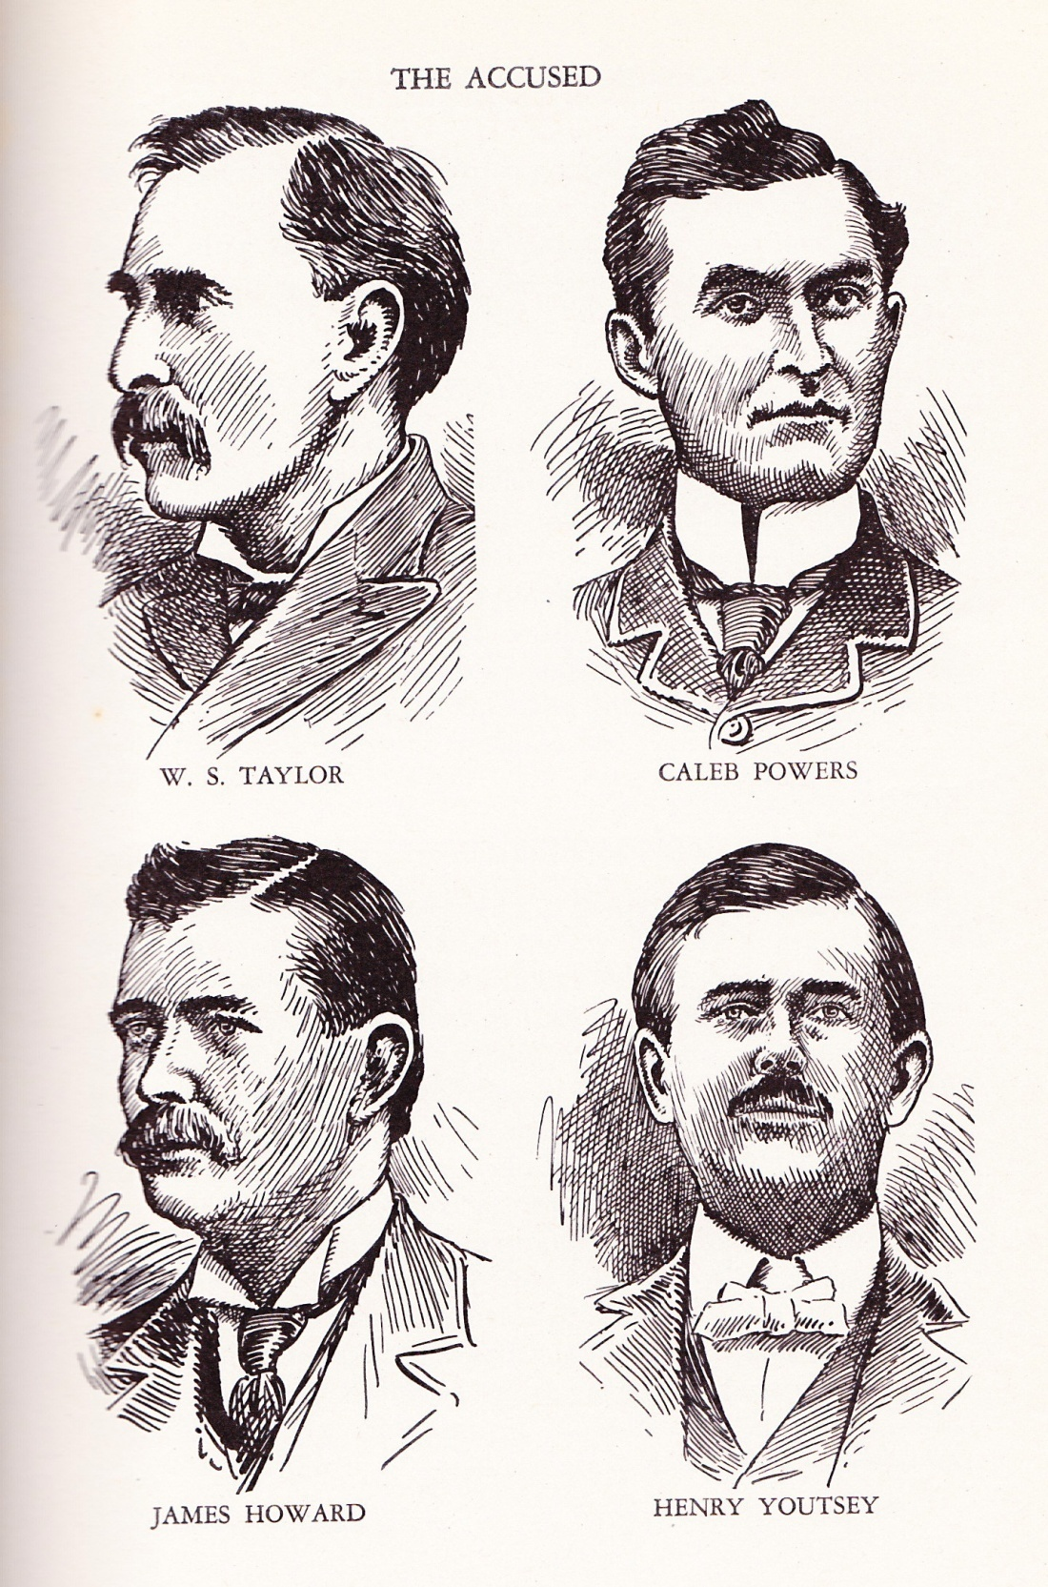
The indicted Gov. Taylor and the three men convicted of being part of the assassination

Slide 34
Kentucky’s Image, 1900

Slide 35
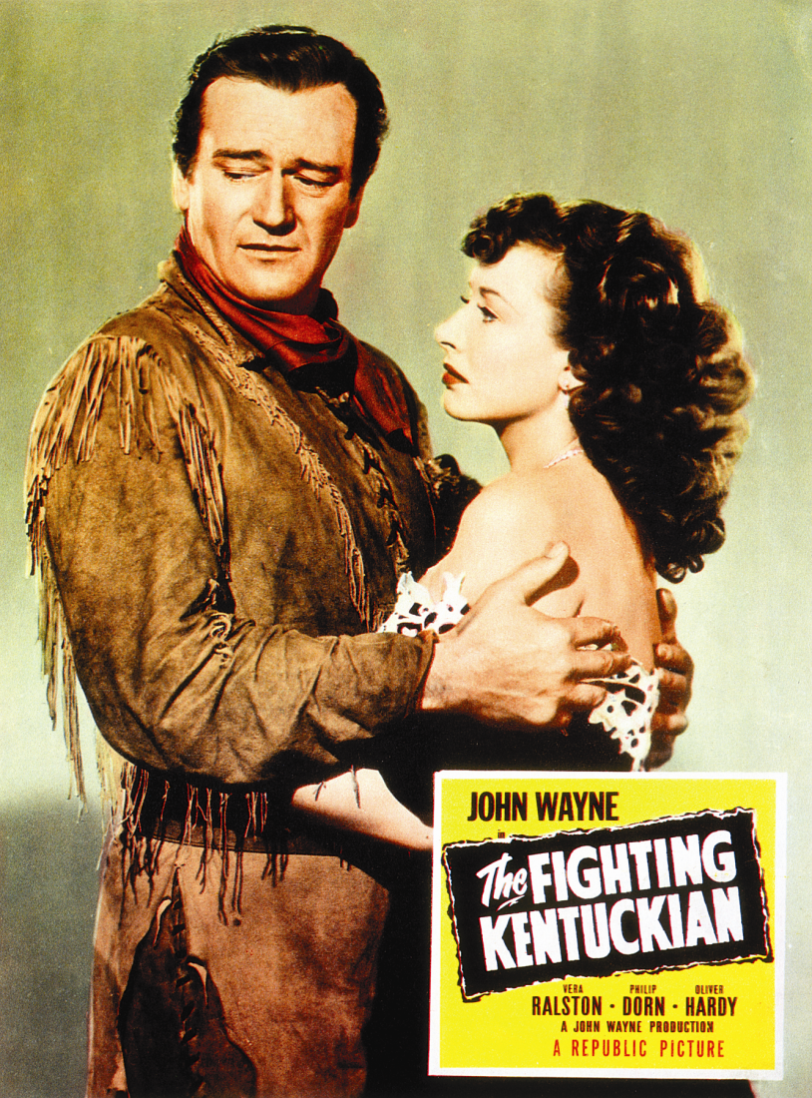
Kentucky Images

Slide 36
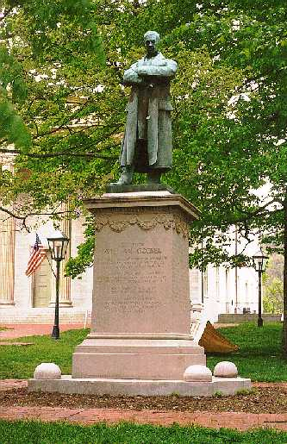
Today, Goebel looks over
the Old Capitol Grounds

Slide 37
Crafting an Inquiry Based Learning Experience
I can create an inquiry based learning experience that incorporates the Four Dimensions of the Inquiry Arc—C3 Framework.

Slide 38
The BIG IDEA
PAGE 17
The C3 Framework emphasizes the acquisition and application of knowledge through an inquiry based approach for learning. The Four Dimensions center on the use of questions to spark curiosity, guide instruction, deepen investigations, acquire rigorous content, and apply knowledge and ideas in a real world setting for students to become active and engaged citizens in the 21st century.
Notes:
Take a moment to look at the Framework for Teaching Components attached 3B, 1A, 3C…discuss how does the Big Idea support highly effective teaching and learning in SS (5 min)…share out

Slide 39
Goals for This Session
PAGES 18-21
Experiment with the PROCESS of Inquiry Based Instruction
Develop a Compelling Question to spark curiosity.
Design supporting questions to scaffold instruction.
Consider content standards when applying disciplinary tools and concepts in Dimension 2.
Be intentional in developing literacy skills for gathering, analyzing and evaluating sources.
Identify opportunities for students to communicate and critique conclusions.
Consider ways to stretch students’ thinking to take informed action as a result of their learning.
Notes:
Please feel free to use resources
If you know of a resource that is not available on Live Binders OR in the Packet, please add it to the Resources List (we are smarter together).
Parking Lots are available if you get stuck and a facilitator is not available at that moment. We will get to you ASAP.
Enjoy the process.

Slide 40
For April…
Before our next meeting, implement your Inquiry Based Learning Experience.
Collect student work to analyze at our next meeting, April 18th.
Notes:
Remind participants to engage students with primary/secondary sources.
Allow them to be the “detectives”.
Student work does not need to be your best piece…this is a time for us to celebrate student success but also to identify some areas of needed growth

Slide 41
Pillars again
Pillars of Network Meetings…Network Foundations
Professional Learning
Highly Effective Teaching and learning
Kentucky’s Core Academic Standards
Assessment Literacy
Leadership
TPGES--Teacher Professional Growth and Effectiveness System
Notes:
Back to Districts

Slide 42
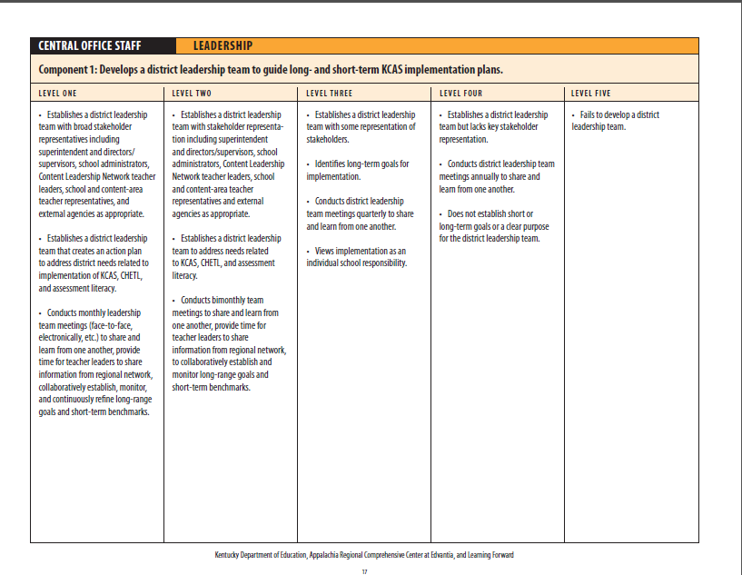
District Innovation Configuration Map
I can describe next steps that need to occur as a member of my District Leadership Team.
Notes:
What is the DICM…It is a guiding document designed by Kentucky Educators and KDE to meet the requirements of Professional Learning…We sent you with the “homework” of locating members / names of the DLT. This document helps clarify the vision and purpose of this group.

Slide 43
Plan, Do, Review
PAGE 22
Use the District Innovation Configuration Map to gain clarity of the vision of DLT
Review Your Plans from Last Meeting
What worked? What work still needs to be done?
Plan:
What will I do with what I have learned in this network meeting?
Do:
When, where, how, with whom will I do what I have planned?
Notes:
Take some time to discuss as a district … Plan/Do

Slide 44
Socratic Circle Discussion Topics… 1. Select ONE of the Topics Below of Interest 2. Use Guiding Questions to Organize Your Thoughts for the Discussion.
Choice #1: Assessment “Can Assessment Improve Learning? Thoughts on Inventive Approaches Aligned to the C3 Framework”
Choice #2: Questioning
“From Inquiry Arc to Instructional Practice”
Notes:
I will be sending out an email for you to select one of these topics…We will be holding a SCD next month to reveal your insights/professional learning.
Feel free to explore the Grant Wiggins resource on Live Binders under Assessment and the Questioning Resources as well.

Slide 45
Session Review and List of “To Do”
Topic & Activities | Before Our Next Meeting…
Assessment -Formative Assessment Strategies | Continue with implementation of Formative Assessment Strategies
KCAS | Incorporate Disciplinary Literacy Practices
Why Study History? | Historical Thinking Skills and Strategies
C3 Framework | Implement C3 Learning Experience—bring student work samples next meeting.
Leadership | Discuss meeting reflections with District Leadership Team.
Socratic Circle | Socratic Discussion … Prepare ONE of the articles for a Socratic Discussion on Assessment OR Questioning

Slide 46
Summer Dates
July 14th and July 15th
Oldham County Arts Center
Crestwood, KY

Slide 47
Please complete your evaluations….
Thank You!
See You At Oldham County Administrative Annex
Friday, April 18th
Notes:
Please add ideas / topics to address during summer.

