Slide 1
















Learning
Teaching
Enhancing
Supporting
Sharing
Social Studies Leadership Network
September 26, 2014

Slide 2

Notes:
https://www.youtube.com/watch?v=IP2n4r6YVkI

Slide 3
What if...
As a Professional Learning Community we:
Collaborate…because professionals achieve more together than they could alone.
Engage in Supportive and Shared Leadership…because the goals of the SSTLN come from its participants.
Share Values and Vision…because we are focused on what is best for students.

Slide 4
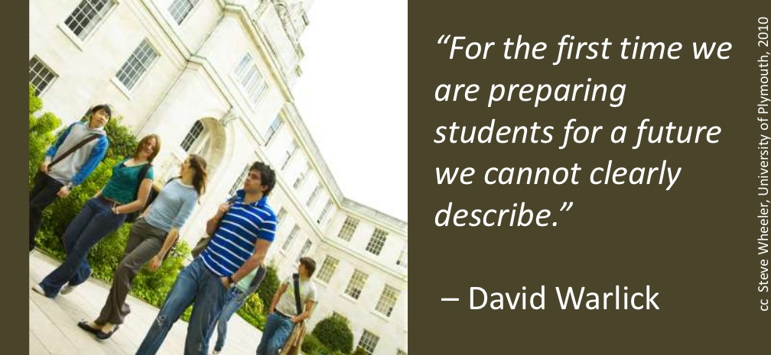
What if…
What if I were teaching students with the hope of preparing them to face a world 20 years from now…
What skills will they need to be successful?
Notes:
Individually participants are asked to generate a list of 21st century skills.
Give One, Get One…Find a partner and compare…and to one another’s list.

Slide 5

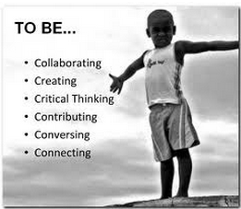
What if…
Assessment Looks Different????
Notes:
Sean share Science Assessment plan

Slide 6
Vision for science assessment:
2014-15 is the year each grade is to begin full implementation of the new Science Standards in Kentucky. In order to do this effectively--that is, in the spirit they are intended—we must prepare to SHIFT…shift our thinking about what it means to know and to teach/learn science—both for us as educators and for our students. We must prepare to engineer learning environments that require students to GATHER, REASON, and COMMUNICATE scientifically—across “3 Dimensions”.

Slide 7
Vision for science assessment:
As we engineer these experiences, we must focus PRIMARILY on what the STUDENTS WILL BE DOING versus what the teacher will be doing. We must remind ourselves that it isn’t enough to have STUDENTS telling WHAT or THAT (something is, is not, etc.)—we must ensure that STUDENTS’ LEARNING is SHIFTED to EXPLAINING—REASONING-- (using evidence)à addressing WHY and HOW.

Slide 8
Vision for science assessment:
We’ll SHIFT our ideas about what constitutes acceptable evidence of student attainment of the standards—and design “lesson ideas” that are “consciously congruent” to the intent of the standards and ASSURE that acceptable and sufficient evidence of student understanding results. AND—as a result of our work to create such a model—we’ll transform our SYSTEM of ASSESSMENT for Science statewide—beginning in the classroom!

Slide 9
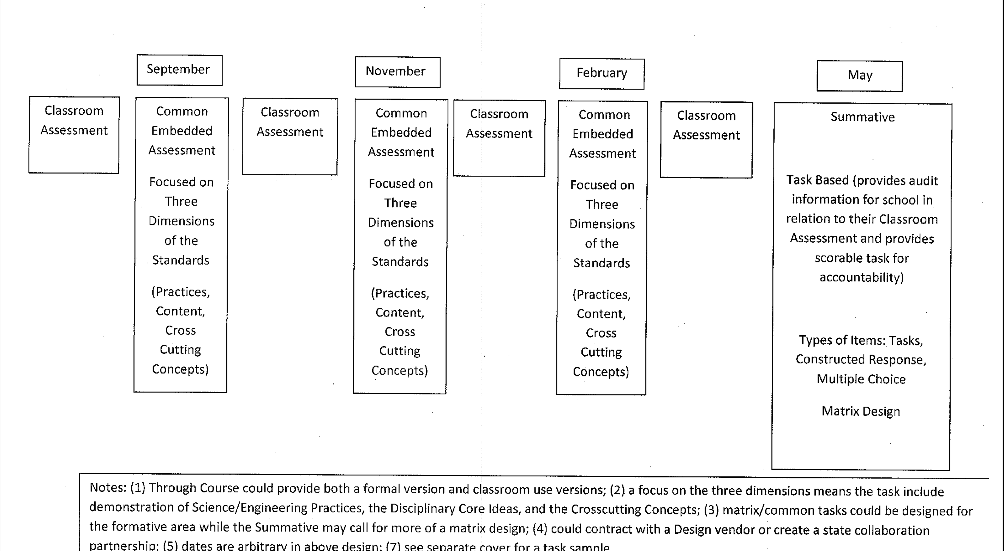
Science assessment (draft)

Slide 10
Social Studies Teacher Leader Network Meeting
WHY NEW? WHY NOW?
Document Based Question
Step 1: Individually
Take 15 minutes to review the documents and collect evidence.
Step 2: Collaboratively
Briefly discuss findings in table groups.
Send ONE district member to engage in “fish bowl” discussion of Why New? Why Now?
James just started Kindergarten. He will enter the workforce around 2030.
How will we prepare him?
Notes:
TL Writers will Lead DBQ…Meet James
He will enter the workforce around 2030…how will we prepare him?

Slide 11
Social Studies Teacher Leader Network Meeting
What does James deserve?
Social Studies education for the 21st Century must equip learners with the dexterity of mind to question, evaluate and communicate what is necessary to become active, productive and engaged citizens in a culturally diverse, democratic society.
James just started Kindergarten. He will enter the workforce around 2030.
How will we prepare him?
Notes:
Each writing team member shares their why new…why now…

Slide 12

Notes:
9:00 am to 9:10 am
Take a brief break (10 minutes)
Relocate into Grade Level Teams Locate 1 to 2 teachers who teach the same subject and grade level

Slide 13


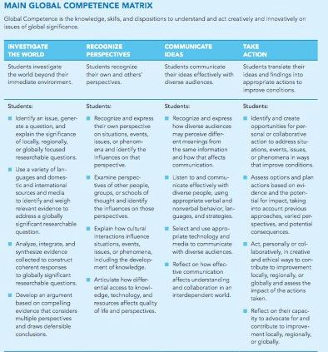
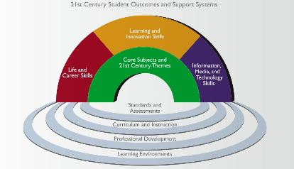
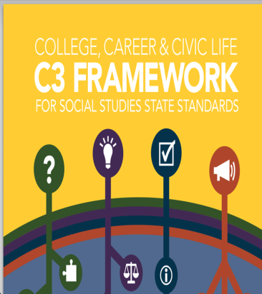
Notes:
Susan—talk about the teachers who came together to write the standards (40 teachers from 8 regions)
Roger—would you be willing to speak about the documents we used to inform the work (global competency matrix, p21 skills, C3 Framework, other content standards Literacy)
Monica—would you be willing to speak about the idea of progressions and how that impacts development of the student as a critical thinker
Kristina—would you be willing to talk about the shifts in these standards…what you feel are the biggest changes and how that is inspiring to teachers

Slide 14
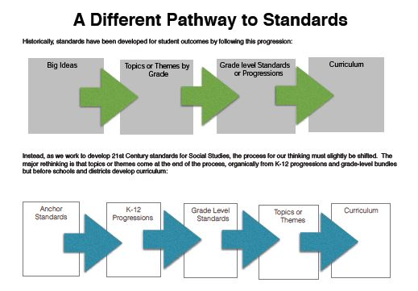
Historically, standards were developed…
Government and Civics
Cultures and Societies
Economics
Geography
Historical Perspective
4th Grade KY
5th Grade US
7th Grade World Prior to 1500 AD
8th Grade US to 1865
High School
World 1500 AD to Present
US History
Enduring Knowledge
Skills and Concepts
Learning Experiences Centered on Significant Events, People,
Etc.
A lot to cover
Limited Understanding

Slide 15
What if…
Exit Criteria
Knowledge and Skills Necessary for STUDENTS to become College, Career and Civic Life
Ready
Build Progressions to help STUDENTS develop Dexterity of Mind of Social Scientists
Grade Level Standards Inquiry Practices + Disciplinary Core Concepts
Empower STUDENTS
Reflects STUDENTS’ Role as a Learner and Participant in Society
Dynamic, STUDENTS Engage In
Culture of Inquiry,
Meets Needs of
21st Century Learners,
Decisions made
by districts

Slide 16


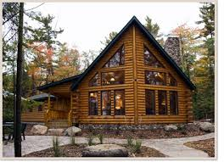
What is the proper relationship between standards and curriculum?
Standards are like the building code…architects must attend to them but the house is built to meet the needs of the client.

Slide 17
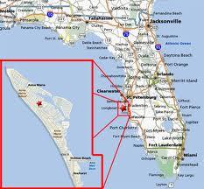
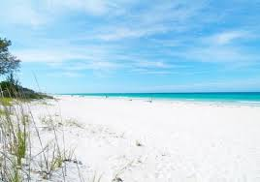

Standards are the destination…routes are the curriculum.

Slide 18
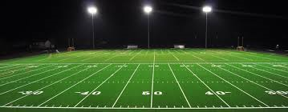
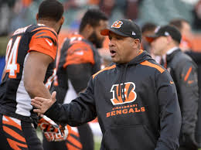
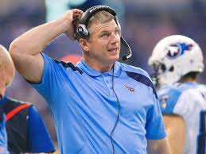
Standards are the rules of the game game…different playbooks make up the curriculum.

Slide 19

Standards (STUDENT outcome) or
Curriculum (plans for how to achieve an outcome)
Organize applicable evidence into a coherent argument including the examination of claims in *historical and multimedia sources.
Explore documents and sources provided, collect evidence to support your argument to the following question: “North or South…who killed reconstruction? ”
Analyze primary and secondary sources to explain how and why perspectives of people have changed over time.
Explore sources in order to determine if Manifest Destiny was just or unjust?

Slide 20
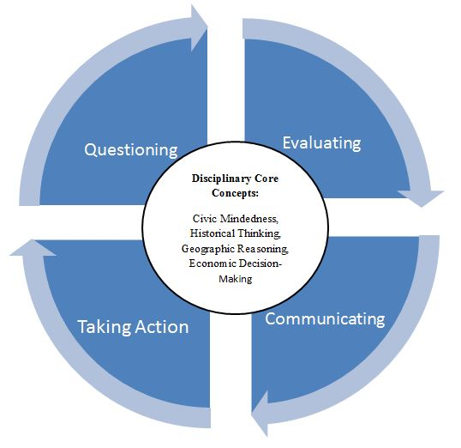
The Architecture
Inquiry Cycle
Inquiry Cycle
Disciplinary Core Concepts
Inquiry Cycle
Inquiry Cycle
Notes:
10 minutes
Examine the Architecture of the Standards
Senate Bill 1 required a reimagining of not only what students learn, but also how they learn. With this imperative, KCAS for SS focuses on both the practice of inquiry and disciplinary core concepts. Combined with the Framework for Teaching, the shifts outlined in these two documents will transform how students access knowledge, skills and understandings in the social sciences to better prepare all learners for college, career and civic readiness.
The Social Studies Standards for the Next Generation ask learners to engage in the practices of the Inquiry Cycle. As you see in the diagram, students will be questioning, evaluating, communicating and taking action while accessing and developing Disciplinary Core Concepts. These standards have identified the DCCs as the methods in which Social Scientists engage in disciplinary thinking. The DCCs define the content of the social studies discipline as the development of Civic Mindedness, Economic Decision Making, Geographic Reasoning, and Historical Thinking. By nurturing the development of inquiry from Kindergarten throughout High School, students will have opportunities to engage in authentic and meaningful learning experiences that deepen their knowledge and allow them to develop as critical thinkers and collaborators. The teachers involved in the writing team this summer elected to use the language of the “Inquiry Cycle” to reinforce the idea that learning is an ongoing process that may be accessed at multiple points. The educators involved in this process shared a vision that the outcomes from such rich and meaningful learning experiences will better prepare their students to become future citizens that are equipped to communicate, collaborate and creatively resolve problems facing our communities, our nation and our world.

Slide 21
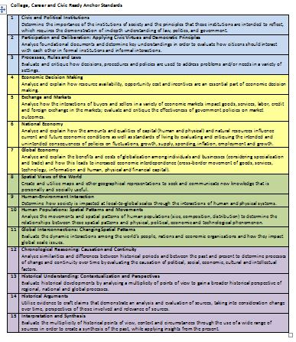
15 Anchor Standards
Notes:
Give participants standards

Slide 22

Theme
Grade Level Storyline
Notes:
Grade Level 2 Storylines Page

Slide 23
Inquiry Cycle
15 Standards
Notes:
Link back to the architecture discussion… and how this translates the key strands/components that were selected…what you see in this particular slide is a grade level snapshot. As teachers begin to interact with the document, they will find the grade level and “theme” that teachers extracted from taking a collective look a the standards on the page. For this particular example, the grade level is 2nd grade and the theme has been identified as explore and discover my role. Next, you will find the practices in the inquiry cycle noted at the top of the page. Recall when we discussed in the architecture of the document, these inquiry practices are included for all grades K-12. Students will use these practices to access and develop the 15 grade level standards that are organized according to Disciplinary Core Concepts. There are three standards used to develop Civic Mindedness, four used to develop Economic Decision Making, four used to develop Geographic Reasoning and four to develop Historical Thinking. This total number of 15 grade level standards answers the requirement of fewer, deeper, clearer. These standards were designed to encourage deeper engagement while nurturing the development of Inquiry. One thing to note as you attempt to navigate this document in its current electronic format, you may click on the Anchor Standard Reference (in blue) which is hyperlinked to the progression so that you may view the progression in its entirety. Also in an attempt to provide clarity, the teachers crafted Grade Level Introductions/Story Lines to set the context for what it means for a child at this grade level to be working towards the goal of college, career and civic readiness.

Slide 24
K-12 Progressions
Anchor Standard 1 | Civic and Political Institutions Determine the importance of the institutions of society and the principles that these institutions are intended to reflect, which requires the demonstration of in-depth understanding of law, politics, and government.
K | Identify the roles and responsibilities of community members
1st | Explain the need for and purposes of rules in a community
2nd | Explain what governments are and how communities work to accomplish tasks and establish responsibilities
3rd | Explain how citizens responsibly participate in democratic processes and practice civic responsibility
4th | Describe the origins, functions, and structure of state government to determine how it supports freedom within a democracy
5th | Explain how government effects how citizens, political and economic groups function within society
Notes:
Concept of Anchor Standards and Progressions – Anchors come from Exit Criteria in C3
progressions particularly emphasize developmentally appropriate skills/reasoning – congruent to ELA standards expectations at same levels; this was the critical work of the 40 teachers this summer –bringing their own expertise and professional knowledge to this work.

Slide 25
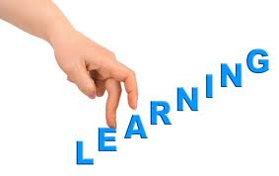



Learning Progressions

Slide 26


1. Congruency
  Does the progression hold true to the Anchor?
2. Coherency
  Do the progressions fit together without any gaps?
3. Clarity
  Do the standards contain clear language that is measurable?
Notes:
Anchor Standard Slips
Charts It says…We Think…

Slide 27

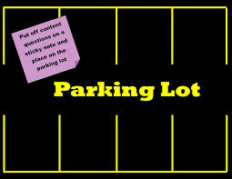
Return to District Teams
Pose Questions regarding Architecture, Construction, Content of New Standards
Share Findings…

Slide 28

LUNCH

Slide 29
Focus Group Schedule
1:00-2:45
Focus Group 1 | Focus Group 2 | Focus Group 3
Facilitator: MK Recorder: Roger Anchorage Bullitt Carroll Eminence Franklin | Facilitator: Chris Recorder: Susan Owen Shelby Spencer Trimble Grant | Facilitator: Jennifer Recorder: Monica Henry Jefferson KSB Oldham Gallatin

Slide 30

Into Grade Level Standards
1. Congruency
  Do the standards hold true to the Anchor?
2. Coherency
  Do the grade level set of standards fit together without any gaps?
3. Clarity
  Do the standards contain clear language that is measurable?

Slide 31

www.surveymonkey.com/s/sskas

Slide 32
Projected Timeline At A Glance…
September 2014 Targeted Focus Groups
*Higher Education
*Content Leadership Networks (Sept 26th)
*Other Key Stakeholders
October 2014 First Read KBE
November 2014 Continue to solicit Feedback and Refine Draft
December 2014 Second Read
January 2015 Public Comment Period
2015-2016 Implementation
Notes:
5 minutes
Feedback Survey will be open to ISLN Administrators in October.

Slide 33
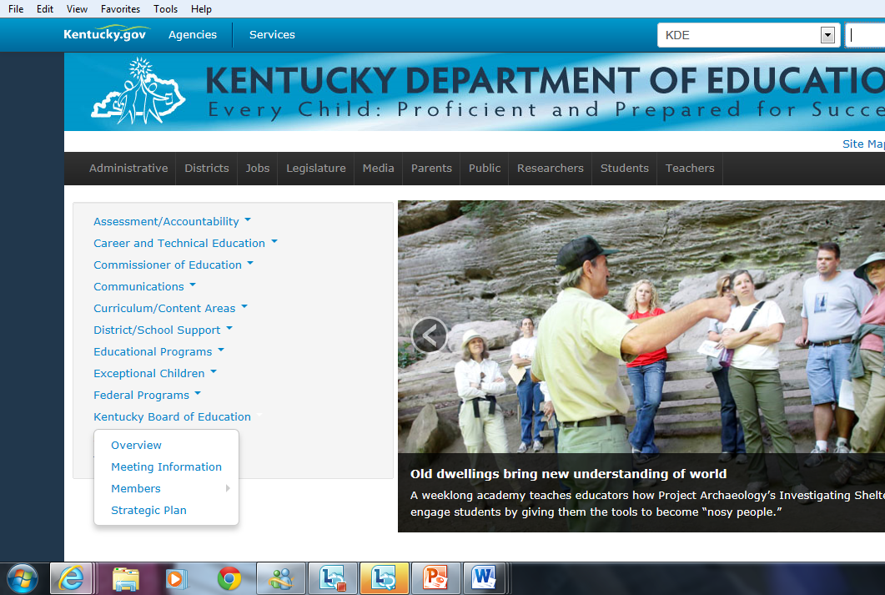
Resources
October Board Meeting Materials KDE Website
Colleagues in SSTLN PLC
LiveBinder
http://ovecssnetwork.weebly.com/
Amy Treece amy.treece@education.ky.gov

Slide 34


1. Kentucky’s Core Academic Standards
  How are you developing understanding of the standards and planning to share this with your school & district?
2. Highly Effective Teaching and Learning
  How are you emphasizing highly effective teaching and learning characteristics in your classroom, school & district?
3. Assessment Literacy
  How are you using formative/summative assessment to improve instruction & learning in your classroom, school & district?
4. Leadership
  How are you using the leadership capacity you are building to share information in your school & district?

