Slide 1
Please go ahead and log in
Password: Jelly Bean (exactly as is)
September 24, 2015
ovecssnetwork.weebly.com

Slide 2
Learning
Teaching
Enhancing
Supporting
Sharing

Slide 3
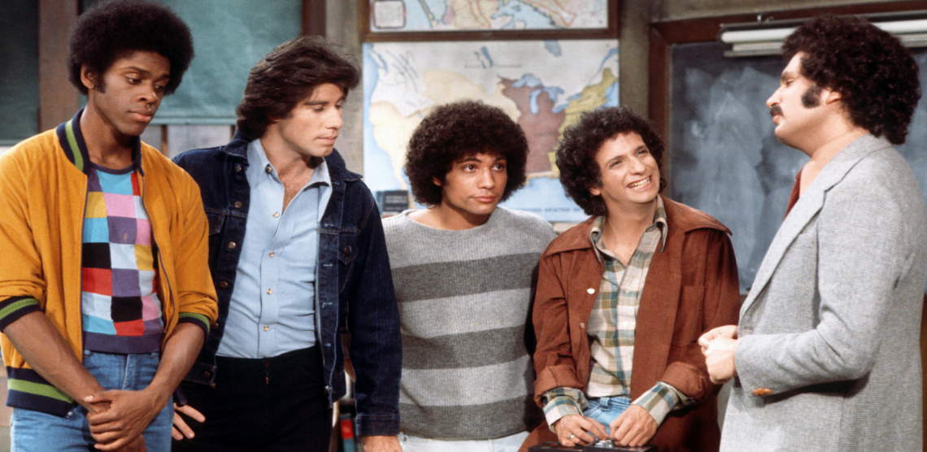
Welcome Back!
Ryan New- KDE Instructional Specialist for Social Studies
Candi Ramsey- KDE Instruction Specialist for Science Consultant
Amy Treece- Social Studies Network Facilitator, Henry County
Jennifer Fraker- KDE Social Studies Consultant
Caroline Sheffield- Professor of Education, University of Louisville
Tina Tipton- Chief Academic Officer, Deputy CEO
Tracey Harris- Director of District Support

Slide 4
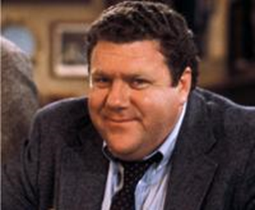
Norms & Agenda
Regroup and rethink
Equip Rubric and Quality
Summer Share
Inquiry Based Units
Developing Inquiry Lesson
Pausing
Paraphrasing
Presume Positive Intentions
Posing Questions
Putting Ideas on the Table
Providing Data
Paying Attention to Self and Others

Slide 5
Building Capacity
Take a 5 minutes to review / read:
7 Thinking Dispositions
The Norms of Collaboration
Characteristics of Network Participants
Notes:
Jacqueline
8:30-9:15

Slide 6
QFT Rules
Ask as many questions as you can
Do not stop to discuss, judge, or answer any question
Write down every question exactly as it is stated
Change any statement into a question

Slide 7
Q Focus #1
The purpose of the social studies teacher leader network
Q Focus #2
My role as a teacher leader.

Slide 9
Year at a Glance
Sept | Oct | Nov | Jan | Feb | Mar
Monthly Themes/Focus Questions
How can CAPACITY for GOING DEEPER be developed and sustained? | What IS Good Practice? How Do You Know? | How can PROFESSIONAL LEARNING support the growth of all educators? | What type of evidence supports the OPERATIONAL-IZATION of the FfT and CHETL? | How can the EXAMINATION OF STUDENT/ EDUCATOR WORK be supported as a routine for continuous improvement? | How can a DLT PLAN, SUPPORT AND SUSTAIN STRUCTURES AND ROUTINES that promote continuous growth and improvement?
Notes:
Jacqueline
8:30-9:15

Slide 10
Let’s Get Organized!
Group 1 | Group 2 | Group 3
Eminence Ind. Spencer Henry Owen Carroll | KSB Gallatin Oldham Grant JCPS | Anchorage Shelby Trimble Franklin Bullitt
Elementary Carmen, Amy* Middle Katie, Jennifer* High School Betsy | Elementary Rick, Kelly Middle Roger, Josh High School Jim | Elementary Kristy, Tracy, Paula Middle Valerie, Ben High School Christine
Notes:
Lauren & Krista introduce
Teacher leaders facilitate
Team circulates
Terry on the mic to guide transition
9:15-10:15

Slide 11
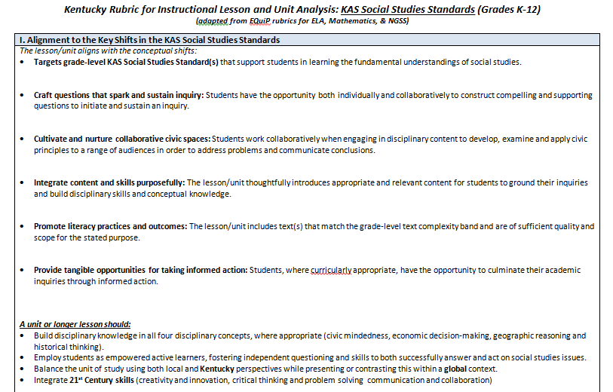
I. Alignment to KASSS

Slide 12
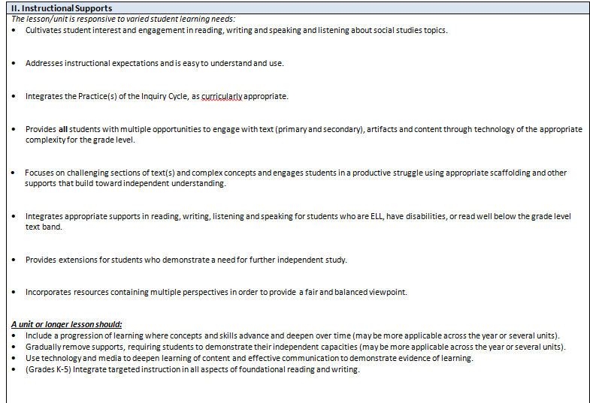
II. Instructional Shifts

Slide 13
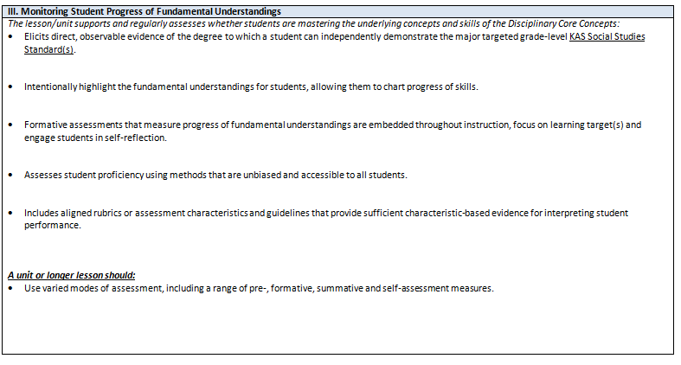
III. Monitoring Student Progress of Fundamental Understandings

Slide 14
Standing Meeting
1
Move to the chart denoted with the same number written at the top of the lesson you analyzed.
How could using the EQuiP rubric ensure we address the characteristics of section three (Instructional Rigor and Student Engagement) of CHETL for SS?
How could the EQuiP rubric be used to gather evidence of 1E in the FfT?
What rating (Inefficient through Exemplary) would give this inquiry based on evidence to support 1E in the FfT?

Slide 15
Deconstructing an Inquiry
Questions
Compelling
Supporting
Tasks
Formative
Summative
Modular
Sources
Spark curiosity
Build knowledge
Evidence
Grant, Swan, & Lee (2015)
Notes:
Replace with new KY template

Slide 16
September
Commit to standards
October
Consider methods for assessment
November
Bring and analyze evidence of student learning
Establish expectations for mastery
Begin planning lessons/units
Construct a common assessment Tool
Make collaborative adjustments to instructional plans.

Slide 17
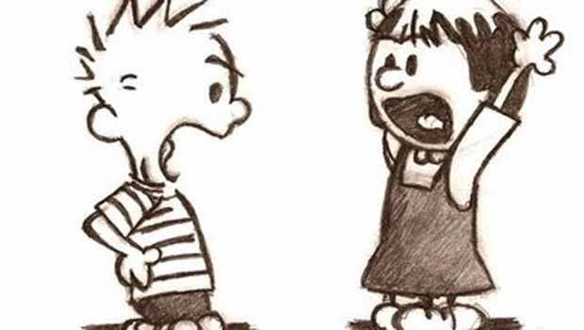
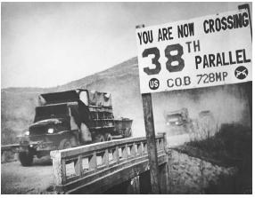
CONFLICT

Slide 18
Header
Notes:
Insert relevant portions of template

Slide 19
Compelling Questions
Notes:
Insert relevant portion of template

Slide 20
Compelling Questions
Characteristics of compelling questions:
Frame for Inquiry
Express the intellectual rigor and student relevance of an inquiry
Set up the summative performance task
Elicit arguments
Grant, Swan, & Lee (2015)
Notes:
Kathy

Slide 21
Rigorous Questions
Reflect an enduring issue, concern, or debate in the field
Demand the use of multiple disciplinary lenses
Civic Mindedness
Economic Decision Making
Geographic Reasoning
Historical Thinking
Grant, Swan, & Lee (2015)
Notes:
Kathy

Slide 22
Relevant Questions
Reflect a quality or condition that we know children care about
Honor and respects children’s intellectual efforts
Grant, Swan, & Lee (2015)
Notes:
Kathy

Slide 23
Compelling?
Where are we?
What were the causes of the Industrial Revolution?
Why is Frankfort the capital of
Kentucky?
Do I have to be rich
to run for President?
Can Canada and the US be friends forever?
Who won the Cold War?
Who are our community helpers?
What’s the deal with hair?
Grant, Swan, & Lee (2015)
Notes:
Kathy

Slide 24
Compelling Questions
Develop a compelling question for your inquiry study.
Check 1:
Kid friendly?
Rigorous?
Check 2:
Develop 3-4 potential argument stems
Notes:
Insert relevant portion of template

Slide 25
Compelling Questions
What should we do about the refugee crisis in the Middle East?
We should do nothing because…
We should maintain our level of involvement because…
We should provide more assistance because…
We should put pressure on Europe because…
Argument Stems

Slide 26
Supporting Questions
Notes:
Insert relevant portion of template

Slide 27
Supporting Questions
Support and extend the Compelling Question
Represent the disciplinary knowledge desired
Reflect the sources selected
Anchor formative performance tasks
Focus on descriptions, definitions, and processes
Elicit explanations
Grant, Swan, & Lee (2015)
Notes:
John

Slide 28
Question Examples
Compelling Question: Was the American Revolution revolutionary?
Supporting Questions:
What political changes resulted from the American Revolution?
What economic changes resulted from the American Revolution?
What social changes resulted from the American Revolution?
Grant, Swan, & Lee (2015)
Notes:
John

Slide 29
Supporting Question
Return to your argument stems:
What would students need to encounter/consider before they can answer the compelling question?
Do you need to alter your compelling question?
Develop at least one supporting question for your inquiry study.
What is a refugee?
Who are the refugees?
Why are the refugees leaving?
What are people already doing for the refugees?
What are some challenges to helping the refugees?
Do refugees usually return home?
Notes:
Insert relevant portion of template

Slide 30
Question Stimulus
Notes:
Insert relevant portion of template

Slide 31
Question Stimulus
Create a context for the compelling question.
Stimulates students’ initial thinking about the compelling question.
Consider various mediums.
Image • Reading • Video Clip
Discussion • Simulation
Develop a question stimulus for your inquiry study.
Notes:
Insert relevant portion of template

Slide 32
Disciplinary Core Concepts (DCCs)
Notes:
Insert relevant portion of template

Slide 33
Disciplinary Core Concepts (DCCs)
Ideally, an inquiry study draws upon multiple disciplines.
Examples
Refugee Crisis
Geographic Reasoning – push and pull factors; spatial representations of migration; Economic Decision-Making – economic impact of influx; supply and demand; scarcity
Civic Mindedness – global “citizenship”; media coverage and representations
Historical Thinking – historical examples (e.g., Cuba, Vietnam); historic roots (e.g., history of Islam; post-WW1 borders)
Other?
Determine how your inquiry study connects to each discipline.

Slide 34
Formative Performance Tasks
Notes:
Insert relevant portion of template

Slide 35
Formative Performance Tasks
In order to make a coherent and evidenced-based argument,
students need practice with argumentation skills.
students need a strong content/conceptual foundation.
This is where we get into formative work—there is no “gotcha” summative assessment.
These formative tasks are framed by the supporting questions and often follow a skill progression of increasing complexity.
Grant, Swan, & Lee (2015)

Slide 36
Grant, Swan, & Lee (2015)

Slide 37
Formative Performance Tasks
Develop a formative task for at least one of the supporting questions in your inquiry study.
Check 1:
Is this task directly related to the supporting question?
Check 2:
Does this task move students toward being able to answer the compelling question?
Check 3:
Will this task provide you with valuable information about your students’ progress?

Slide 38
Sources
Notes:
Insert relevant portion of template

Slide 39
Part II – The Instructional Uses of Sources
What makes a source disciplinary?
This session
The Instructional Uses of Sources
Sources can be used to:
Spark curiosity
Build knowledge
Construct arguments
Grant, Swan, & Lee (2015)

Slide 40
This session
Sparking Curiosity
Using sources for the purpose of curiosity & engagement.
Focusing on relevance and what we know students care about.
Can be used throughout the tasks but often used within Staging Activities in IDM.
Grant, Swan, & Lee (2015)

Slide 41
This session
Building Knowledge
Sources in an inquiry contain the disciplinary knowledge (content and concepts) students need to complete tasks.
Students use disciplinary skills when building knowledge.
Students gather information from the sources during an inquiry.
Grant, Swan, & Lee (2015)

Slide 42
This session
Constructing Arguments with Evidence
Inquiries result in arguments.
Sources contain information that can be used as evidence in an argument.
Students need support determining what information should be used in an argument.
Grant, Swan, & Lee (2015)

Slide 43
Preparing Sources for use in an Inquiry
This session
When planning to use sources in an inquiry teachers should consider the following:
Selecting sources
Adapting sources
Scaffolding
Grant, Swan, & Lee (2015)
Notes:
Didn’t include expanded slides – figured we might mention this, but I don’t think they’d have time to engage in the process, so didn’t think we’d need to review them.

Slide 44
Sources
Select one of your supporting questions and determine 3-4 key sources that could be used to spark interest, build knowledge, or construct an argument.
Consider…
Include various mediums (e.g., text, chart, image)
Include various (perhaps conflicting) perspectives
Include primary and secondary
Notes:
Insert relevant portion of template

Slide 45
Culminating Performance
Notes:
Insert relevant portion of template

Slide 46
Culminating Performance
Because compelling questions produce arguments, the culminating task will typically be an argument, BUT that argument might take various forms.
Outline? Debate? Essay? Editorial? Documentary?
What’s most important is that students have the opportunity to answer the compelling question.

Slide 47
What is an argument?
An argument is a collection of claims supported by relevant evidence, which can be considered an answer to the question investigated by the research.
As arguments become more sophisticated, students might include counterclaims.
Grant, Swan, & Lee (2015)
Notes:
It is important to pause here and make sure that teachers understand the nature of arguments. In this slide, arguments are defined as a “collection of claims supported by relevant evidence, which can be considered an answer to the question investigated by the research.” Further, as students become more sophisticated in making arguments, they should begin to include counterclaims that acknowledge the other side of the argument.
It may be good to pull from the Common Core ELA writing standards to make an explicit connection to the shared responsibility for literacy in social studies.

Slide 48
Culminating Performance
Extensions of learning
make connections to other events, time periods, or topics
outlets for additional creativity
optional
long-term
greater use of technology
Determine the culminating performance for your inquiry study – both the argument task and extension.

Slide 49
Talking Informed Action
Notes:
Insert relevant portion of template

Slide 50
Taking Informed Action
Students civically engage through inquiry
Action can be embedded throughout inquiry
Action can be the calumniating performance
Informed action is a progression: students need to progress through
Step 1: Understand the problem
Step 2: Assess the problem
Step 3: Take action on the problem
Grant, Swan, & Lee (2015)

Slide 51
Taking Informed Action
REMEMBER… Action falls along a continuum.
Most Complex Least Complex
student experience
teacher preparation/support
necessary resources
where it’s happening

Slide 52
Taking Informed Action
Determine an appropriate approach to taking informed action for your inquiry study.
Keep in mind
Be sure to address the progression.
Be conscious of your context.
Encourage Student Ownership!
Understand the factors that are contributing to the current refugee crisis in the Middle East.
Assess the steps that the United States could take in response to the refugee crisis.
Act by
Writing a letter to your Senator or Congressperson
Contacting an international aid organization to see how you can support refugee relief efforts
Organizing an awareness event.

Slide 53
Invite a
Guest
Speaker
Write an
article for
the school
newspaper
Promote
a cause on
Twitter
Create a
class
position
statement

Slide 54
Organize
a Rally
Conduct and
publish a
survey that
gauges
community opinion
Interview
an expert
or activist
Have a
Debate
with
Invited Guests

Slide 55
Create a
short
public service announcement
Speak at a
school,
town,
or city meeting
Write a
Letter to a
Government
Official
Create a
Poster and
Hang it in a
Public Space

Slide 56
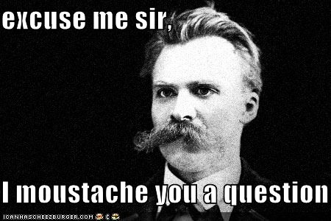
Reflections
Something that was less difficult than you expected…
Something about your inquiry study of which you’re particularly proud…
Any lingering questions…

Slide 57
CHETL & FfT Reflection of Today’s Work
Use the CHETL & FfT Reflection
CHETL = Section III: Instructional Rigor & Student Engagement
FfT = Domain I: Planning & Preparation (1C – 1F)
Notes:
Terry
2:30-3:00

Slide 58
The DLT & Me: Action Plan
As a Teacher Leader
Leading to Connect to Larger Community and World
Leading to Professionalize Teaching
Leading to Increase Teacher Voice and Influence
Leading Groups and Teams
Leading through Modeling and Coaching
Leading from the Classroom
District Leadership Team (DLT)
Notes:
Terry
2:30-3:00

Slide 59
Wrap Up
Reminders:
Build Unit and/or Lesson
Continue to support—or begin the conversation to create/utilize—your DLT
Next meeting: October 21st
Evaluation
Notes:
Terry
2:30-3:00

